Slide 1
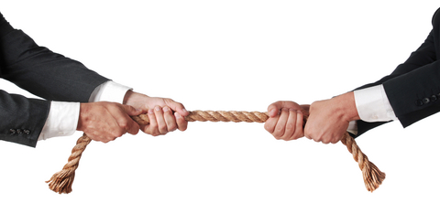


MULTI-OBJECTIVE
MULTI-STAKEHOLDER
DECISION ANALYSIS
L. Robin Keller
President
Institute for Operations Research & the Management Sciences
Professor
University of California, Irvine, USA

Slide 2
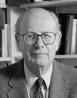



Decision Analysts
Howard Raiffa &
Ralph Keeney
advise us to make
Smart Choices & use Value-Focused Thinking
Think about what we value
as expressed in our objectives
Hammond, J. S., Keeney, Raiffa. 1999. Smart Choices: A Practical Guide to Making Better Decisions. Harvard Business School Press.
Keeney, 1992. Value-Focused Thinking—A Path to Creative Decision Making. Harvard University Press, Cambridge, MA.

Slide 3

A key component
of systems analysis
is examining the perspectives and actions of multiple stakeholders
Constructing a hierarchy of objectives for stakeholders provides decision insights

Slide 4



Understanding the Objectives of
Multiple Stakeholders can help…
-identify mutually agreeable alternatives
-foresee opposition to decisions
-design new & better alternatives
-understand the evolution of
past decisions from
multiple perspectives

Slide 5

Differences across stakeholders in:
-tradeoffs between objectives
-evaluations of performance of alternatives on objectives
Sometimes, one objectives hierarchy is suitable for a set of stakeholders

Slide 6
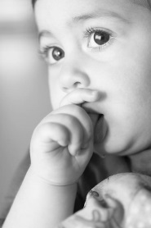
One Objectives Hierarchy
Evaluate plans for distribution of potassium iodide (KI) to protect against thyroid cancer, due to radioactive iodine exposure resulting from an incident at a U.S. nuclear power plant.
Young children or fetuses at most risk.
KI distribution alternatives:
• Predistribute to households, schools, hospitals, etc.
—Via mail
—Via voluntary pickup
• Stockpile at evacuation reception centers
• Do not predistribute
.. Based on book: http://www.nap.edu/catalog/10868/distribution-and-administration-of-potassium-iodide-in-the-event-of-a-nuclear-incident
T. Feng, L. R. Keller, “A Multiple-Objective Decision Analysis for Terrorism Protection: Potassium Iodide Distribution in Nuclear Incidents”,
Decision Analysis, (June 2006), 3 (2): 76-93. http://pubsonline.informs.org/doi/abs/10.1287/deca.1060.0072
(supplement has Excel file) Much of this material is at http://faculty.sites.uci.edu/lrkeller/classes/

Slide 7

KI Distribution Decision Objectives
Minimize Radioactive Iodine Risk to Thyroid
Maximize KI Availability
Optimize Ability To Take KI On Time
Minimize Harm From Inappropriate KI Administration
Minimize Harm from Other Aspects of Incident
KI Procedures Don’t Impede Evacuation
Avert Mortality/Morbidity From Radiation Or Accidents
Minimize Panic/Anxiety Due To KI Procedures
KI Procedures’ Resource Use Not Excessive
Simple KI Procedures Before/During Incident
Educate Public To Respond To Incidents

Slide 8
Objectives Hierarchy in Tree form
a.1. Maximize KI Availability
a.1.1. Max. Availability for Children & Pregnant Women
a.1.2. Max. Availability for Other Residents
a.1.3. Max. Availability for Mobile Population
a.2.1. Max. Number of People who Know Where Pill is
A. Minimize Radioactive Iodine Risk to Thyroid
a.2. Optimize Ability to Take KI on Time
a.2.2. KI Taken at Optimal time if No Evacuation
a.2.3. KI is Taken at Optimal Time if Evacuation
a.2.4. Ensure KI is Stored to Assure Stability
a.3. Minimize Harm from Inappropriate KI Administration
a.3.1. Correct KI Dose Given (and Taken) for Age
a.3.2. First KI Dose Not Taken Too Late
MINIMIZE RADIATION HEALTH RISKS
a.3.3. Adverse KI Side Effects (non-thyroid cancer) Minimized
b.1. KI Procedures Don’t Impede Evacuation
b.2. Avert Mortality and Morbidity from Radiation or Accidents
B. Minimize Harm from Other Aspects of Incident
b.3. Minimize Panic/Anxiety due to KI Procedures
b.4. KI Procedures’ Resource Use Not Excessive
b.5. Simple KI Procedures before/during Incident
b.6. Educate Public to Respond to Nuclear Incident

Slide 9
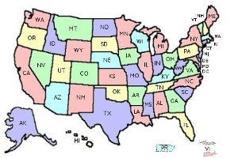
Different regions may differ in
tradeoffs among objectives, or
performance evaluations on objectives, …
choosing different
policy actions
Excel sheet with sliders allows dynamic sensitivity analysis on additive tradeoff weights

Slide 10
One Objectives Hierarchy:
MERGER DECISION
ANALYSIS OF POTENTIAL MERGER OF
OPERATIONS RESEARCH SOCIETY OF AMERICA
(ORSA)
AND
THE INSTITUTE OF MANAGEMENT SCIENCES
(TIMS)
L. Robin Keller and Craig W. Kirkwood, “The Founding of INFORMS: A Decision Analysis Perspective”, Operations Research. 47(1), Jan.-Feb. 1999, 16-28. [faculty.sites.uci.edu/lrkeller/files/2011/06/The-Founding-of-Informs-Decision-Analysis.pdf]
Powerpoint: http://faculty.sites.uci.edu/lrkeller/classes/

Slide 11
Elicited stakeholders’ objectives & combined them into 1 hierarchy
Top-level ORSA/TIMS MERGER OBJECTIVES
IMPROVE COST EFFICIENCY
ENHANCE QUALITY OF PRODUCTS
ESTABLISH STRONG EXTERNAL IMAGE
MAINTAIN SCOPE/DIVERSITY OF FIELD
IMPROVE OPERATIONS

Slide 12
ADD BRANCHES TO
MAIN CATEGORIES
IMPROVE COST EFFICIENCY
MAINTAIN ALLOCATE WELL MAINTAIN
EFFICIENT REVENUES AND EFFICIENT
USE OF FUNDS EXPENSES USE OF
TIME
EXPLOIT BALANCE DUES REMOVE
ECONOMIES RATE & FEE- DOUBLED
OF SCALE FOR-SERVICE DUES

Slide 13
1.1 Maintain efficient use of funds
1. Improve cost efficiency of
1.2 Allocate well revenues/expenses to
TIMS/ORSA operations
activities/entities
1.3 Maintain efficient use of time of volunteers
2.1 Provide high quality main and specialty
conferences
2.2 Provide high quality publications
2. Enhance the quality of ORSA
2.3 Provide appropriate career services
and TIMS products
2.4 Provide support for sub-units
2.5 Provide other member services
MAXIMIZE OVERALL
VALUE
3. Establish a strong & coherent
3.1 Increase visibility and clout of OR and MS
external image of field
3.2 Foster professional identity
4.1 Maintain/improve membership composition
4. Manage the scope and diversity
of the field
4.2 Create strong relationships with other societies
5.1 Maintain/improve quality of governance process
5. Maintain/improve effectiveness
of ORSA and TIMS operations
5.2 Maintain/improve quality of operation output

Slide 14
MEMBERS VOTED TO MERGE IN
SEAMLESS MERGER
on JAN. 1ST, 1995
into
INSTITUTE FOR OPERATIONS RESEARCH AND
THE MANAGEMENT SCIENCES

Slide 15
In other cases, an objectives hierarchy will be constructed for each stakeholder because their objectives are so different that construction of separate hierarchies better represents their divergent perspectives.

Slide 16

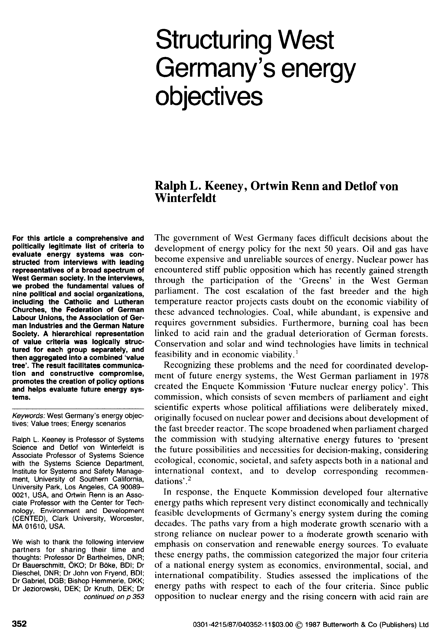
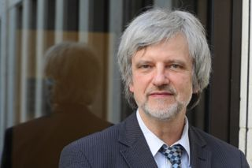
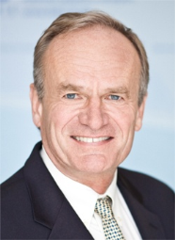
Construct Separate Objectives Hierarchies,
then Combine Together; August 1987 article in Energy Policy

Slide 17
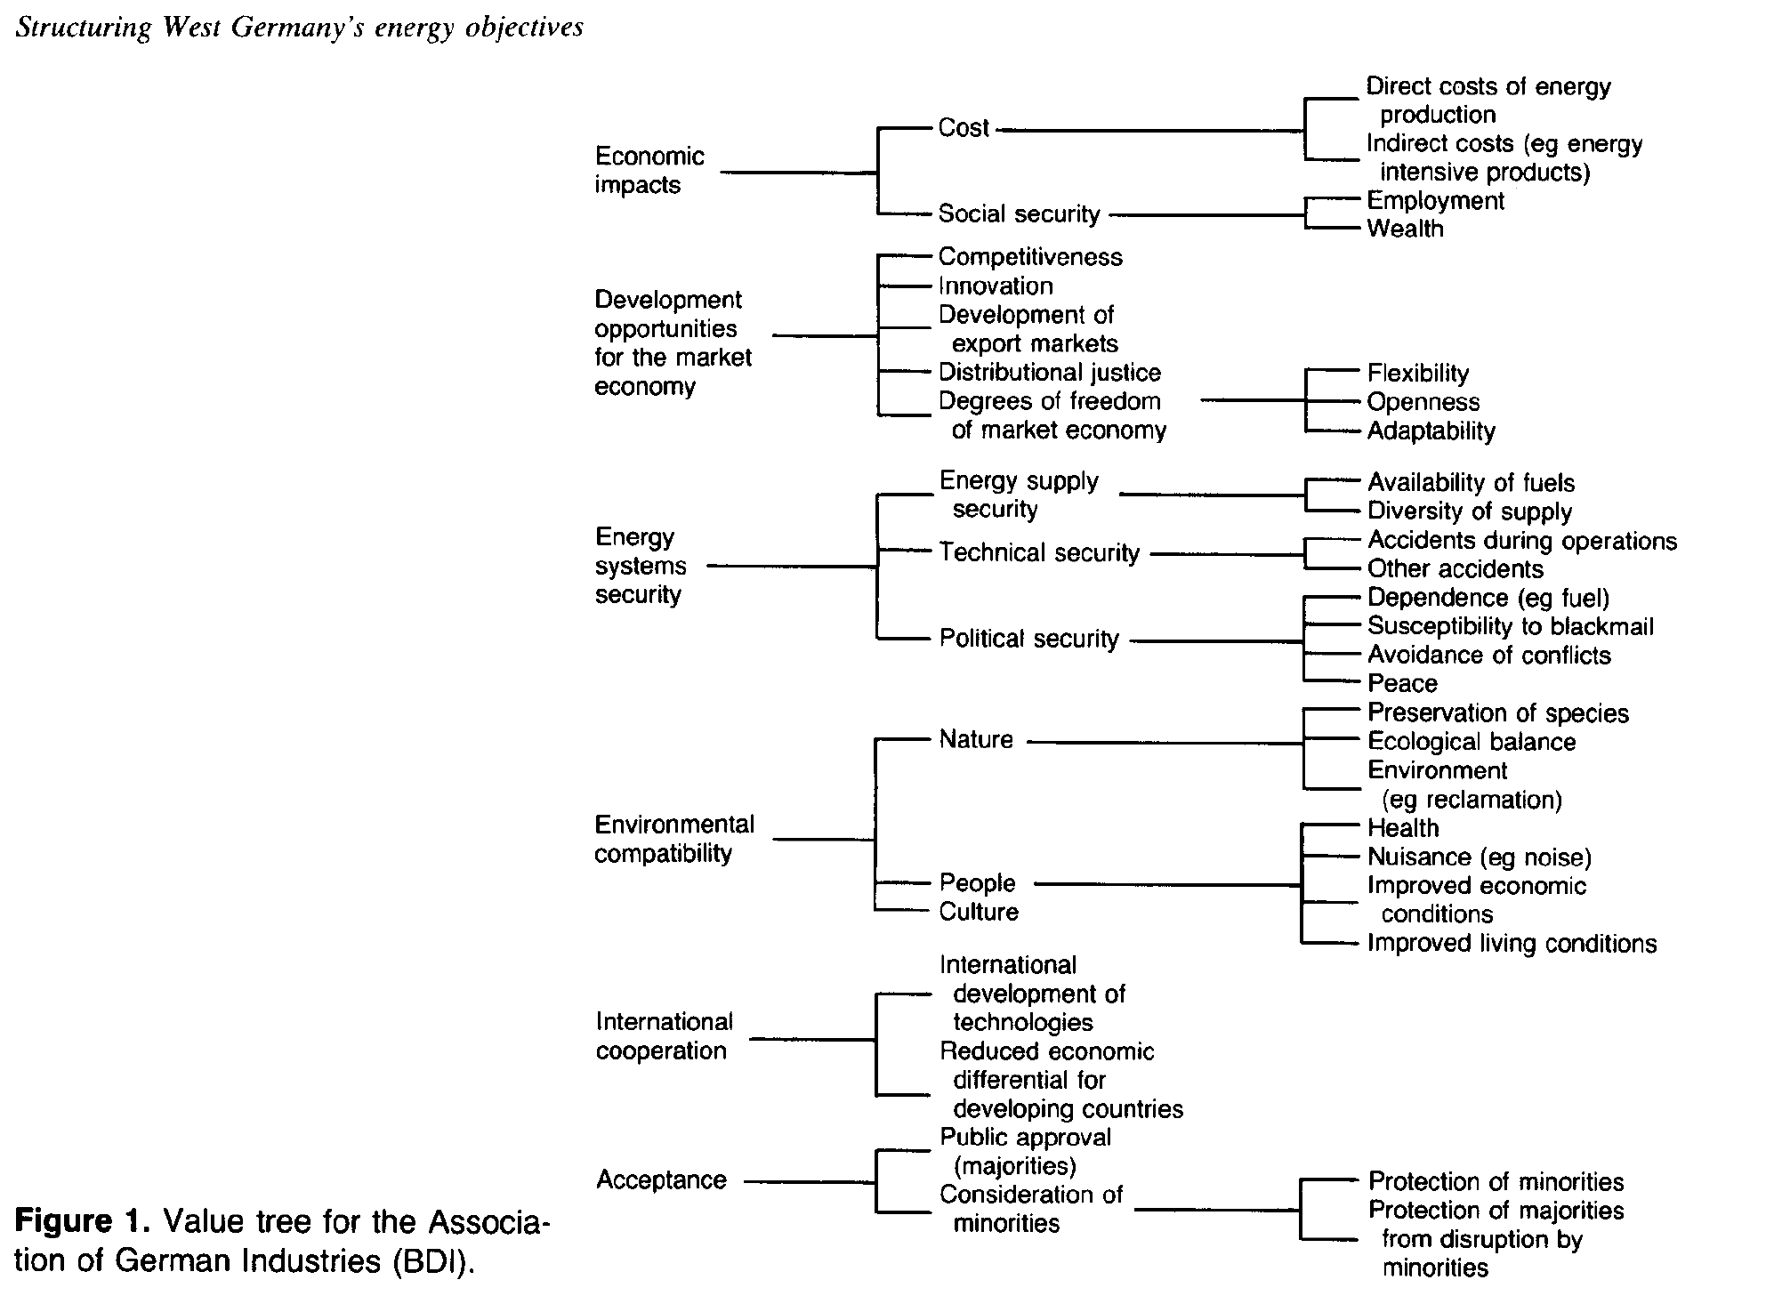
Bund der Deutschen Industrie (Association of German Industries)

Slide 18
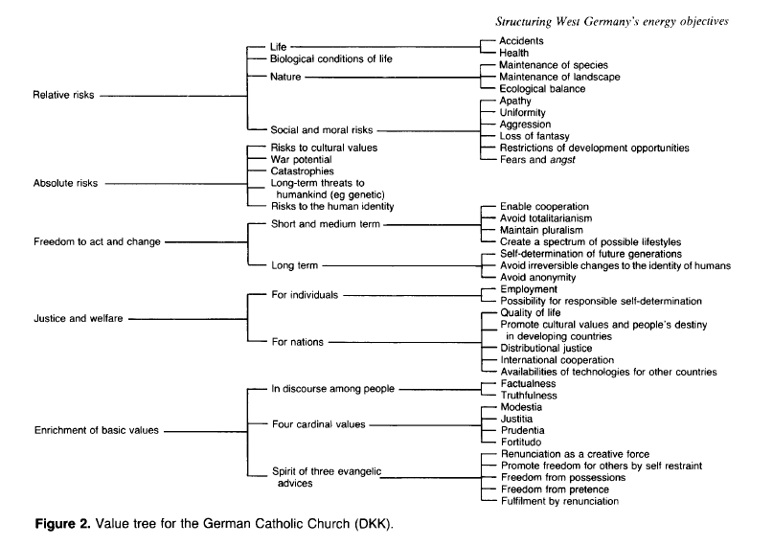
Deutsche Katholische Kirche (German Catholic Church)

Slide 19
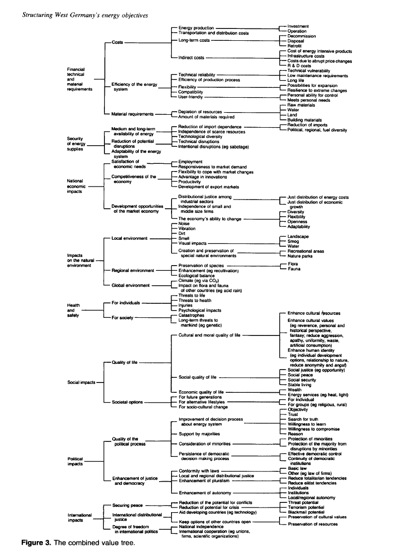
Combined hierarchy

Slide 20
Combined hierarchy-Top half

Slide 21
Combined
hierarchy-
Bottom half

Slide 22
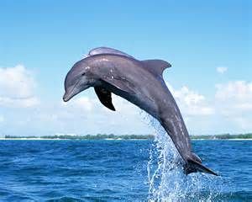
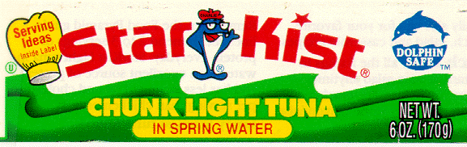

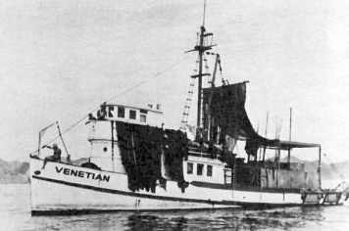
Multiple-Stakeholder Decision Making
The StarKist Tuna Fishing Decision
3 Major Stakeholders
Tuna Fishing Fleet San Diego, CA USA http://www.sandiegohistory.org/journal/81fall/images/piva.jpg http://www.earthisland.org/index.php/donate/
Monika I. Winn and L. Robin Keller, “A Modeling Methodology for Multi-Objective Multi-Stakeholder Decisions: Implications for Research”, Journal of Management Inquiry. 10(2), June 2001, 166-181. [faculty.sites.uci.edu/lrkeller/files/2011/06/A-Modeling-Methodology-for.-Multiobjective-Multistakeholder-Decisions.-Implications-for-Research.pdf]
Much of this material is at http://faculty.sites.uci.edu/lrkeller/classes/

Slide 23
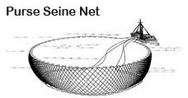
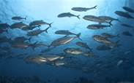
Problem: Boats’ nets catch dolphins with tuna fish in Pacific ocean image source http://www.crownprince.com/nets-tuna.htm

Slide 24
DECISION ALTERNATIVES
Legal Quota
Maintain current practices and stay within legal limits
Limited Mortality
Step up efforts to reduce the number of dolphins killed
Zero-Mortality
No fishing associated with setting nets on dolphins

Slide 25
Decision Alternatives Rated for Fishing Fleet
+ favorable 0 neutral/balanced ? insufficient info. - unfavorable

Slide 26
Decision Alternatives Rated for
Environmental Interest Groups

Slide 27
StarKist’s “Crisis Mode” Objectives Hierarchy
StarKist’s (1991) Dolphin Safe Policy
"StarKist will not buy any tuna caught in association with
dolphins in the Eastern Tropical Pacific."

Slide 28

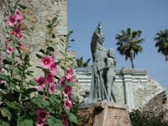
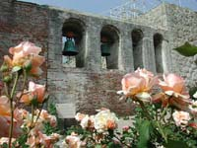
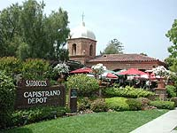


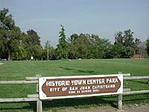
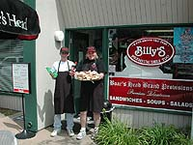
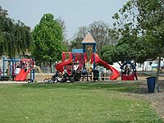
Home Depot Case
Sell Land?
Feng, T., L. R. Keller, X. Zheng. 2008. Modeling Multi-Objective Multi-Stakeholder
Decisions: A Case-Exercise Approach. INFORMS Transactions on Education 8(3) 103-114,
(http://ite.pubs.informs.org/, http://pubsonline.informs.org/doi/abs/10.1287/ited.1080.0012
supplemental files: HomeDepotTeachingNote.pdf (for instructors), Excel file. Files also at
http://faculty.sites.uci.edu/lrkeller/classes/

Slide 29

Background
Building products company Home Depot proposed to open a
retail building supply store
in San Juan Capistrano, California USA
The new store would be on 15 acres in a strip of industrial land.
Home Depot owned two acres of this land.
The rest of the land was owned by the city, and would need to be bought.

Slide 30
Background
The city would get $9 Million if it sells Home Depot the 13 acres.
Many were concerned that a “big box store” would destroy its historical small town feeling.
Nearby residents also worry that a Home Depot would cause traffic jams, pollute the air, produce noise and block ocean breezes.

Slide 31
Home Depot Case
Alternatives
Build Home Depot
Don’t develop the land
Build a recreational vehicle park
Build specialty retail facilities
  Stakeholders
  City of San Juan Capistrano
  Competing Local Small Businesses
  Complementary Local Small Businesses
  Home Depot
  Nearby Residents
  Other Area Residents

Slide 32
Spreadsheet Structure for Each Stakeholder
Improve the City of San Juan Capistrano

Slide 33
Identify group’s objectives
Promote convenience of shopping
Promote convenience of shopping
Improve the City of San Juan Capistrano

Slide 34
Complementary Local Small Businesses-
Representative Hierarchy of Objectives

Slide 35
Moving Sliders on Weights
Dynamically Changes Graph

Slide 36
Moving Sliders on Weights
Dynamically Changes Graph

Slide 37
What do you think: Yes or No?
Sell Land?
(City voters voted on this issue in November 2002.)

Slide 38
Example Home Depot Case Perspectives
 | Overall Values
 | Option 1 Build Home Depot | Option 2 Don't develop the land | Option 3 Build RV Park | Option 4 Build specialty retail
City of San Juan Capistrano | 4.5 | 4.2 | 4.2 | 5.6
Competing Local Small Businesses | 0.6 | 3.0 | 5.0 | 8.0
Complementary Local Small Businesses | 10.0 | 5.0 | 5.7 | 3.5
Home Depot | 9.4 | 1.0 | 1.0 | 1.0
Nearby Residents | 1.0 | 5.2 | 1.4 | 4.2
Other Area Residents | 6.2 | 3.8 | 0.8 | 3.6
Data from Executive Education session, February 2009. UC Irvine Merage

Slide 39
Each Stakeholder’s View of
Different Alternatives

Slide 40

Can examine how fair an alternative is from the perspective of each stakeholder, based on their overall value for the alternative

Slide 41
Each Alternative from Different Stakeholders’ Viewpoints

Slide 42

Voters voted NO
There is no Home Depot in the city

Slide 43
So far, we have modeled decisions under certainty, with no probabilistic states of nature.
Different stakeholders often disagree about the riskiness of new ventures and technologies.
Decision trees with decision nodes and chance nodes can be constructed for each stakeholder.
Stakeholders may agree or disagree on different components (probabilities of outcomes, alternative actions, utility of outcomes, etc.)
Such models may help clarify where there is agreement or not.

Slide 44
SUMMARY
A key component of systems analysis is examining the perspectives and actions of multiple stakeholders
Constructing hierarchies of objectives for stakeholders provides decision insights

Slide 45
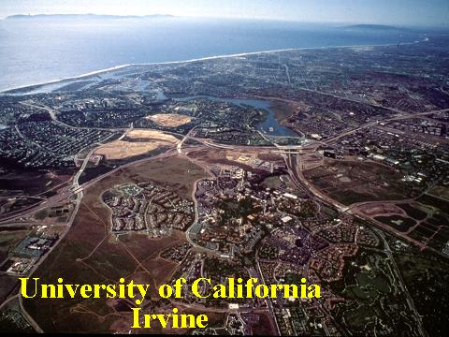
Questions?

Slide 46
Appendix with added details

Slide 47
MULTI-OBJECTIVE MULTI-STAKEHOLDER DECISION ANALYSIS
A key component of systems analysis is examining the perspectives and actions of multiple stakeholders. Constructing a hierarchy of each stakeholder’s objectives with respect to a decision situation can provide insights on areas of agreement and disagreement.
Sometimes, one objectives hierarchy is suitable for a set of stakeholders, and differences in opinions across stakeholders can be characterized by differences in the multiple objectives’ weights. Examples include planning for protection against radioactive iodine releases in nuclear incidents and analysis for the merger of the Operations Research Society of America and The Institute of Management Sciences to become INFORMS.
In other cases, an objectives hierarchy will be constructed for each stakeholder because their objectives are so different that construction of separate hierarchies better represents their divergent perspectives. Examples include a tuna fish supplier source selection decision (from the perspectives of the StarKist company, environmentalists, and the San Diego tuna fishing fleet), a prostate cancer treatment decision (of former Intel CEO Andy Grove, his family, his company, and his doctors), and the potential siting of a new Home Depot building supply store.
Having modeled stakeholders’ objectives, dynamic sensitivity analysis can be conducted using sliders in Excel on the objectives’ weights, to rapidly see how the preferred action may change with weight changes. It would also be possible to examine the perceived fairness across stakeholders of anticipated environmental changes or proposed societal policies. Just as groups may differ in objectives, they may also differ in their perception of risks. In particular, scientists and laypeople often judge the magnitude of risks very differently.

Slide 48
MULTIPLE OBJECTIVE DECISIONS UNDER CERTAINTY
Model
Objectives hierarchies of stakeholder(s)
Additive “weight & rate” multiple objective measurable value function
Software
Use Excel with sliders to input swing weights
Show sensitivity analysis in real time as bar graphs change
Much of this material is at http://faculty.sites.uci.edu/lrkeller/classes/. LR Keller, JSimon, Y Wang. "Multiple objective decision analysis involving multiple stakeholders," Ch. 7 in M. R. Oskoorouchi (ed.) Tutorials in Operations Research- Decision Technologies and Applications. INFORMS. (2009). [faculty.sites.uci.edu/lrkeller/files/2011/06/multiple-objective-decision-analysis-involving-multiple-stakeholders.pdf]

Slide 49
VALUE RATING SCALE
2: SEEN BY AVERAGE MEMBER AS IMPROVED
1: SEEN BY OFFICERS AS IMPROVED
BUT NOT BY AVERAGE MEMBER
0: NO CHANGE
-1: SEEN BY OFFICERS AS WORSE
-2: SEEN BY AVERAGE MEMBER AS WORSE

Slide 50
INTERPRETATION OF
“MEASURABLE” VALUE RATINGS
STRENGTH OF PREFERENCES IS REFLECTED IN DIFFERENCES OF VALUES
DEGREE OF IMPROVEMENT
FROM 0 TO 1
IS THE SAME AS
FROM 1 TO 2

Slide 51
JUDGED VALUE RATING SCORES
JUDGED VALUE RATING
ON ALTERNATIVES
OBJECTIVES
SEP
SQ
SM
M2
M3
1. IMPROVE COST EFFICIENCY
1.1 MAINTAIN EFFICIENT USE OF FUNDS
1.1.1 EXPLOIT ECONOMIES OF SCALE
-2
0
1
-1
1
1.1.2 BALANCE DUES RATE AND
-2
0
1
-1
1
FEE-FOR-SERVICE
1.1.3 REMOVE DOUBLED DUES
-1
0
2
1
2

Slide 53
COMPUTE WEIGHTED AVERAGE OF
VALUE RATINGS
MULTIPLY OBJECTIVE’S WEIGHT TIMES VALUE RATING ON EACH OBJECTIVE
SUM UP OVER ALL OBJECTIVES
(Use SUMPRODUCT function in Excel)
RECOMMENDED OPTION IS ONE WITH
HIGHEST OVERALL VALUE

Slide 54
WEIGHTS FOR OBJECTIVES
SUM OF WEIGHTS IS 1OO% FOR ALL LOWEST LEVEL OBJECTIVES
OBJECTIVE’S WEIGHT DEPENDS ON RANGE ATTAINABLE ON OBJECTIVE
Use a SWING WEIGHT Interpretation
Assume a weighted Additive Model
DECISION MAKER JUDGES WEIGHTS ON OBJECTIVES

Slide 55
RESULTS
OFFICERS PREFERRED MERGER3 ALTERNATIVE
VOCAL OPPONENTS COMPROMISED ON SEAMLESS MERGER, AS LONG AS NEW NAME included “OPERATIONS RESEARCH”

Slide 56
Decision Alternatives Rated with
StarKist’s “Business-As-Usual” Objectives Hierarchy

Slide 57
StarKist’s “Strategic Planning” Objectives Hierarchy

Slide 58
Methodology
A Multi-objective Multi-stakeholder Decision Analysis Methodology
Identify Stakeholders
Develop
the
Weights
Identify Alternatives
Rate Alternatives over Objectives
Is There a Dominant Alternative?
Compute Overall Values of Alternatives
No
Yes
Develop the
Objectives
Hierarchy
Make
the
Recommendations
Conduct Dynamic Sensitivity Analysis Using Sliders in Excel

Slide 59
Stakeholders
The city of San Juan Capistrano: interested in the potential revenue, but concerned with interests of multiple stakeholders
Competing local small businesses: will be influenced by the arrival of Home Depot in terms of profit, etc.
Complementary local small businesses: will definitely be affected in terms of profit, etc.
Home Depot
Nearby residents: concerned with the possible adverse impacts on their quality of life
Other area residents: will enjoy the convenience, but may suffer from the possible increased traffic flow

Slide 60
Home Depot in San Juan Capistrano
A Sample Spreadsheet
to Evaluate the Home Depot Case
Excel file (HomeDepotCase.xls)
http://faculty.sites.uci.edu/lrkeller/classes/
Make sure to choose "enable the macros" when you open the spreadsheet. If you still have the problem of adjusting the sliders due to the security level after that, please go to the menu of "tools->macro->security", switch the security level from high to medium, save the file, then close the file and finally reopen the file and it should work.

