Slide 1
Tomorrow-
Move to S-120

Slide 2
SIGNALING GAMES:
Dynamics and Learning
NASSLI 2016
Wednesday

Slide 3
Evolutionary Dynamics of
Lewis Signaling Games

Slide 4
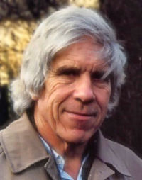
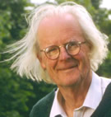
Hamilton Maynard Smith

Slide 5

Peter Taylor
T. & J. “Evolutionarily Stable Strategies and Game Dynamics” (1978)

Slide 6
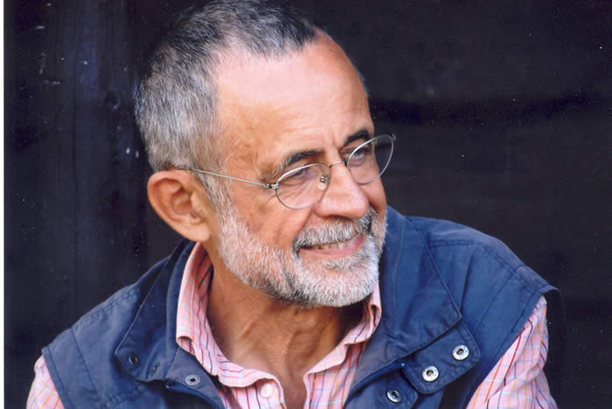
Leo Jonker
T. & J. “Evolutionarily Stable Strategies and Game Dynamics” (1978)

Slide 7
Replicator Dynamics
Differential Reproduction
Differential Imitation
Note: qualitative behavior of replicator dynamics may generalize to a wide class of adaptive dynamics.

Slide 8
Replicator Dynamics
x_{i}’ = x_{i} (average fitness s_{i} – average fitness pop.)

Slide 9
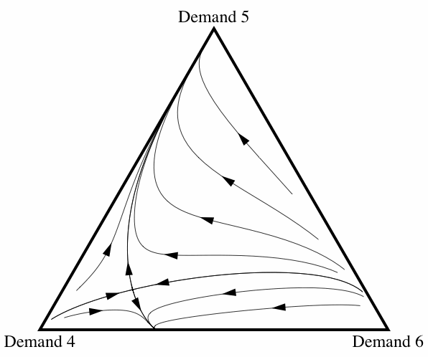
Bargaining Example
Orbits: replicator dynamics

Slide 10
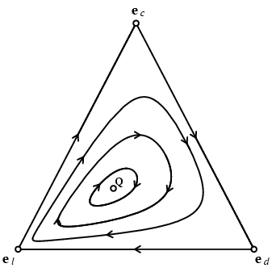
A Rock-Scissors-Paper Type Example
Orbits: replicator dynamics

Slide 11
The Simplest Lewis Signaling Game
Nature flips a fair coin to choose state 1 or 2.
Sender observes the state & sends signal A or B.
Receiver observes the signal and guesses the state.
Correct guess pays off 1 to both; otherwise nothing.

Slide 12
Evolution in the Simplest Signaling Game
Replicator Dynamics – random encounters
2 populations: Senders; Receivers
1 population: roles

Slide 13
Evolution in the Simplest Signaling Game
Replicator Dynamics – random encounters
2 populations: Senders; Receivers
1 population: roles
Simulations always learn to signal. Why?

Slide 14
Evolution of Signaling: 2 populations
(only separating strategies)
• Sig I
Sig II•
(vector field)

Slide 15
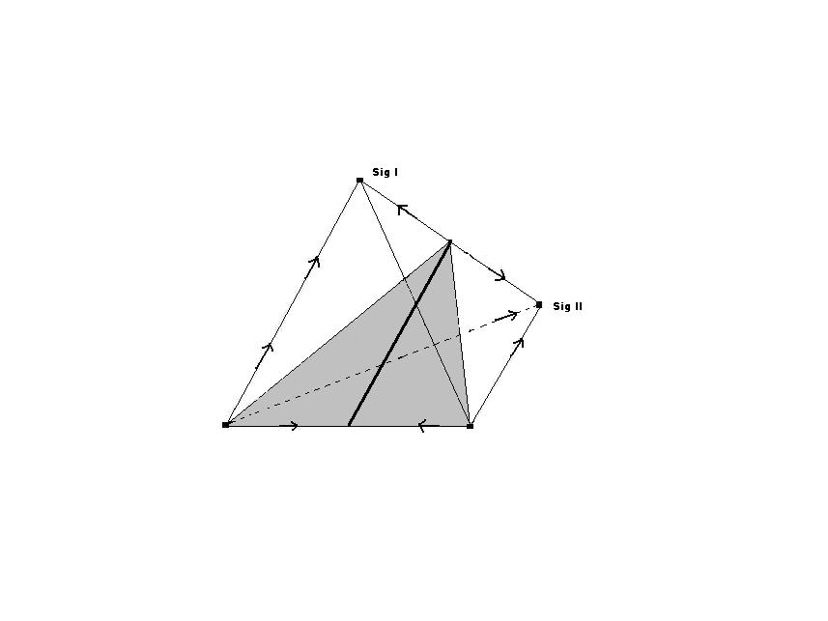
Evolution of Signaling: 1 population
(only separating strategies)

Slide 16
Analytic Proof 2 population
(Hofbauer and Huttegger (2008) JTB
Signaling Systems are attractors.
Pooling equilibria are all dynamically unstable.
Signaling systems emerge spontaneously from almost every starting point.

Slide 17
A result almost too strong to believe.
We started by asking whether it is possible for meaning to emerge spontaneously.
Here it seems almost necessary for signaling to evolve.

Slide 18
Is this result robust?
The model is not structurally stable.

Slide 19
Structural Stability
A Dynamics (given by a vector field) is
Structurally Unstable
if an arbitrarily small change in the vector field yields a qualitatively different dynamics.

Slide 20
Arbitrarily small difference?
At each point in the simplex, for each component, there is a numerical difference. Take the maximum.
Take the least upper bound of these numbers.
This is the distance between the vector fields.

Slide 21
Qualitatively Different?
Two vector fields are qualitatively the same, i.e.
(topologically equivalent) if there is homeomorphism of the simplex to itself that takes the orbits of one into the orbits of the other (preserving sense of the orbits).

Slide 22
Perturbation 1: States not equiprobable
Component of pooling equilibria collapses from a plane to a line.
Interior points of this line now stable.
Pooling has a positive basin of attraction.

Slide 23
Perturbation 1: States not equiprobable
Component of pooling equilibria collapses from a plane to a line.
Interior points of this line now stable.
Pooling has a positive basin of attraction.
-- but this model also is not structurally stable.

Slide 24
Perturbation 2: mutation
(or experimentation)
Replicator Dynamics replaced by
Selection-Mutation dynamics
Experimentation rates might be different for receivers, ∊, and for senders,∂.

Slide 25
Mutation
Pooling equilibria collapse to a single point.
Is it dynamically unstable, stable, strongly stable?
It depends.

Slide 26
Perturbation: mutation
Pooling equilibria collapse to a single point.
Is it dynamically unstable, stable, strongly stable?
It depends on:
- the disparity in the probabilities of the states
- the relative mutation rates in the two populations
(Hofbauer and Huttegger JTB 2008).

Slide 27
Mutation
Pooling equilibria collapse to a single point.
If mutation rates are equal (and small) a qualitative transition from unstable to stable takes place at about
p = .788

Slide 28
Mutation
Pooling equilibria collapse to a single point.
If mutation rates are equal (and small) a qualitative transition from unstable to stable takes place at about
p = .788
… but if the receiver is at least twice as likely to mutate as the sender, the point is always unstable.

Slide 29
Mutation
Pooling equilibria collapse to a single point.
If mutation rates are equal (and small) a qualitative transition from unstable to stable takes place at about
p = .788
… but if the receiver is at least twice as likely to mutate as the sender, the point is always unstable.
Model is structurally stable.

Slide 30
What about 3?
3 states, 3 signals, 3 acts
States equiprobable
Partial pooling can evolve.
States not equiprobable
Total pooling can evolve (as before)

Slide 31
What about 3?
3 states, 3 signals, 3 acts
Mutation helps, as with 2 by 2 by 2.
Analysis is complex.
See Hofbauer and Huttegger (2015)

Slide 32
A Peek Beyond Common Interest

Slide 33
Variation on R-S-P
 | A1 | A2 | A3
S1 | -1, 1 | .5, -.5 | 1, -1
S2 | 1,-1 | -1, 1 | .5, -.5
S3 | .5, -.5 | 1,-1 | -1, 1

Slide 34
Chaos
(structurally stable)
Wagner BJPS 2012,
Sato Akiyama, Farmer, PNAS 2002.

Slide 35
Mixed Interests with Differential Signaling Costs
Cycles also occur here in a non-trivial way in:
Spence Signaling Game
- Noldeke &Samuelson J. Econ. Th. (1997)
- Wagner Games (2013)
Sir Philip Sydney Game
- Huttegger & Zollman Proc.Roy.Soc.(2010)

Slide 36
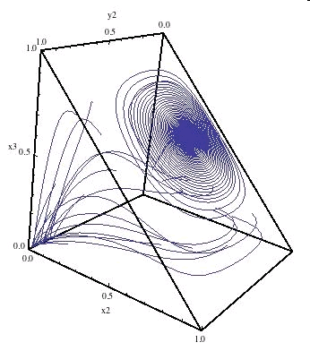
Cycles around Hybrid Equilibrium

Slide 37
Summary: Replicator
With common interest, emergence of signaling systems with positive probability is ubiquitous, but with probability 1 only in special circumstances.
With opposed interests, equilibrium may not be reached, but rather persistent “Red Queen” information transmission.
In well-known costly signaling games the “Red Queen” is a real possibility.

Slide 38
II. Finite Population
Frequency-Dependent Moran Process
With rare mutations

Slide 39
Frequency Dependent Moran Process
Everyone plays the base game with everyone else, to establish fitness.
One individual leaves to group (dies); a new one walks in the door (is born). The new individual imitates a strategy in the population with probability proportional to its average success.
Fudenberg, Imhoff, Nowak, Taylor (2004)

Slide 40
Markov chain where the state is the number of members of the population playing each strategy.
Monomorphisms are the unique absorbing states.
Add mutation: The new member with some small probability chooses any strategy (including those extinct).
Then the Markov chain is ergodic.

Slide 41
Small Mutation Limit
Study the proportion of time a population spends in states in the limit,
-as mutation rate goes to zero.
Fudenberg and Imhof JET (2006)
(It suffices to study transition probabilities between monomorphisms, initiated by one mutation.)

Slide 42
A Type of Game
- Sender is one of two types, High or Low.
- Sender sends one of two signals. (cost-free)
Receiver has two acts, one which she would prefer for the high sender; the other for the low sender.
But Sender would always prefer to be treated as a high type.
The only Nash equilibria are pooling.

Slide 43
Numerical Example
 | Act High | Act Low
State High | 1, 1 | 0, 0
State Low | 1, 0 | .8, 1
probability of state 1 (high) = .4.
Symmetrize the game
population size = 50

Slide 44
Long-run Behavior
(from Wagner BJPS 2014)

Slide 45
Related:
Costless Pre-play Exchange of Signals
-in Stag Hunt
-in PD
More Signals are better.
Santos, Pacheco, Skyrms JTB (2011)

Slide 46
Summary: Replicator
With common interest, emergence of signaling systems is guaranteed only in special circumstances.
With opposed interests, equilibrium may not be reached, but rather persistent “Red Queen” information transmission.
In well-known costly signaling games the “Red Queen” is a real possibility.

Slide 47
Summary: Moran Process, Small Mutation Limit
A small population may spend most of its time in a signaling system – even when pooling is the only Nash equilibrium.
Pre-play signaling can lead to high levels of cooperation – in Stag Hunt, and even in PD.

Slide 48
Thank you.

Slide 49

Selection-Mutation Dynamics
Hofbauer (1985) J. Math. Bio.

Slide 50

Selection-mutation dynamics
Pooling equilibria collapse to a single point.
Is it dynamically unstable, stable, strongly stable?
It depends. (Hofbauer and Huttegger JTB 2008).
If
a sink, otherwise a saddle. (for small mutation rates).

