Slide 1
Action Potential – II
(the Hodgkin-Huxley Axon)
Hodgkin and Huxley 1952 papers
membrane permeability during AP
AP threshold
AP propagation

Slide 2
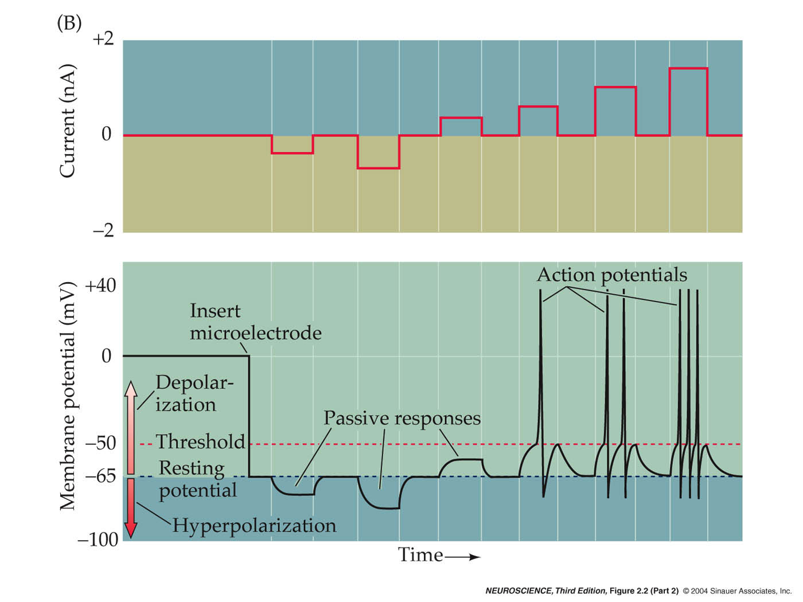
Fig. 2.1

Slide 3
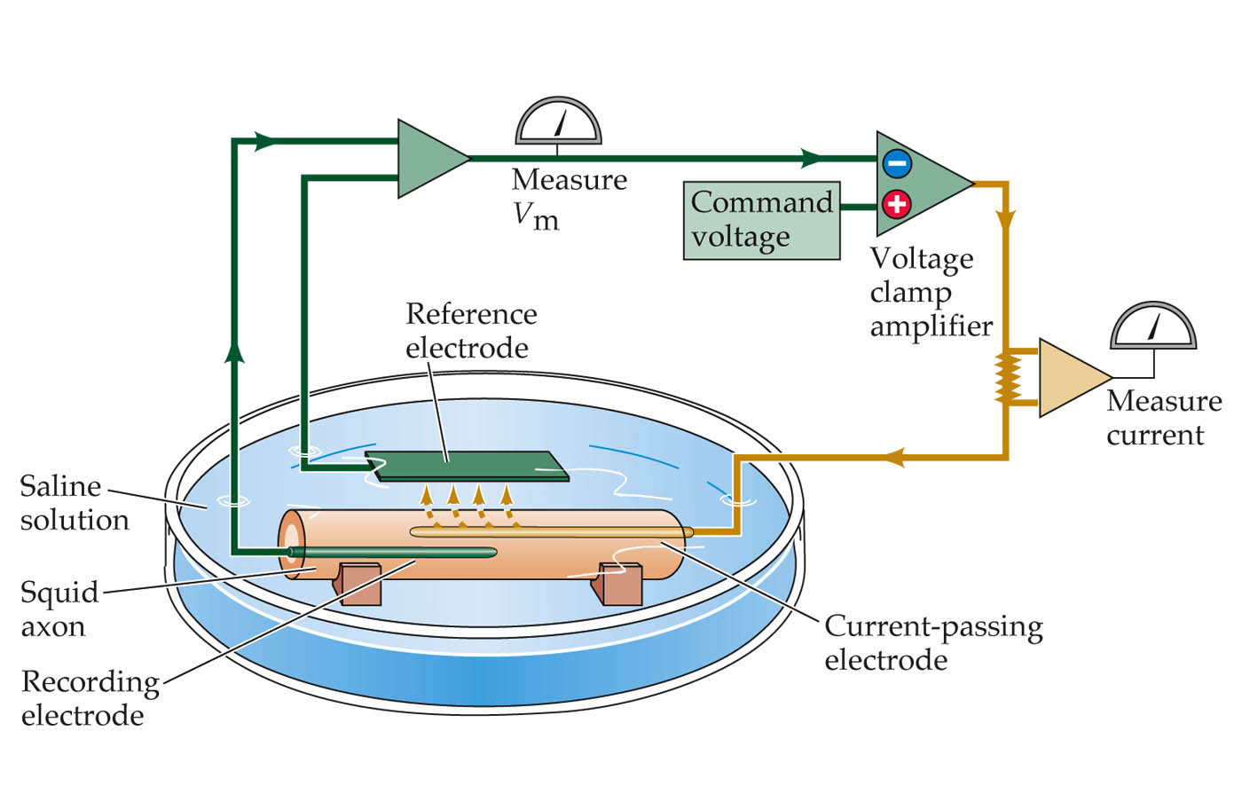
Voltage clamp
Hypothesis: potential-sensitive Na+ and K+ permeability changes are both necessary and sufficient for the production of action potentials.

Slide 4
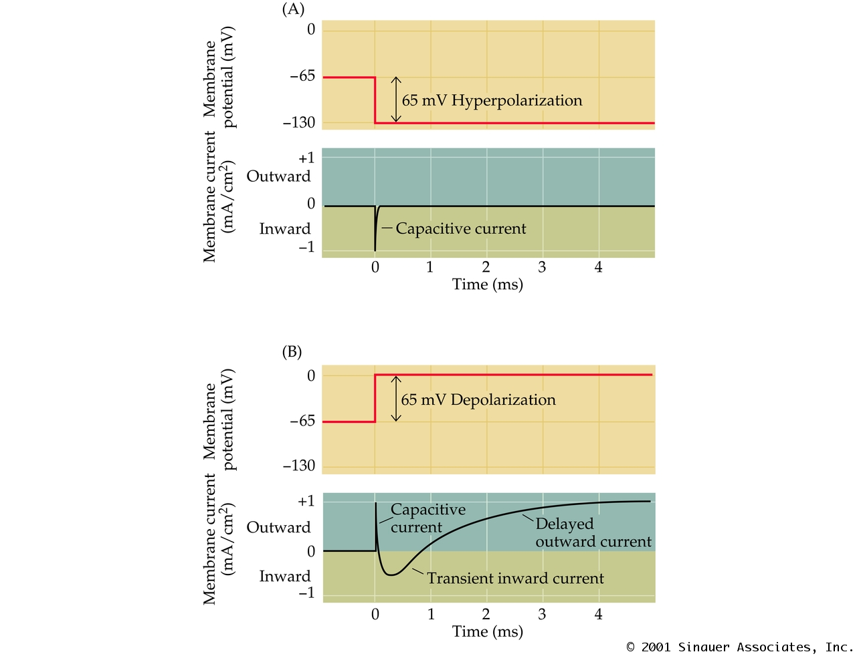
Voltage dependent permeabilities.
Fig 3.1

Slide 5
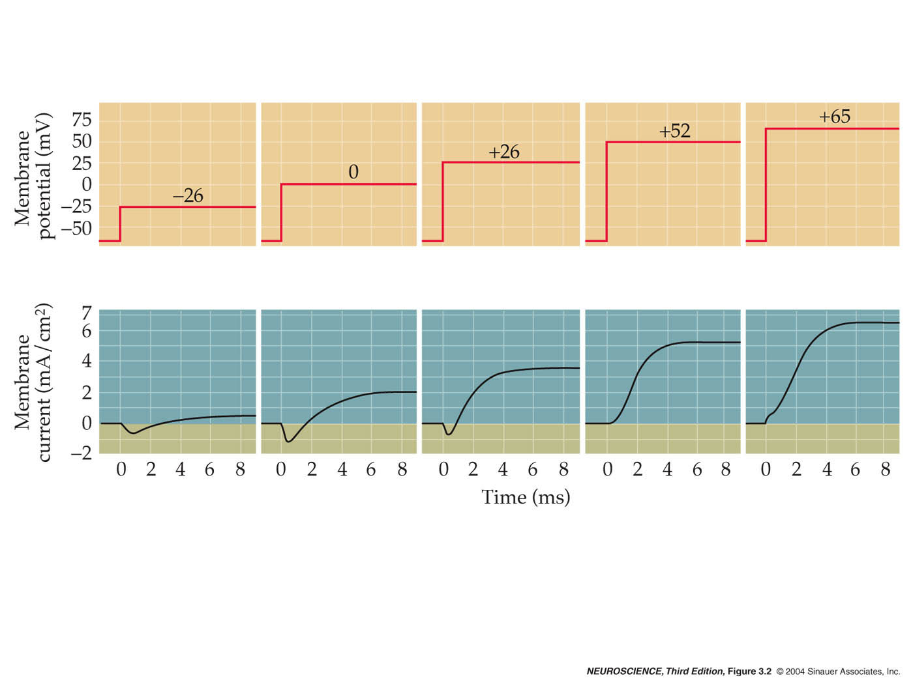
What ionic species are engaged?
Fig 3.2

Slide 6
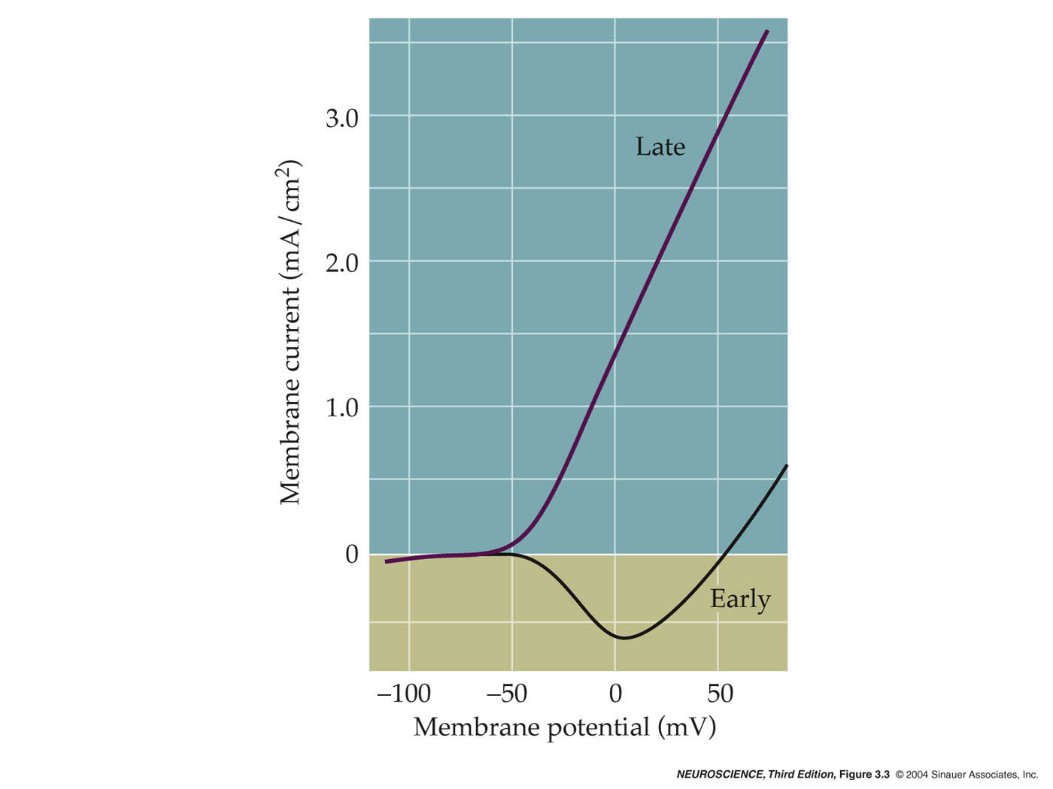
The I/V curve of an AP
Fig 3.3

Slide 7
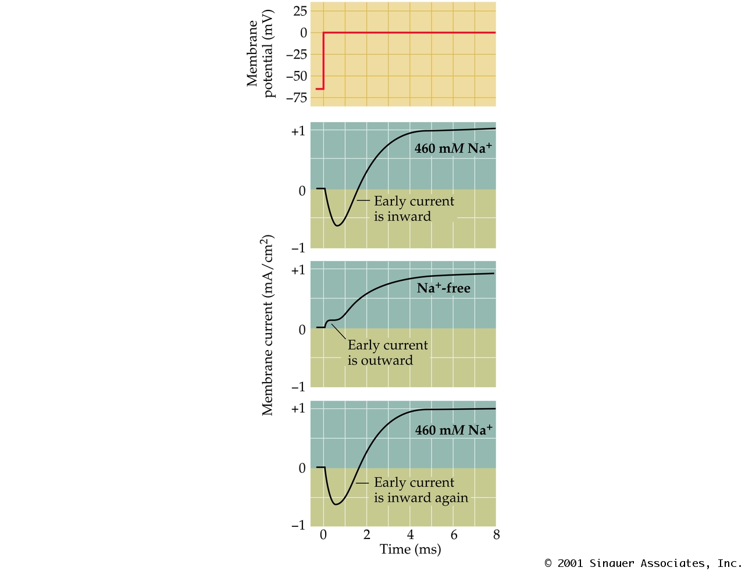
The involvement of Na+ (and K+)
Fig 3.4

Slide 8
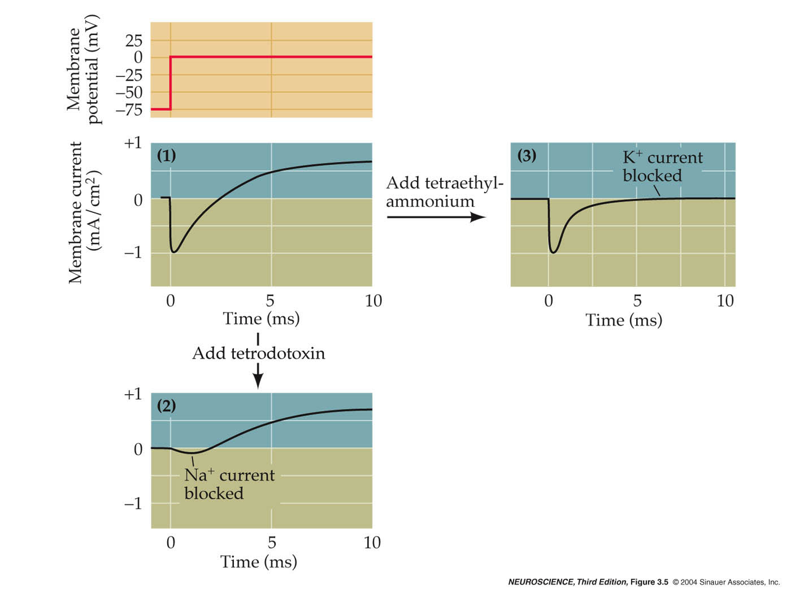
Two separate ionic conductances
(TEA)
(TTX)
Fig 3.5

Slide 9
A rigorous description of membrane conductances
V = IR (Ohm’s law)
for Na⁺ in neurons:
V = V_{m} - E_{Na} (“driving force”, fixed in v-clamp)
I = ionic current
R = 1/conductance, g
therefore, g = I/V

Slide 10
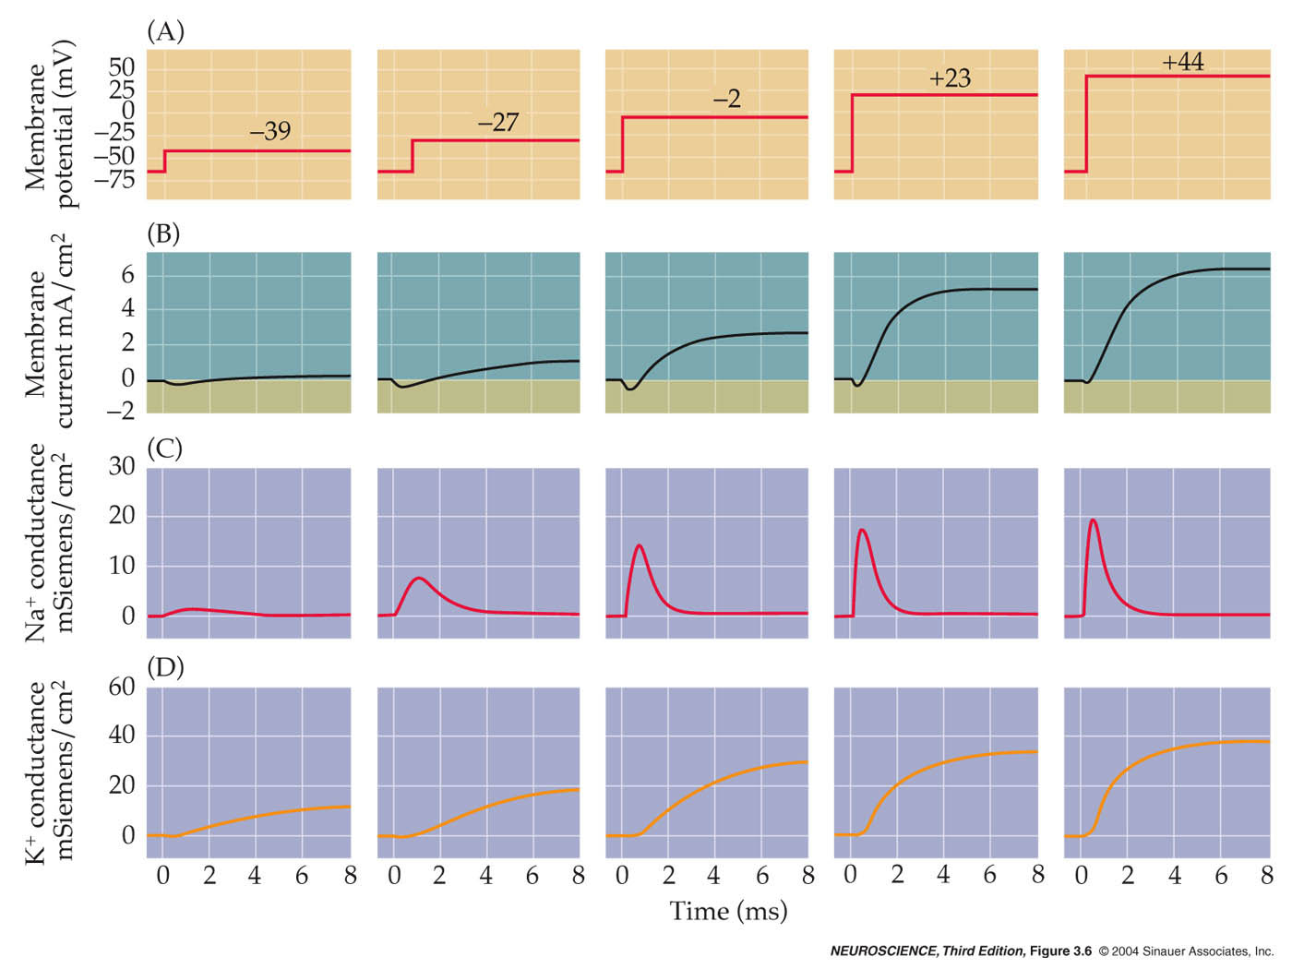
Na and K conductances with time
Both conductances are voltage- and time-dependent
gNa+ quickly activates, then inactivates
gK+ slowly activates, does not inactivate
Fig 3.6

Slide 11
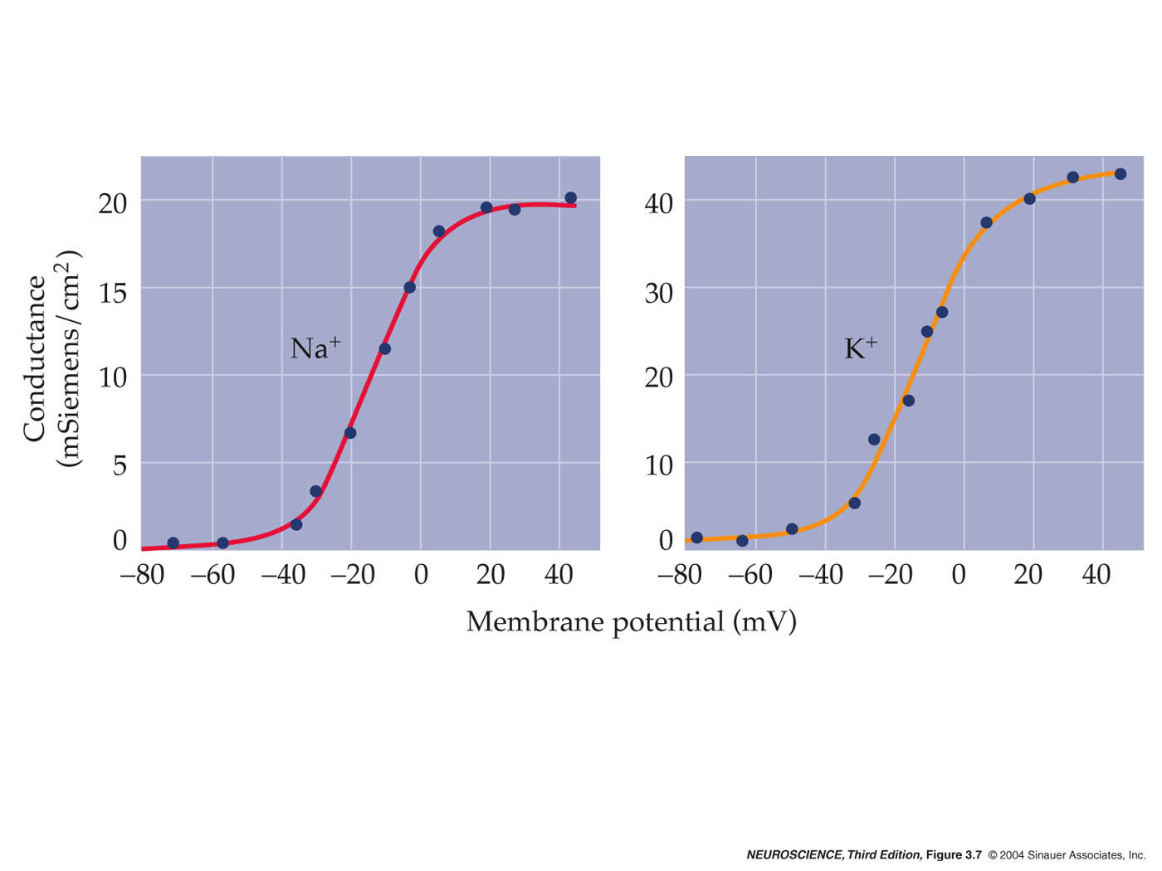
Na+ and K+ conductance are voltage dependent
Na+ channel activation defines threshold
fig 3.7

Slide 12
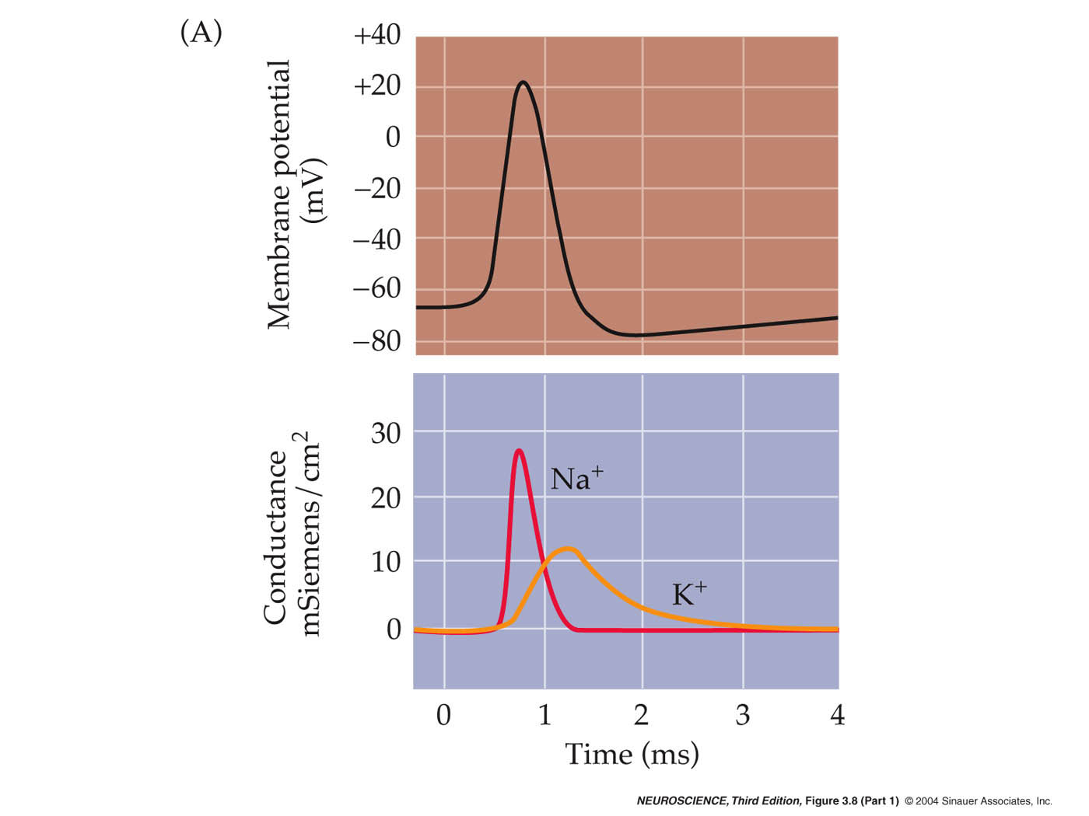
Mathematical reconstruction of the AP
gNa+ and gK+
fully explain AP:
shape
threshold
after hyperpolarization
refractory period
propagation
Fig. 3.8

Slide 13
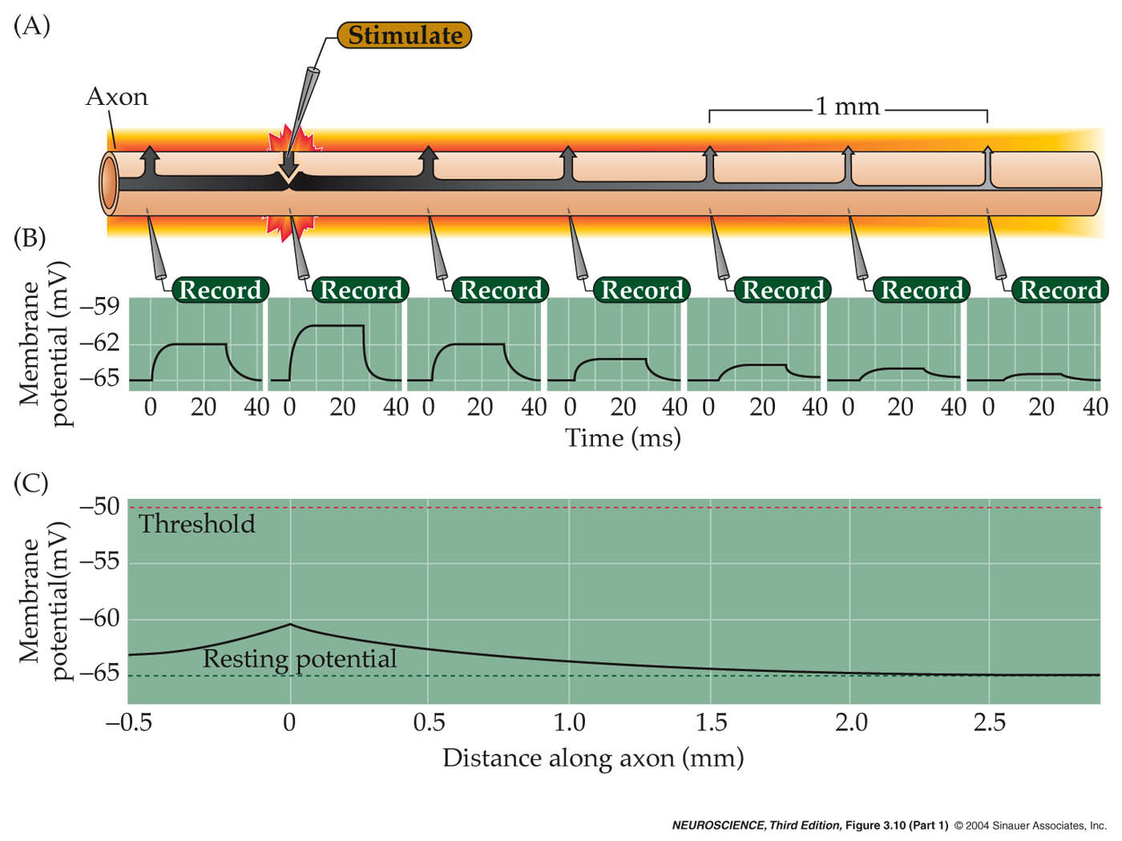
Passive conductance is not great in an axon
Fig 3.10

Slide 14
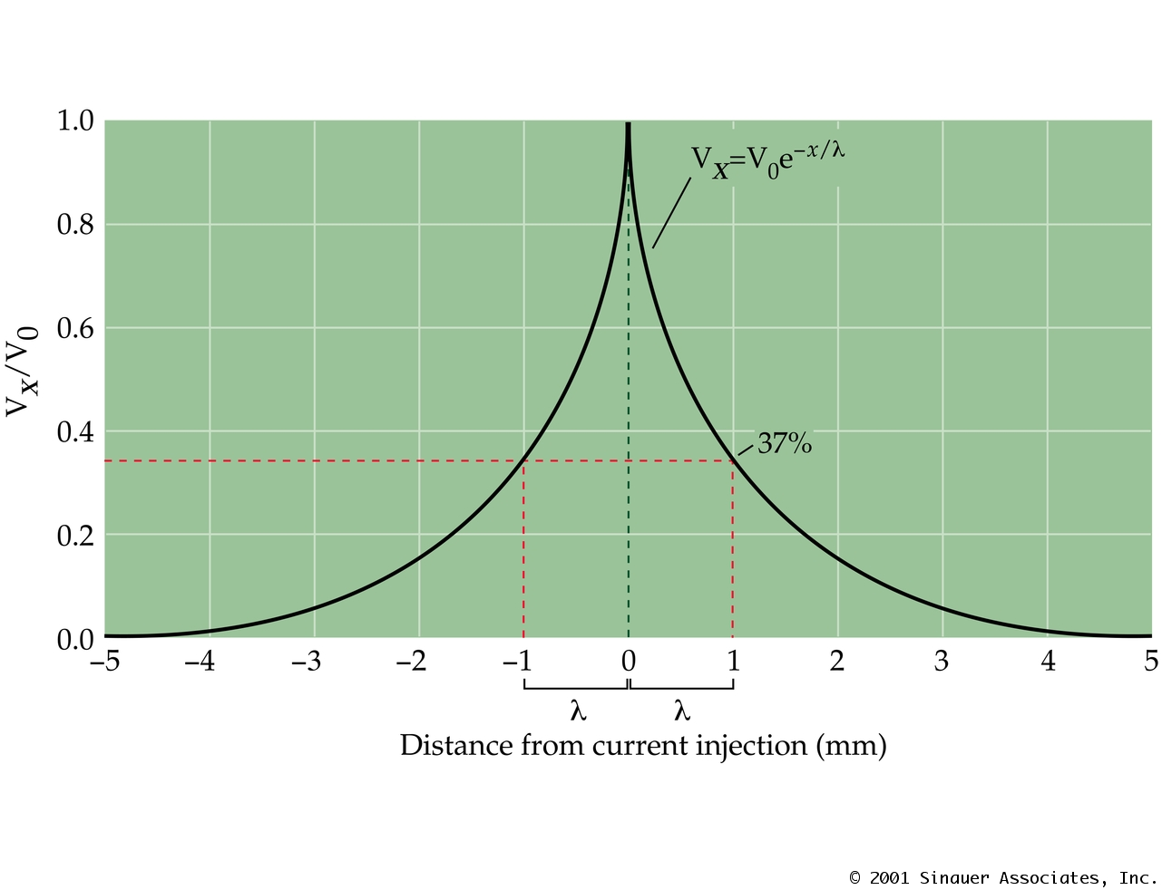
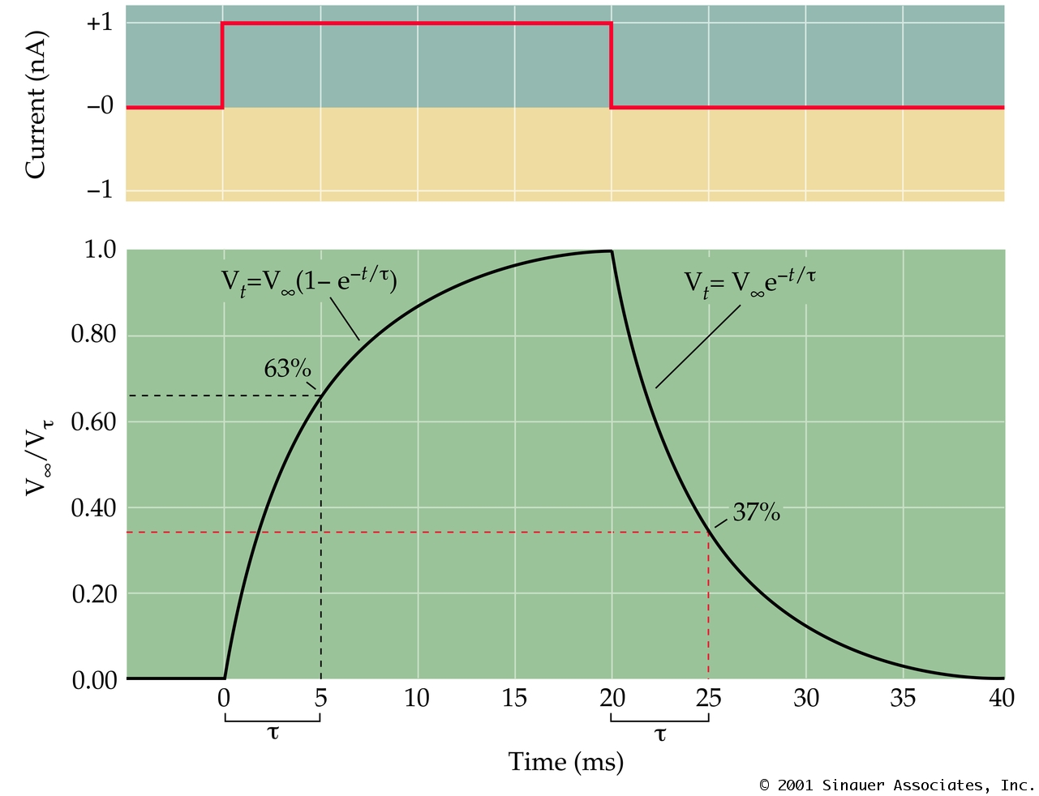
Passive membrane properties
Ch. 3 Box C

Slide 15
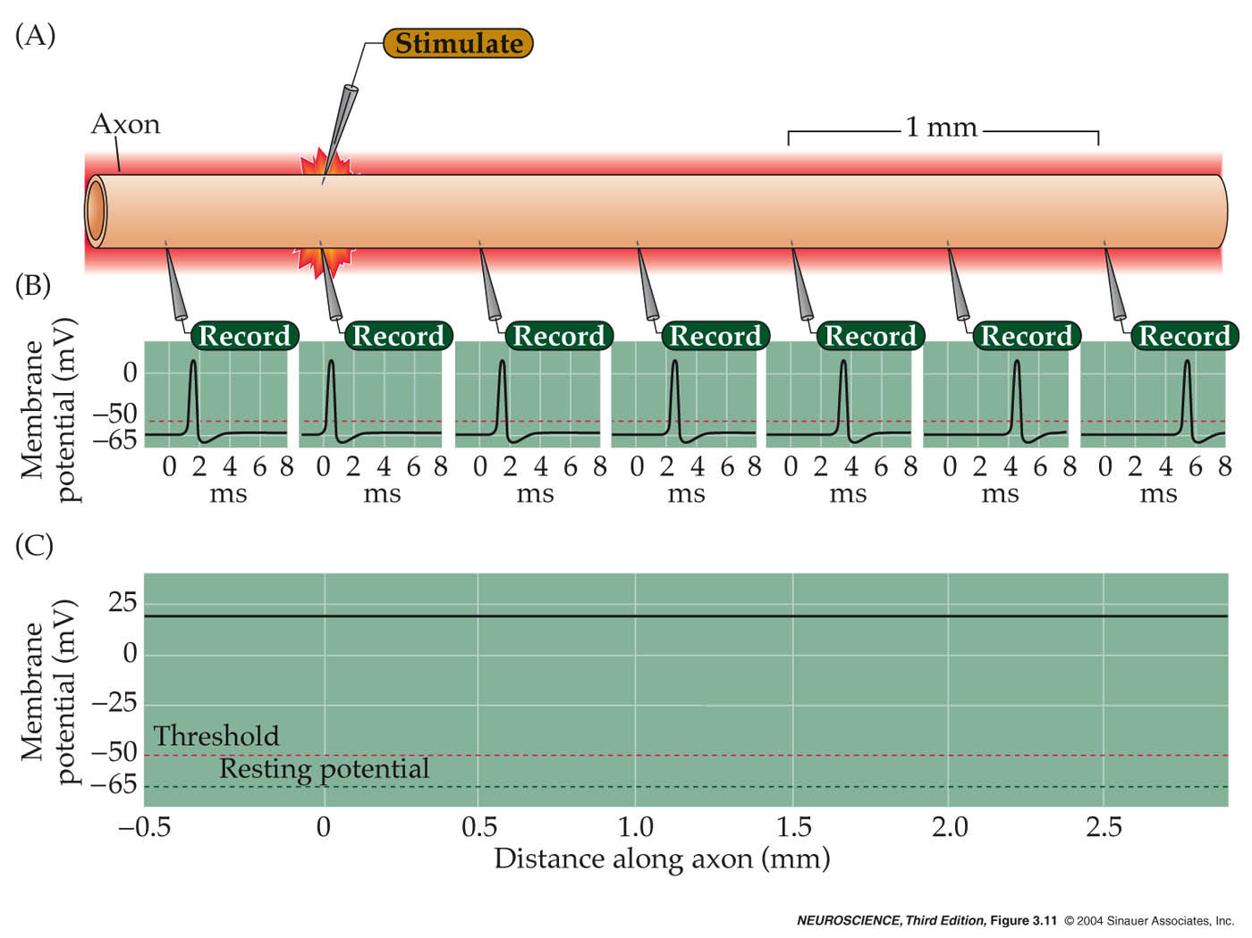
Propagation of an action potential
Fig 3.11

Slide 16
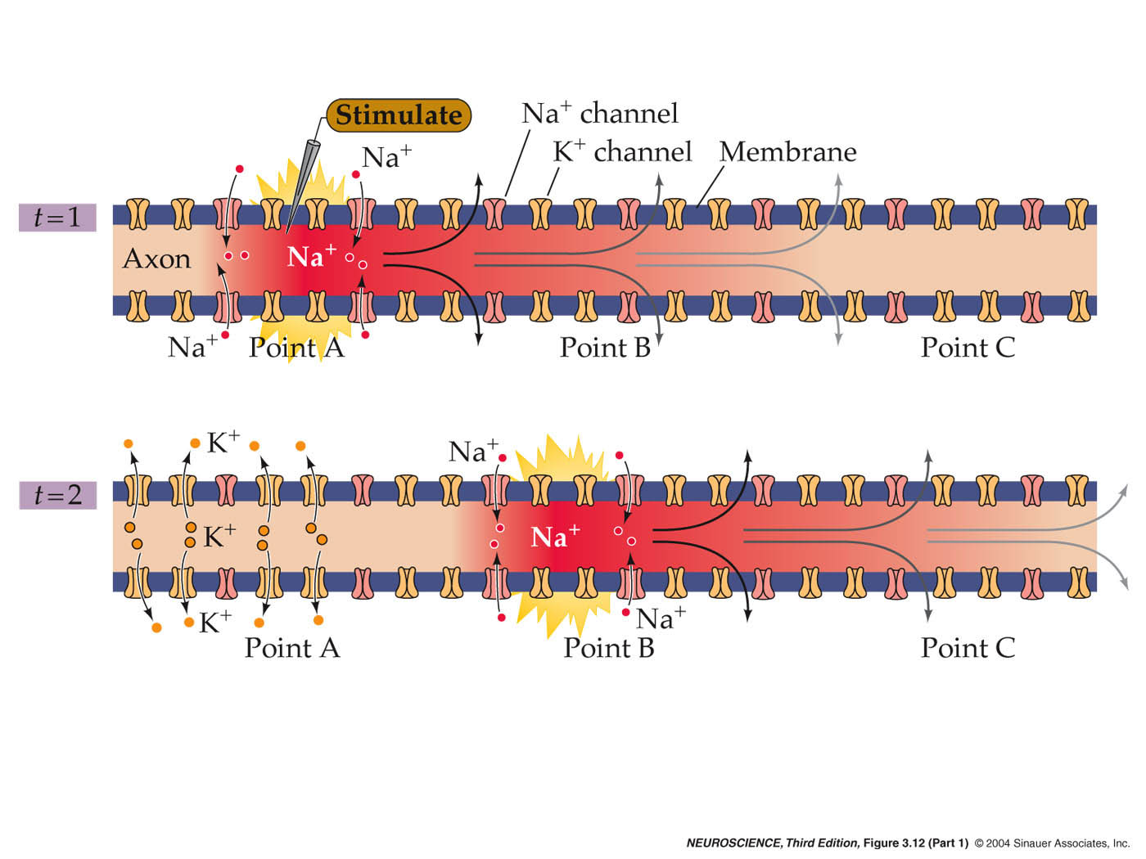
The mechanism of action potential conduction
Fig 3.12

Slide 17
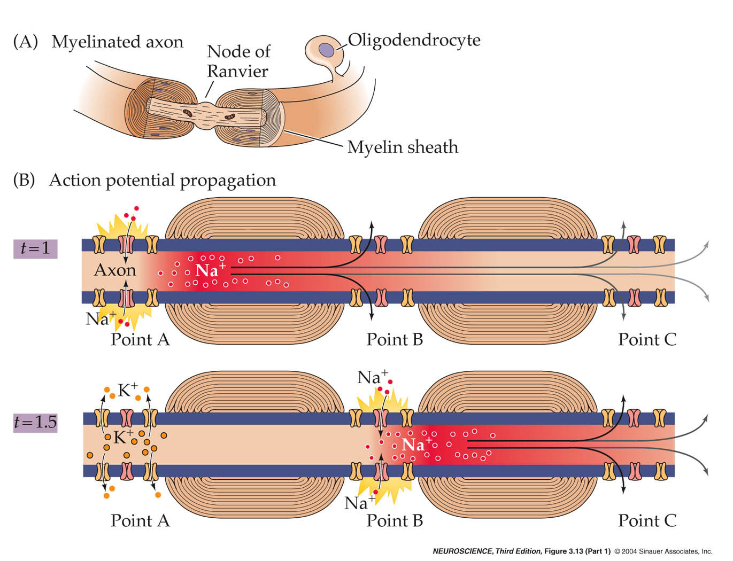
AP propagation in a myelinated axon (“saltatory”)
Fig 3.13

Slide 18
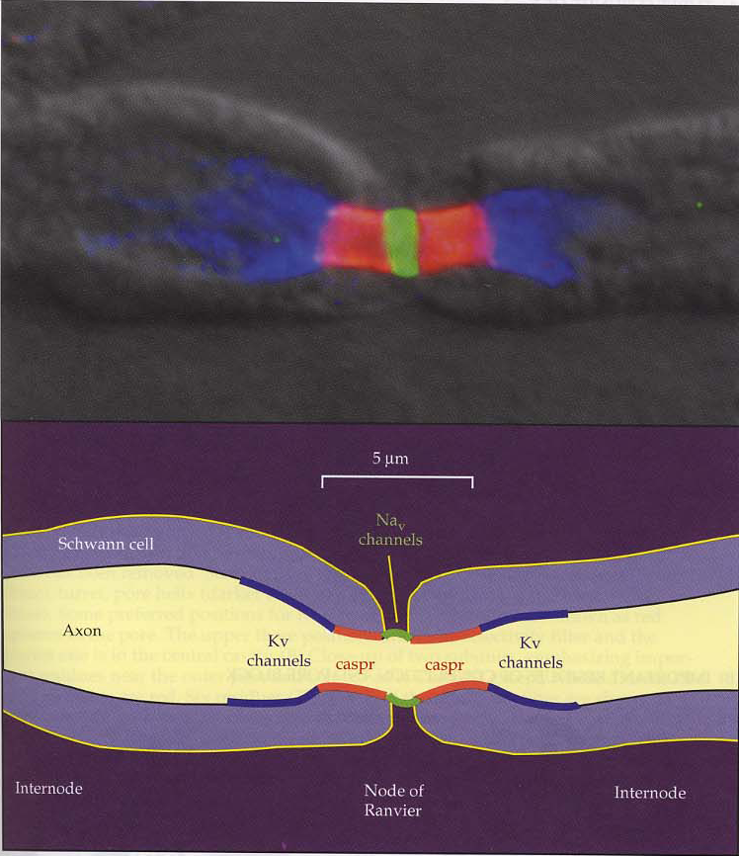
Ion channel distribution in nodes of Ranvier
Na⁺ channels in node of Ranvier
(Rasband and
Shragger 2000)

