Slide 1
Postsynaptic currents and potentials
NMJ: ACh
CNS: Excitation by glutamate
Inhibition by GABA
Reversal potentials for synaptic currents

Slide 2
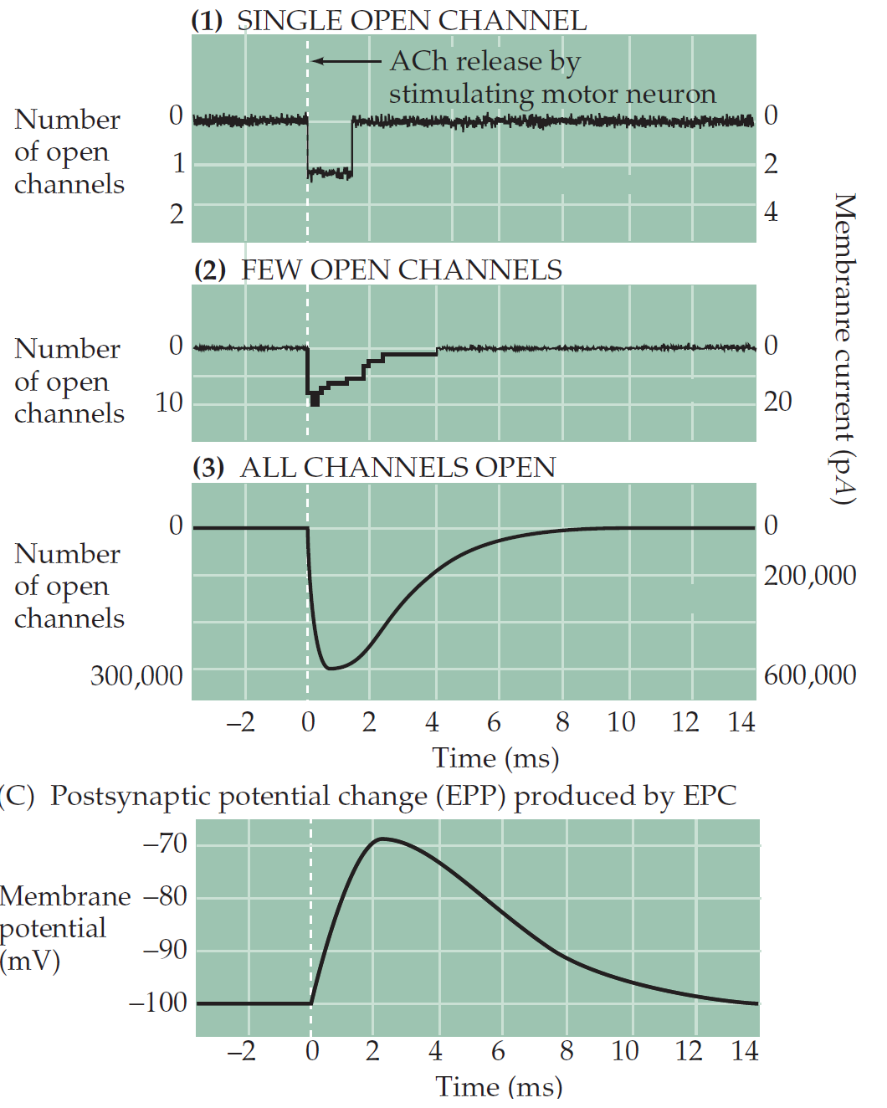
NMJ postsynaptic current : opening of ligand gated channels

Slide 3
The electrochemical driving force
muscle equilibrium potentials:
K+: -100mV
Na+: +70mV
Cl-: - 50mV
Resting Vm: -90mV
Reversal: 0mV
Important: if conductance of the channel is not sensitive to Vm (ligand-, not voltage-gated), direction of the current is determined by electrochemical driving force.
E(drive) = Vm – E(rev)
EPC = g(ACh) * E(drive)

Slide 4
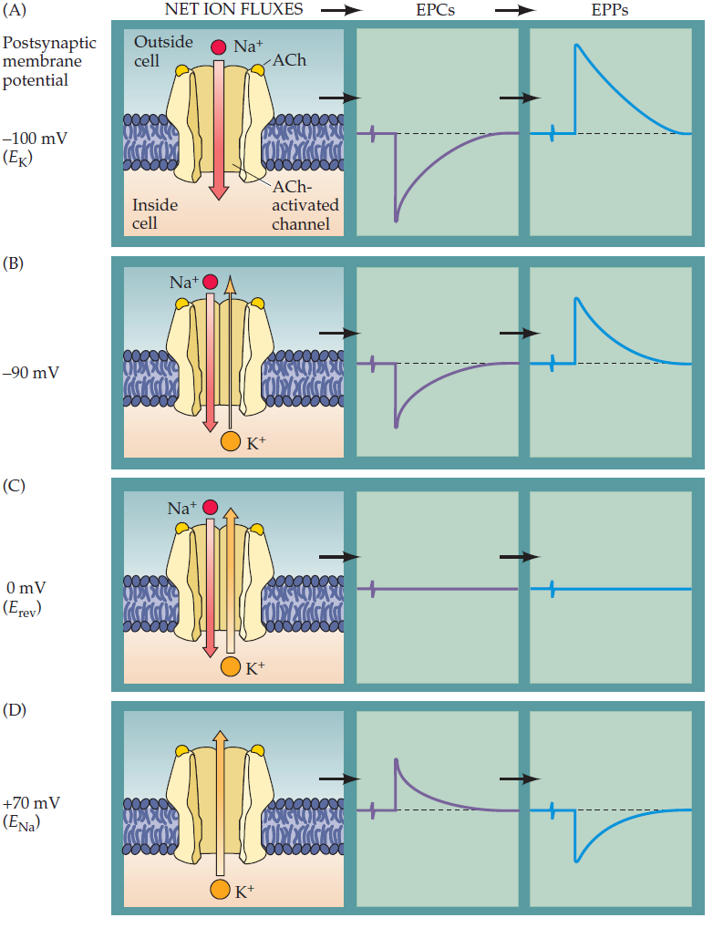
Vm dependent action of a neurotransmitter
the action of a transmitter drives the postsynaptic membrane potential toward Erev for the particular ion channels being activated.

Slide 5
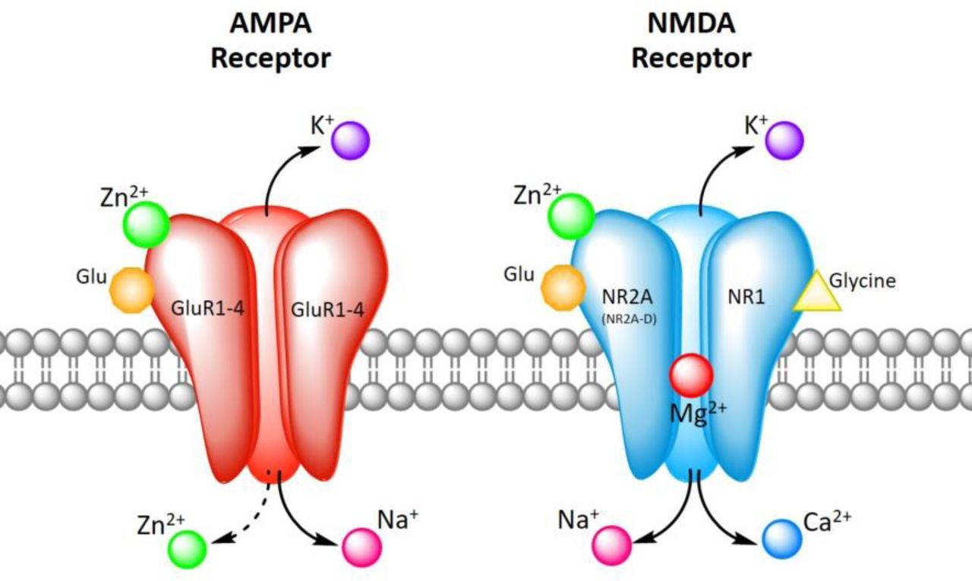
Glutamatergic EPSC

Slide 6
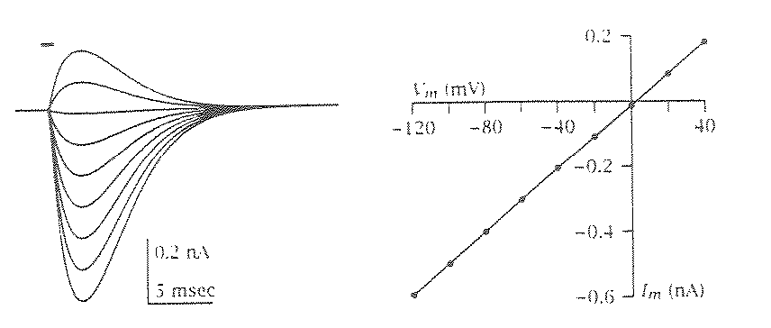
AMPA receptor

Slide 7
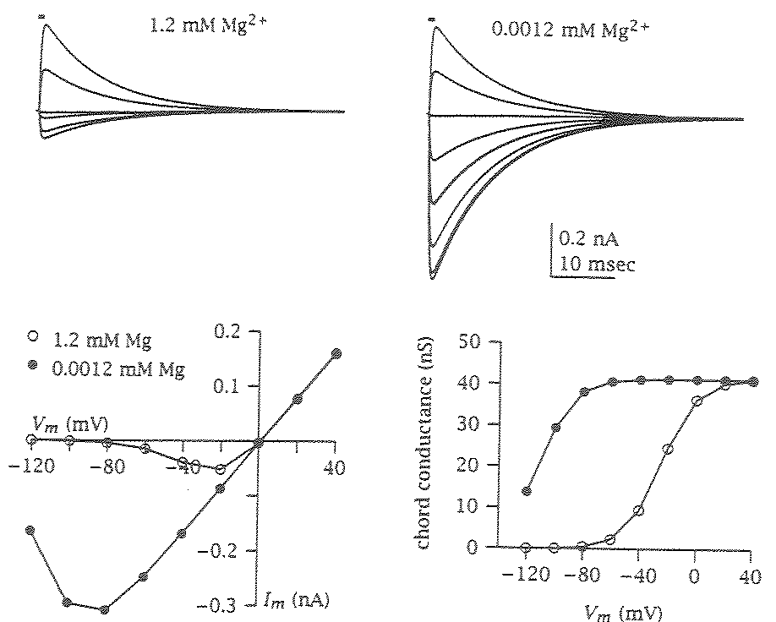
NMDA receptor

Slide 8
AMPA - NMDA receptor interaction
Weak stimulus
Strong stimulus

Slide 9
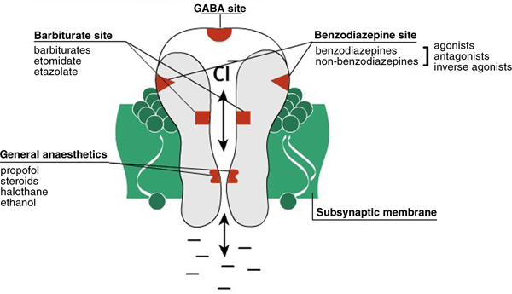
Inhibition – GABA receptors

Slide 10
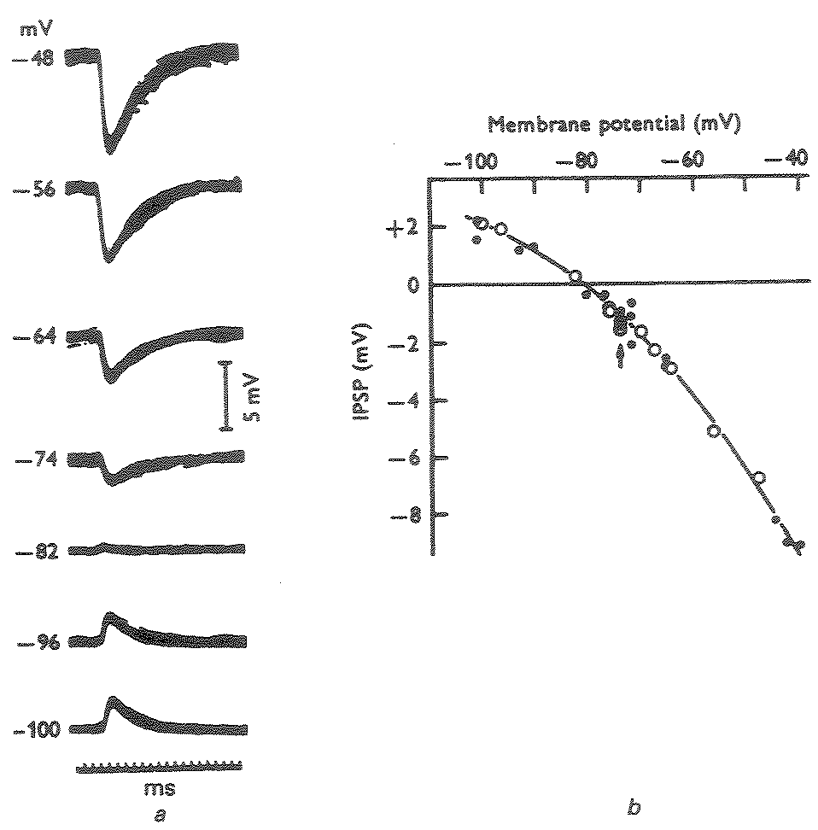
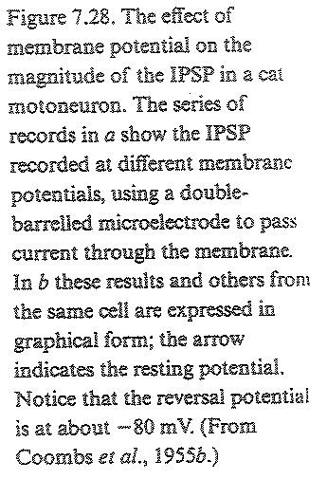
GABA receptor Vm dependence

Slide 11
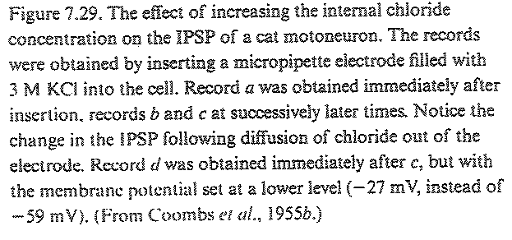
GABA receptor with high internal Cl-
Normal Cl- concentrations
[Cl-]in: ~5mM
[Cl-]out: ~110mM

Slide 12
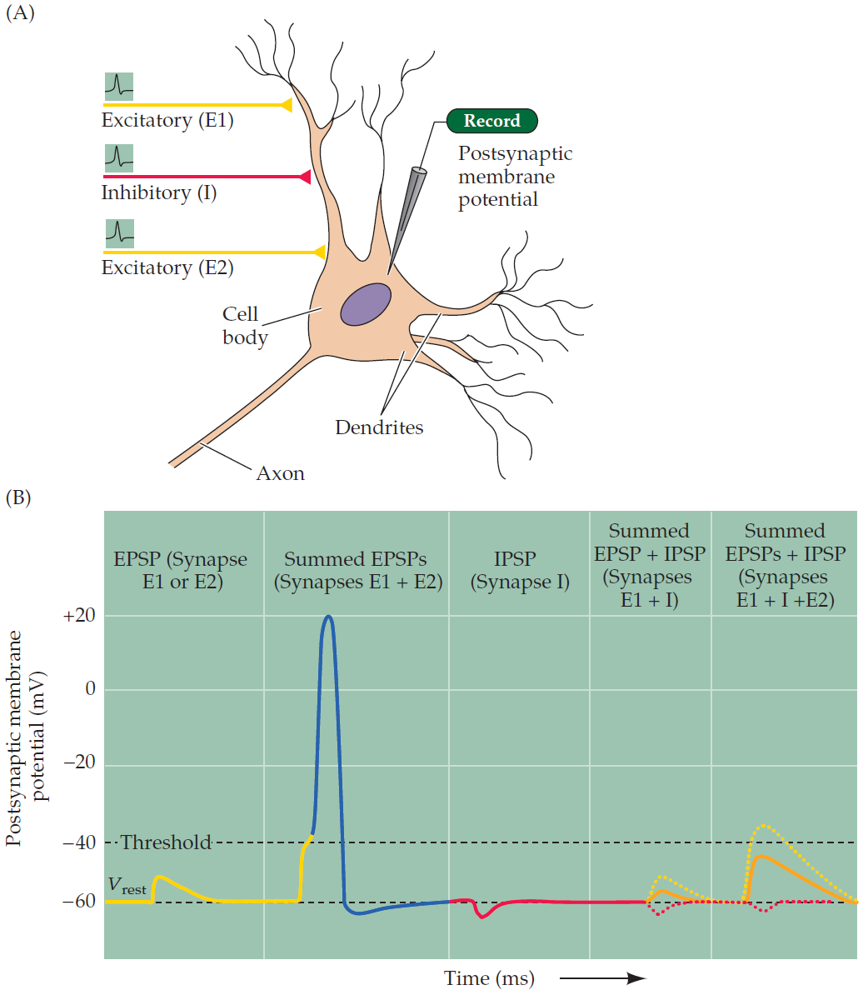
Integration of EPSP and IPSP

Slide 13
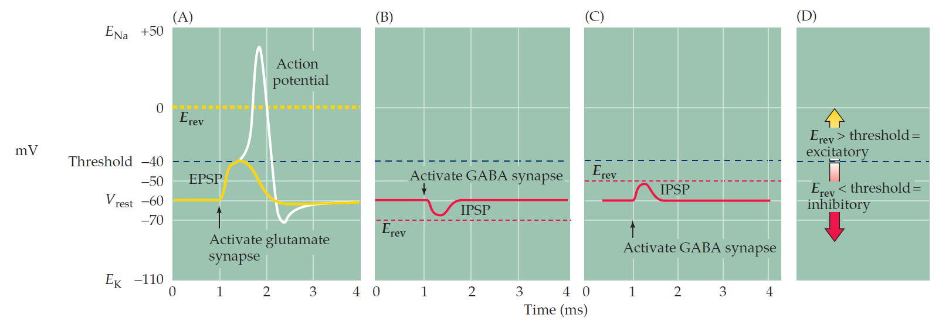
Inhibition regardless of PSP direction?
Depending on the cell’s Vm (or other factors such as [Cl-] in/out or neuromodulators) GABAergic current can cause hyperpolarization or depolarization.

Slide 14
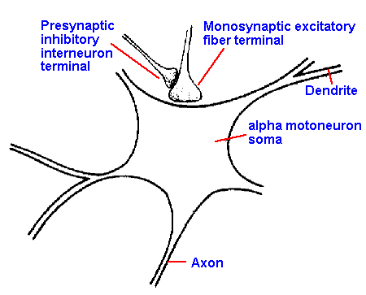
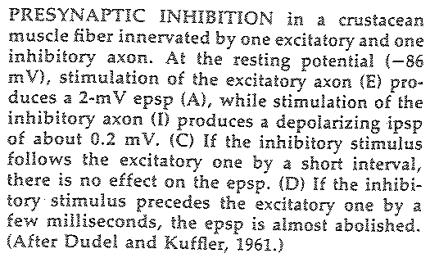
Presynaptic inhibition

