Slide 1
Slow synaptic potentials
Slow synaptic potentials
Neuromodulation
Synaptic integration

Slide 2
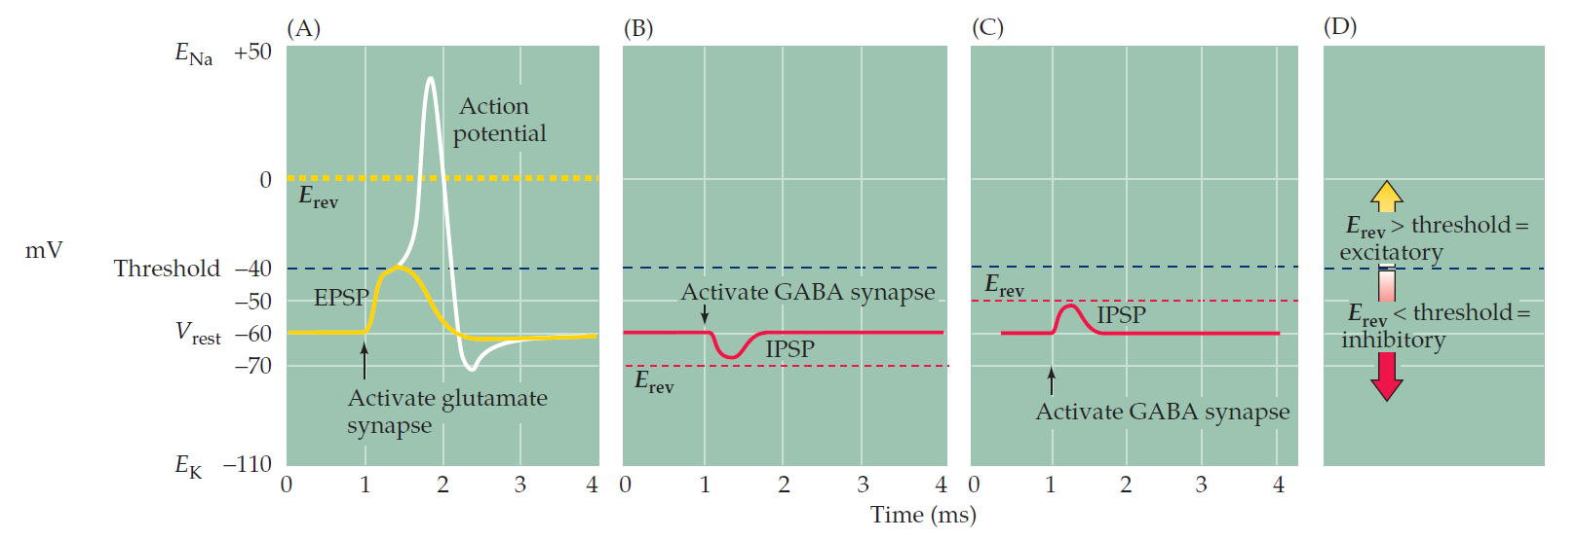
Fast (ionotropic) PSPs
EPSP: ACh (nicotinic), glutamate (AMPA, NMDA)
IPSP: GABA

Slide 3
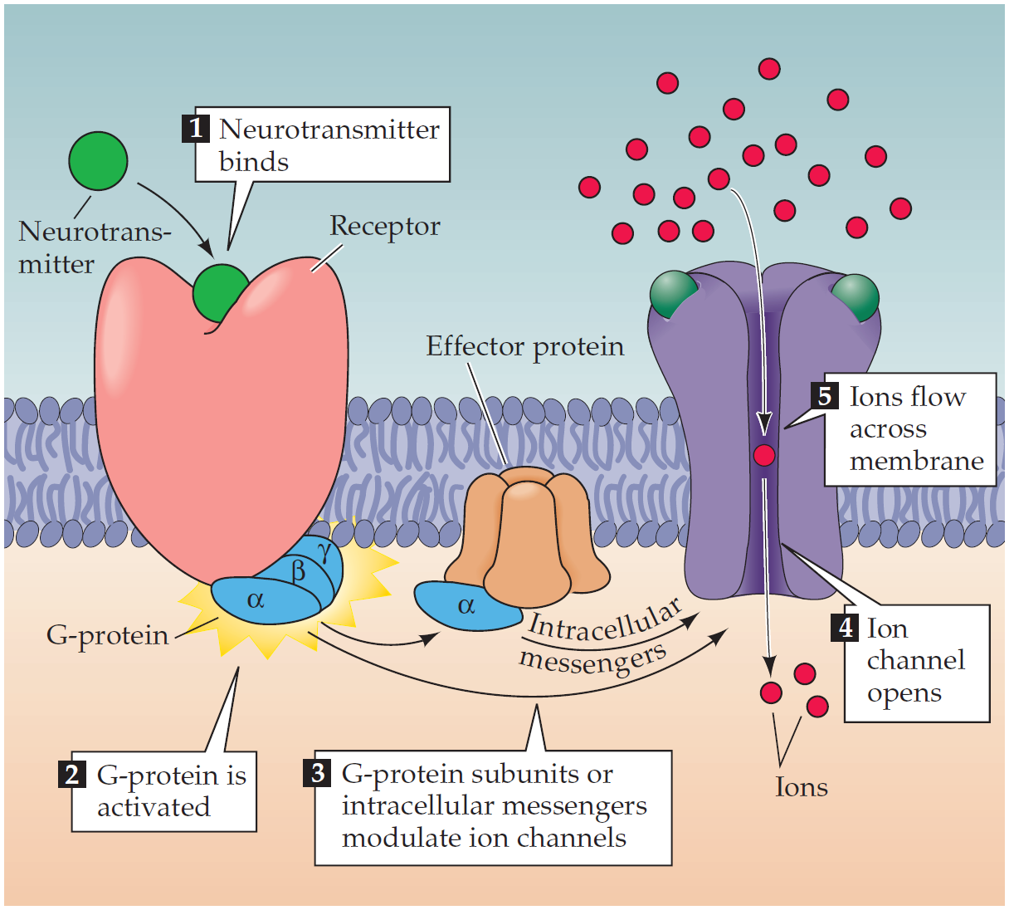
Slow (metabotropic) PSPs

Slide 4
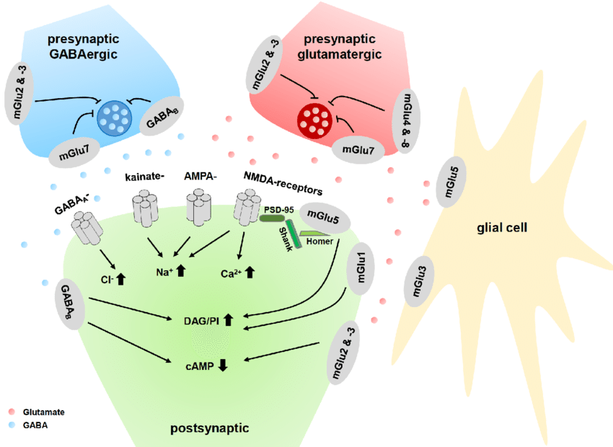
Metabotropic glutamate receptors (mGluRs)
Group I: Gq coupled, increases IP3, postsynaptic
Group II & III: Gi coupled, reduces cAMP, mostly presynaptic
Function: regulating NMDA receptor activation, synaptic plasticity

Slide 5
Metabotropic GABA receptors (GABAb)
Gi coupled, reduces cAMP, mostly postsynaptic
Function: produces an slow IPSP with an E(rev) = -100mV
regulates Ca2+ channels
opens K+ (GIRK – G-prot. activated, inwardly rectifying K) channels
Hackert et al, 2016

Slide 6
Neuromodulators
Dopamine
Serotonin
Norepinephrine
Histamine
Acetyl-choline
Adenosine
Opioids
Endocannabionids
Somatostatin
VIP
NPY
Choecystokinin (CCK)
Oxytocine
CRF
Substance P
Bradykynin
Etc etc etc.

Slide 7
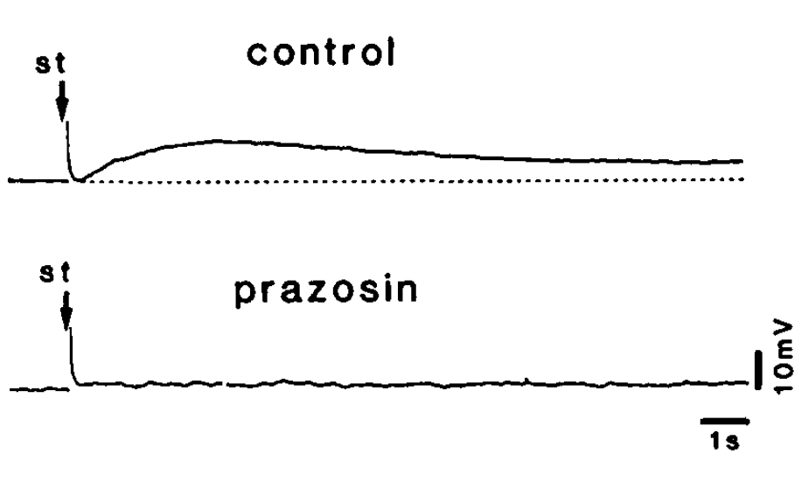
Norepinephrine in action
e.g.: NE decreases g(K+)
1) Sustained depolarization: enhanced sensitivity to incoming input
2) Interferes with AP repolarization
Yoshimura et al. 1987
Receptor specific actions of NE agonists
uEPSC_{AMPAR}
ΔCa²⁺_{NMDAR}
Lur et al. unpublished

Slide 8
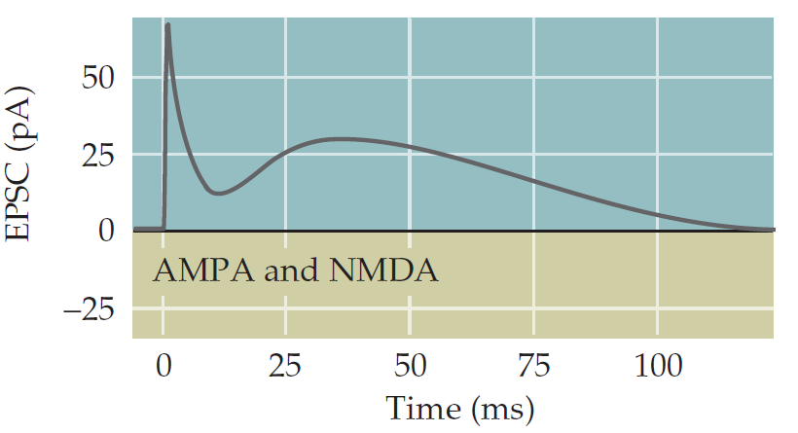
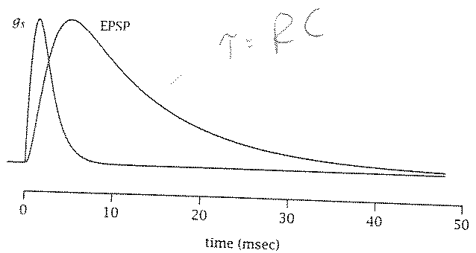
Synaptic integration
0 100 200 300 400 500

Slide 9
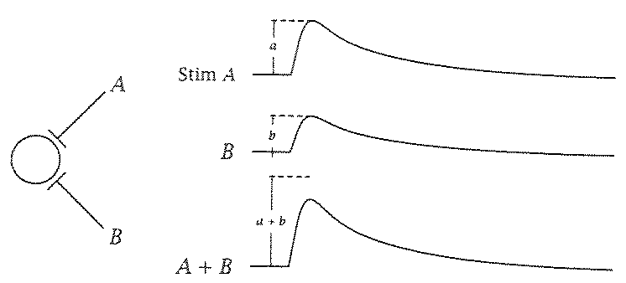
Spatial summation of synaptic inputs

Slide 10
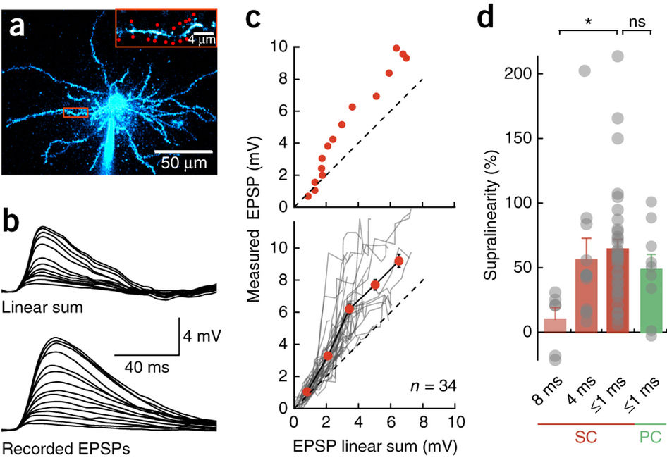
Supra-linear dendritic integration
Look for work by Jeff Magee and Michael Hausser

Slide 11
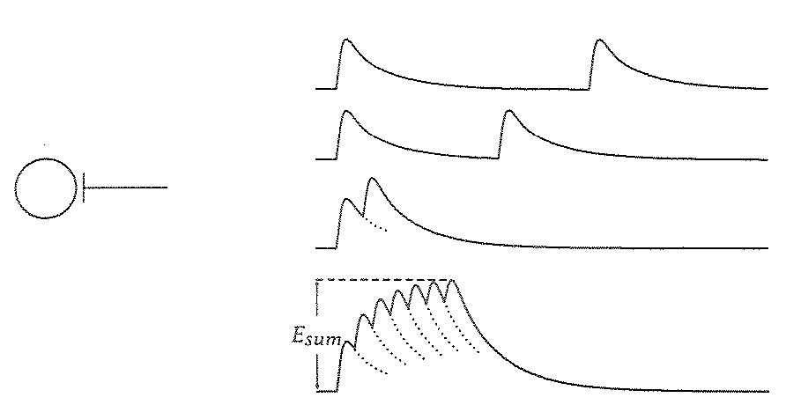
Temporal summation of synaptic inputs

Slide 12
Spatial and temporal summation of inhibition and excitation
Chiu & Lur et al. 2013

Slide 13
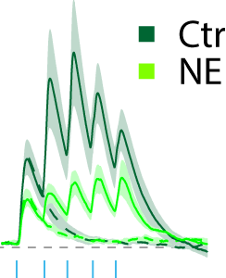
Note: neuromodulation alters both temporal and spatial summation.
L1
L2/3
L5
L6
Lur et al. unpublished

