Slide 1
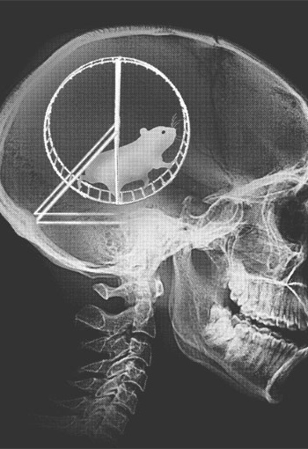
Action potential and synaptic transmission

Slide 2
Action potentials - I
equilibrium / resting potential
action potential
voltage-dependent membrane currents

Slide 3
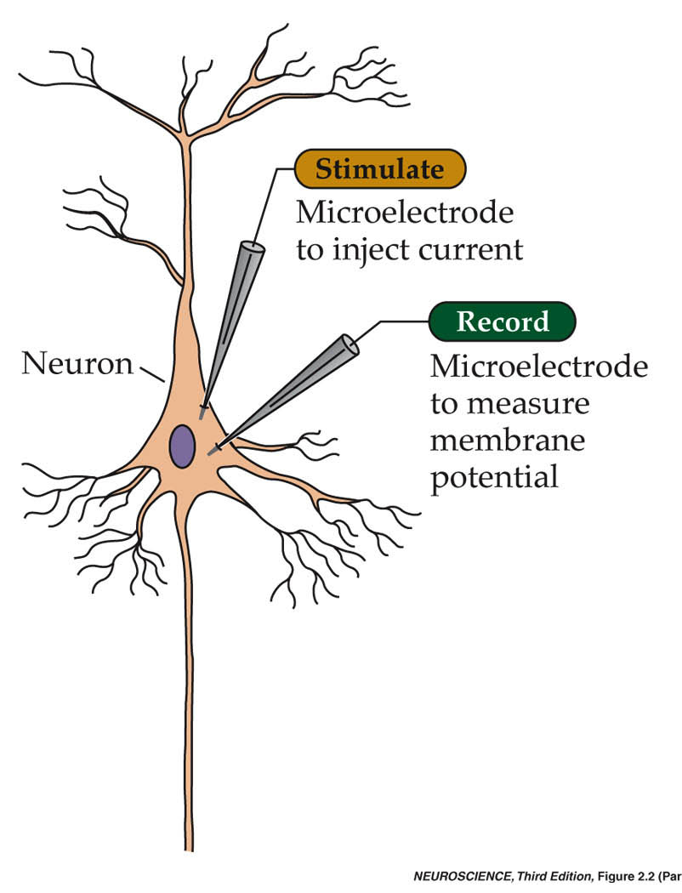
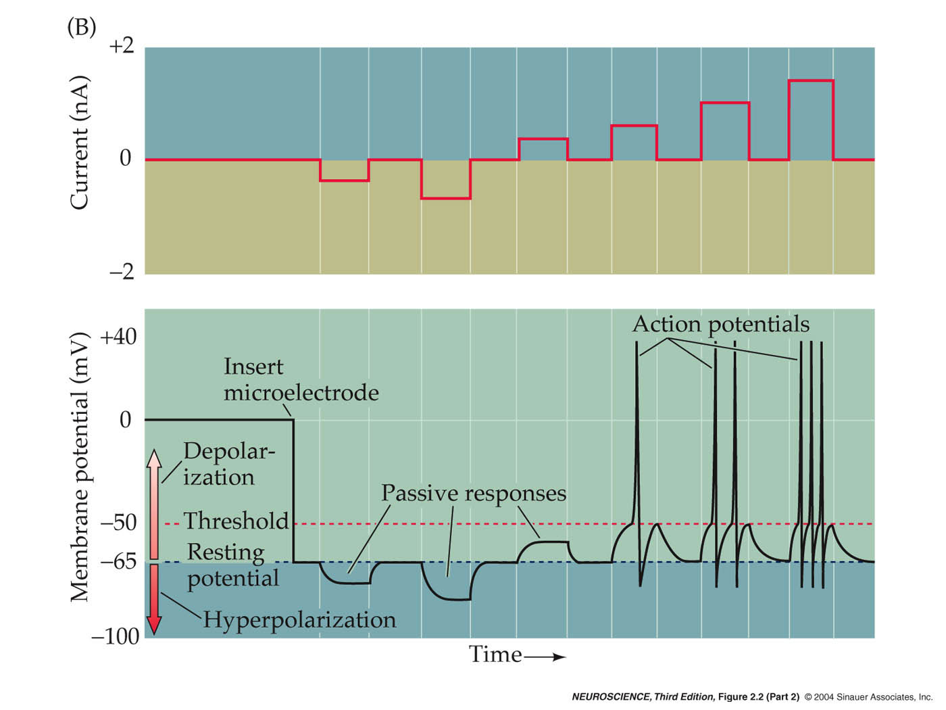
Passive and active electrical signals in neurons
Fig. 2.1

Slide 4
Ionic movements across a neuron’s membrane
Fig. 2.2

Slide 5
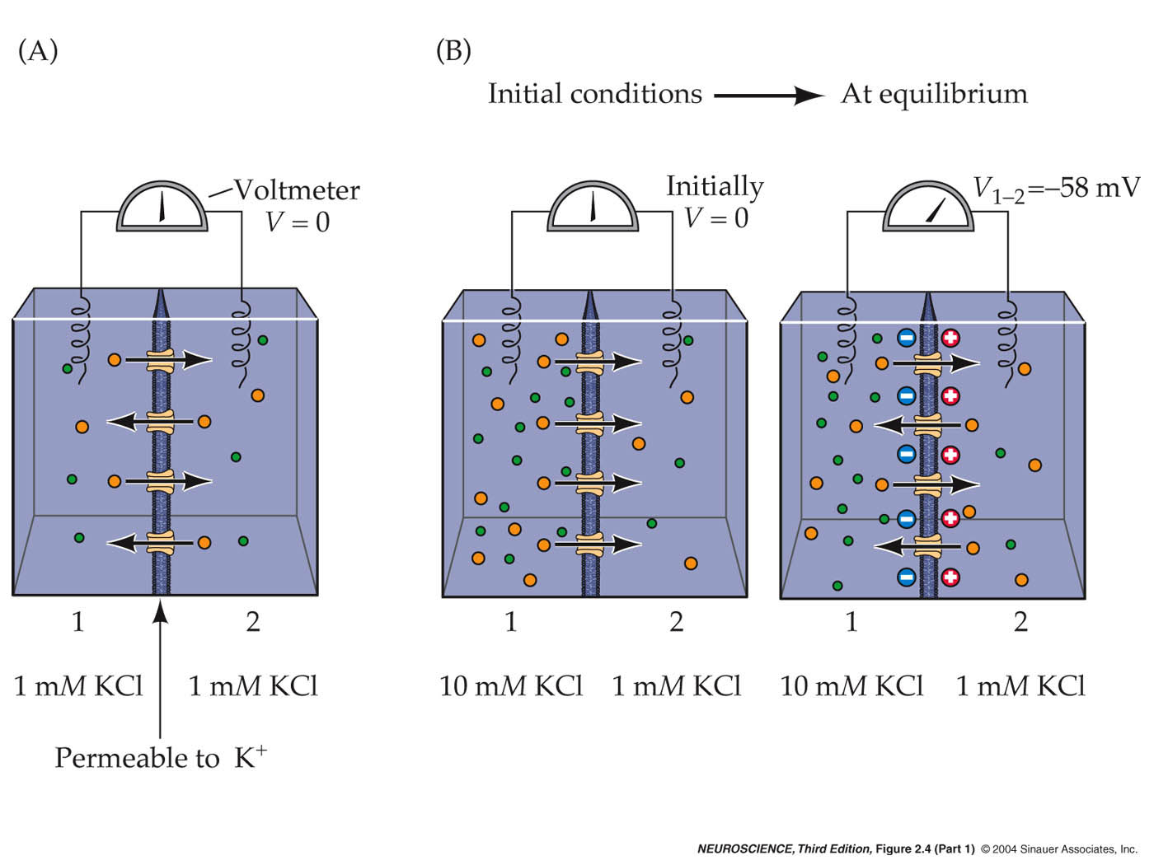
Generating the resting potential
Fig. 2.3

Slide 6
Nernst equation gives
“equilibrium potential” for K⁺
E_{K} = RT/Fz ln [K_{out} / K_{in}]
= 58 log [K_{out} / K_{in}]
= -58 mV (for 0.1 K⁺ ratio)

Slide 7
Manipulating the potential

Slide 8
What if we have more than one ion in the mix?
Goldman equation for K+, Na+ and Cl-:

Slide 9
In neurons, this mixed situation is exactly the case
Extracellular and Intracellular Ion Concentrations
Concentration (mM)
Ion Intracellular Extracellular
Squid neuron
Potassium (K+) 400 20
Sodium (Na+) 50 440
Chloride (Cl-) 40–150 560
Calcium (Ca2+) 0.0001 10
Mammalian neuron
Potassium (K+) 140 5
Sodium (Na+) 5–15 145
Chloride (Cl-) 4–30 110
Calcium (Ca2+) 0.0001 1–2

Slide 10
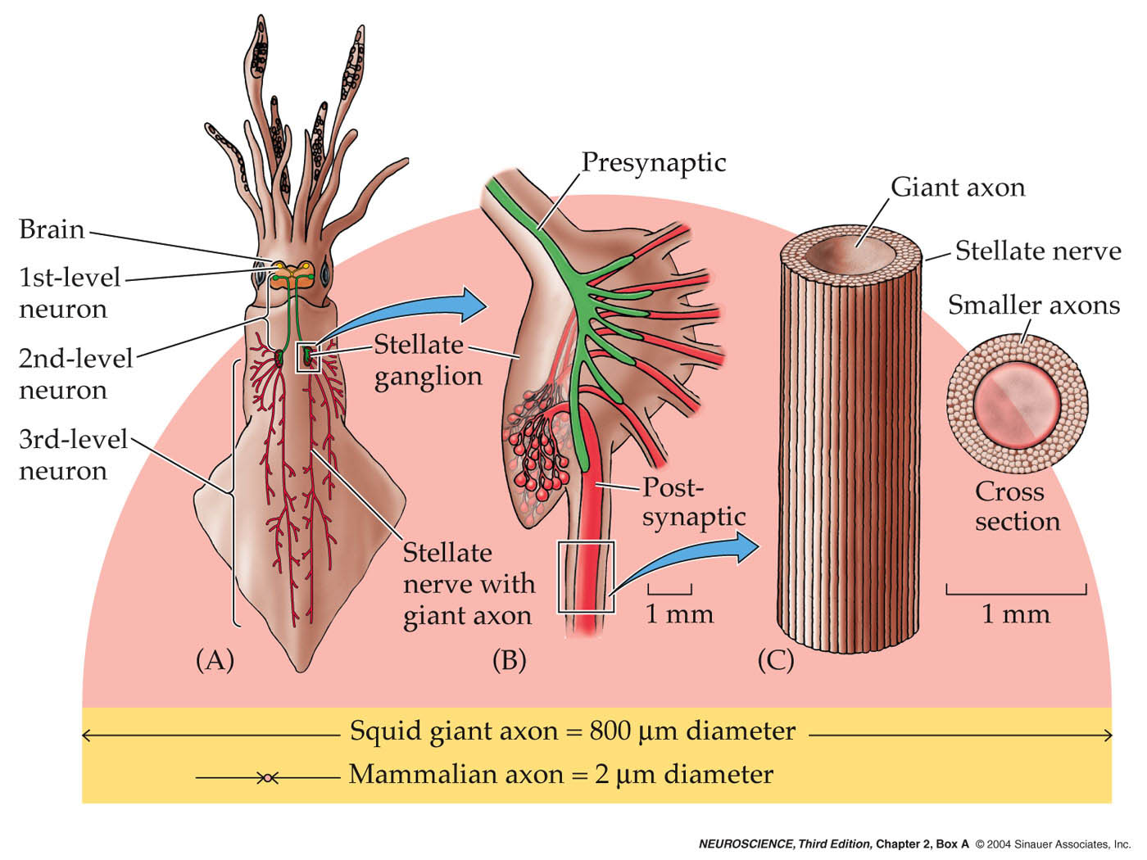
Giant squid axon
Box A, Ch. 2

Slide 11
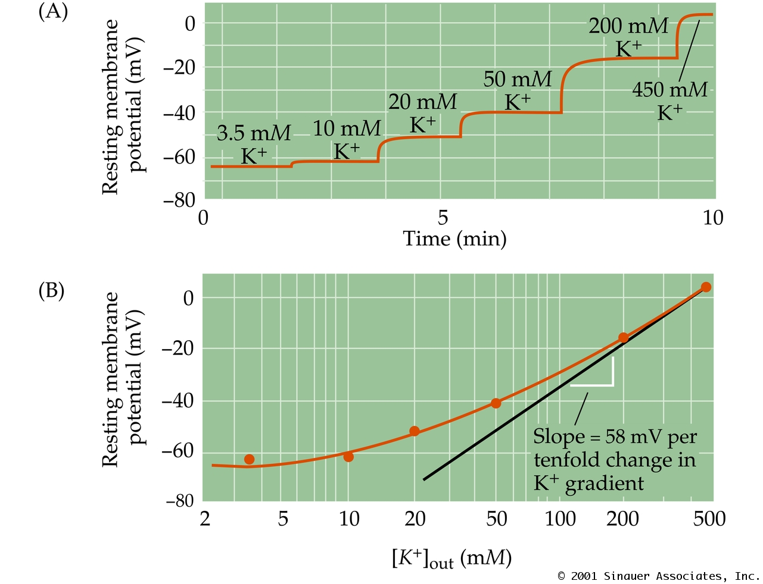
Measuring the K+ dependence of the resting membrane potential
Fig. 2.6

Slide 12
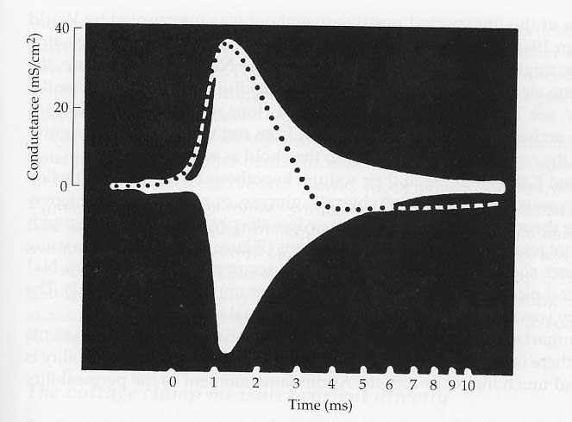
Action potential theory
1902, Bernstein - hypothesized: ii) general increase in membrane permeability could underlie action potential.
1939, Cole and Curtis - measured conductance during action potential.
from Cole and Curtis, 1939

Slide 13
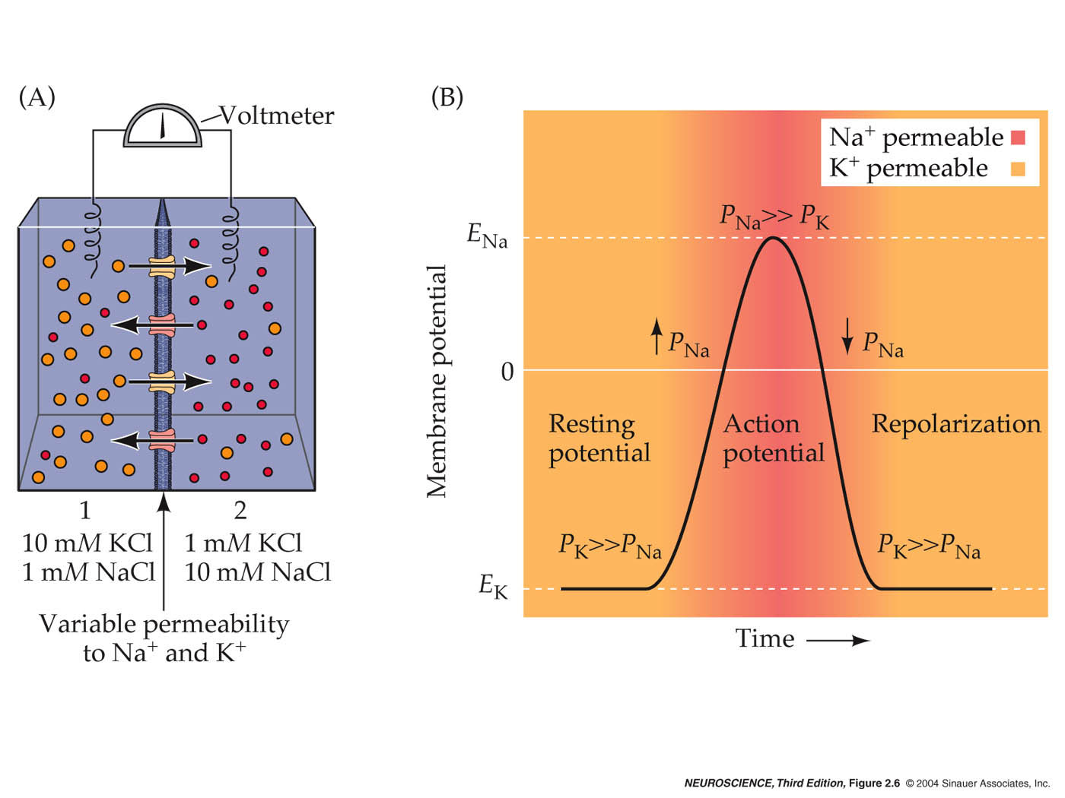
Action potential theory, part 2
Fig. 2.5

Slide 14
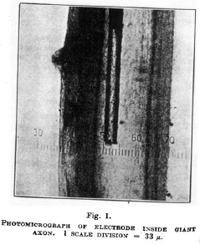
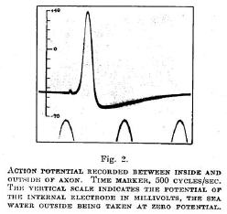
1939, Hodgkin and Huxley - direct recordings of action potential
from Hodgkin and Huxley, 1939

Slide 15
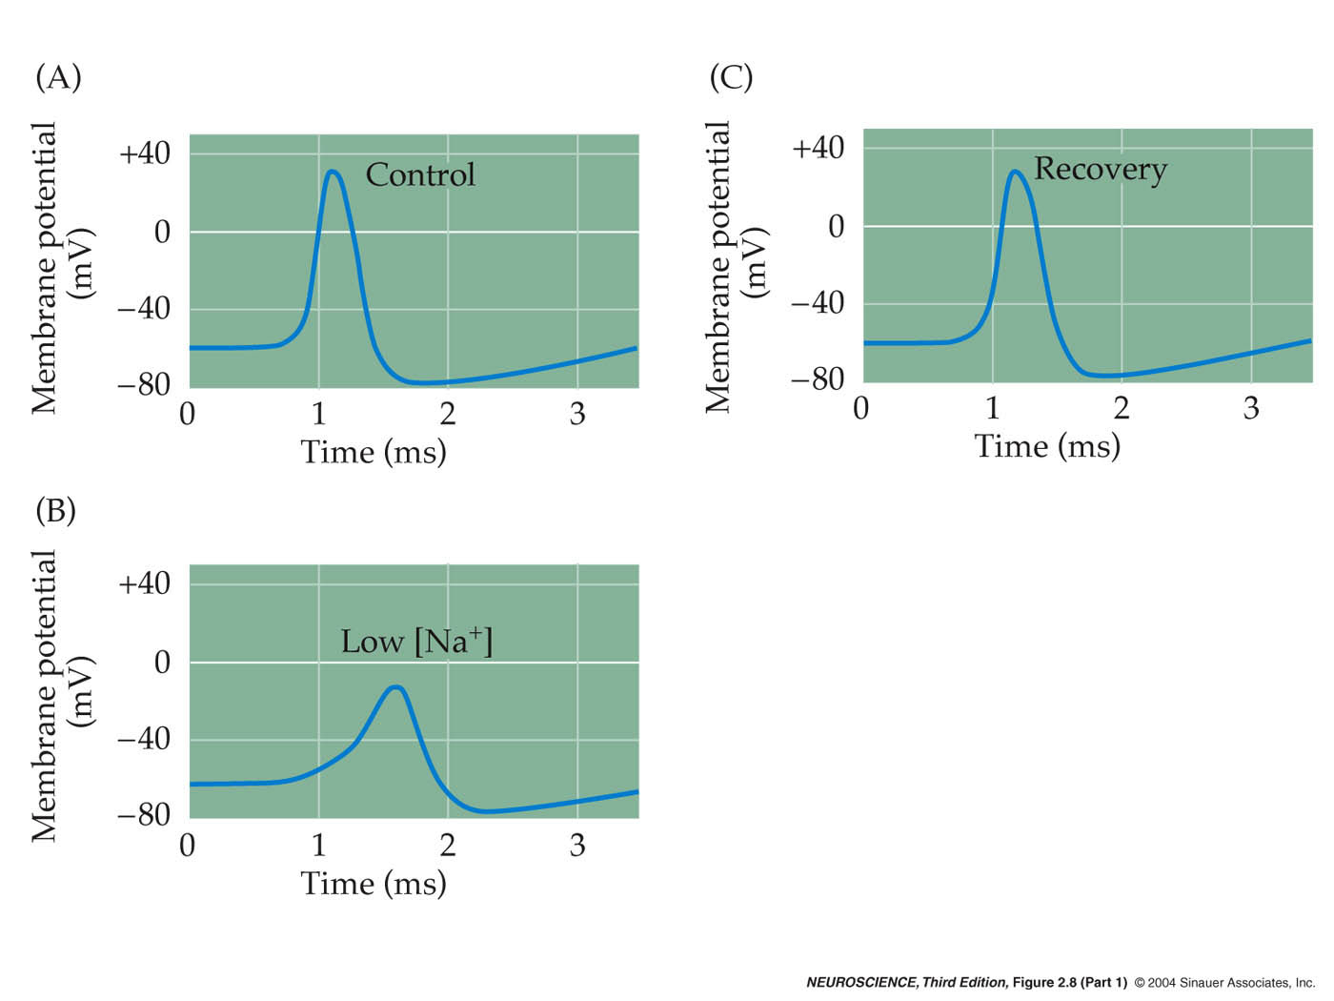
Changing [Na⁺]_{out} during action potentials
Fig. 2.7

Slide 16
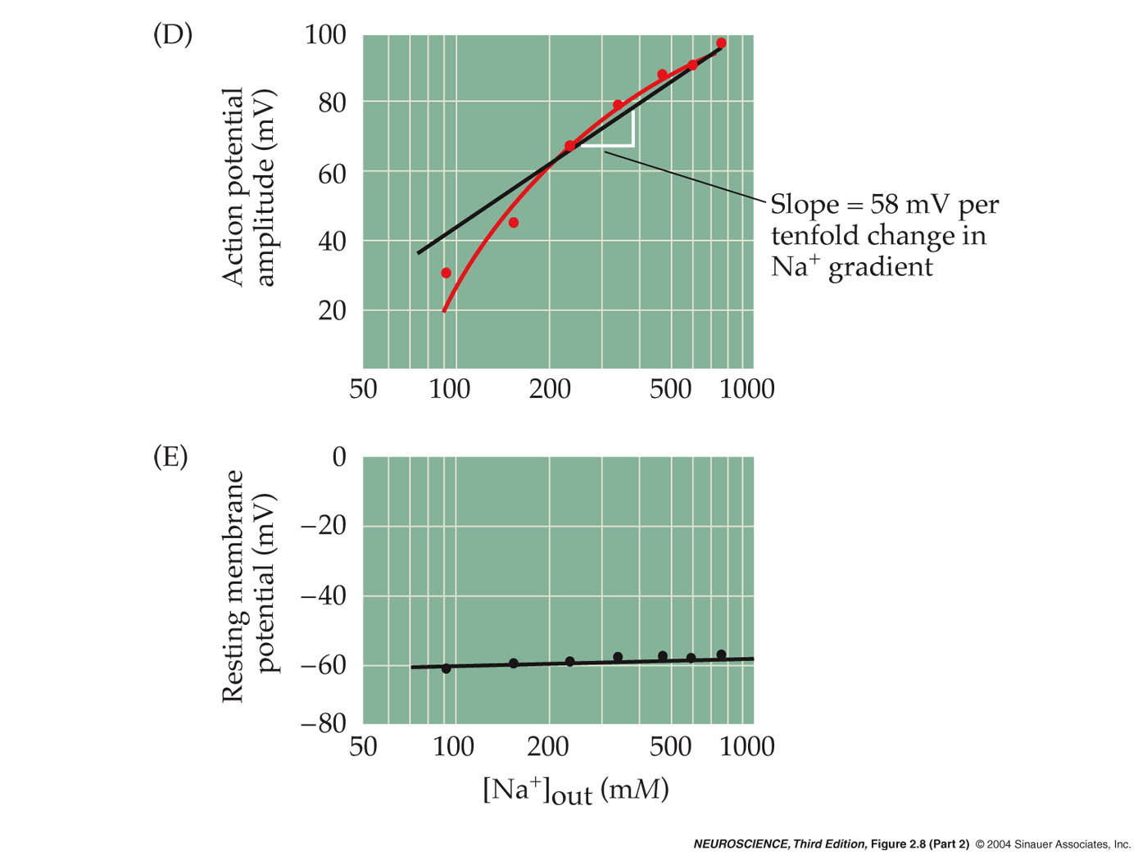
fig 2.7

Slide 17
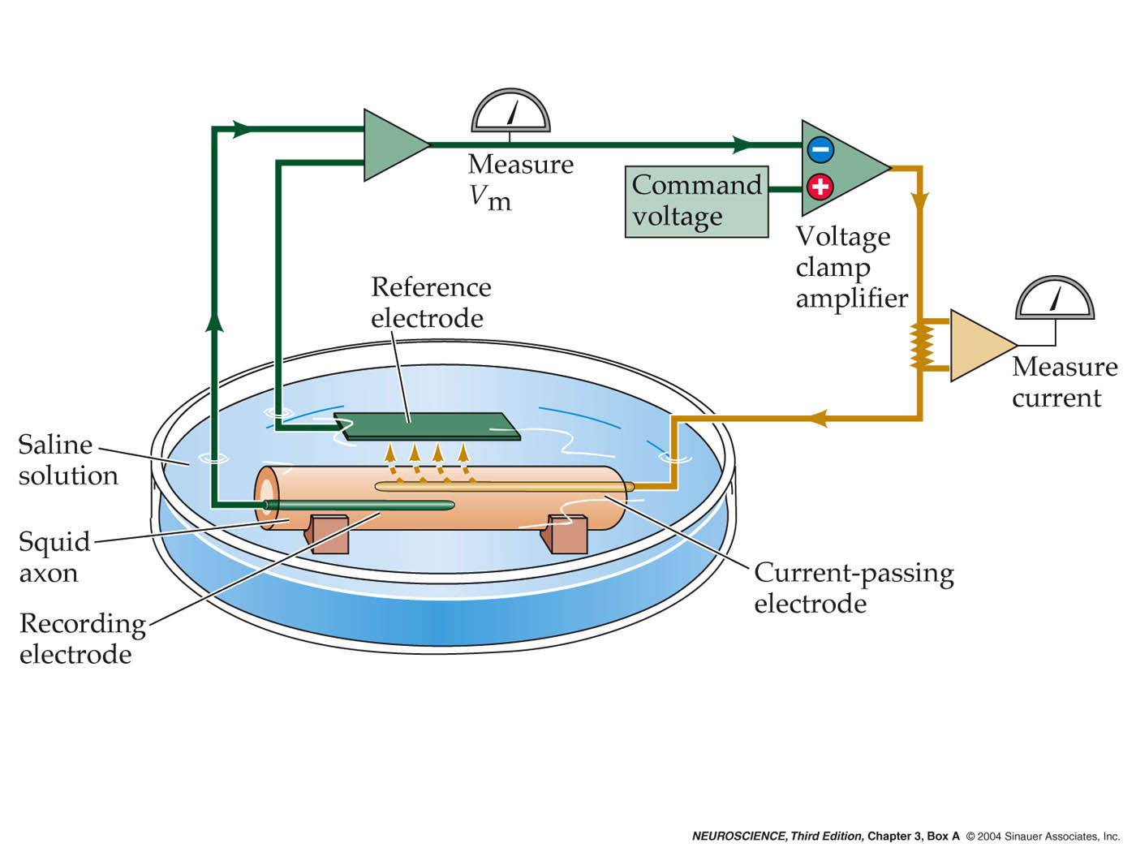
Voltage clamp
box A

Slide 18
Voltage clamp
Hypothesis: potential-sensitive Na+ and K+ permeability changes are both necessary and sufficient for the production of action potentials.

