Slide 1
Synaptic transmission
background history
electrical transmission
chemical transmission
the quantum hypothesis

Slide 2
History
    1900 Ramon y Cajal - Golgi stain revealed individual neurons
    Sir Charles Sherrington - ‘synapse’ in reflex arc
    1921 Otto Loewi - chemical transmission, ‘vagusstoff’ (ACh)
    1936 Henry Dale - identified ACh at nmj
    - argued for chemical transmission
    John Eccles - argued for electrical transmission
    1950s Bernard Katz et al - mechanisms of chemical transmission
    Eventually, both electrical and chemical synapses accepted (EM).

Slide 3
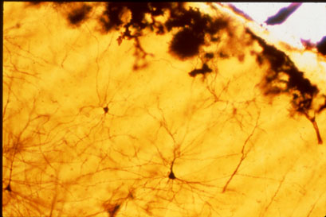
Visualizing neurons
Golgi stain

Slide 4
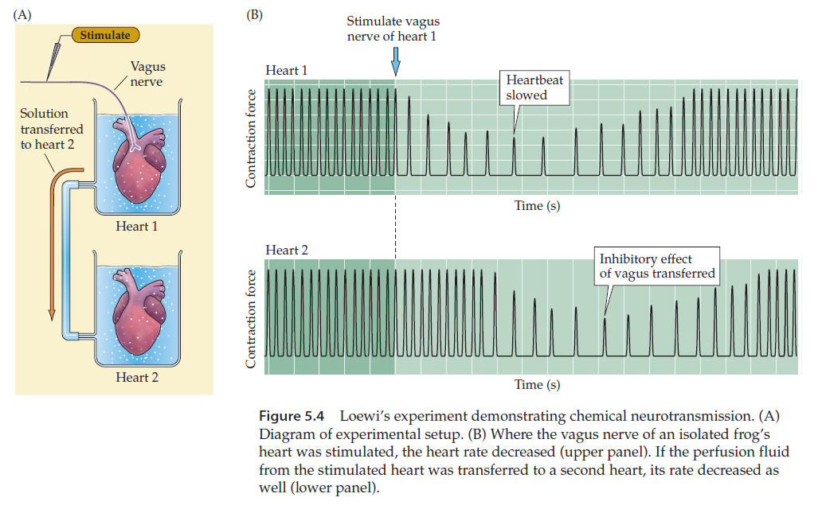
Demonstration of chemical transmission

Slide 5
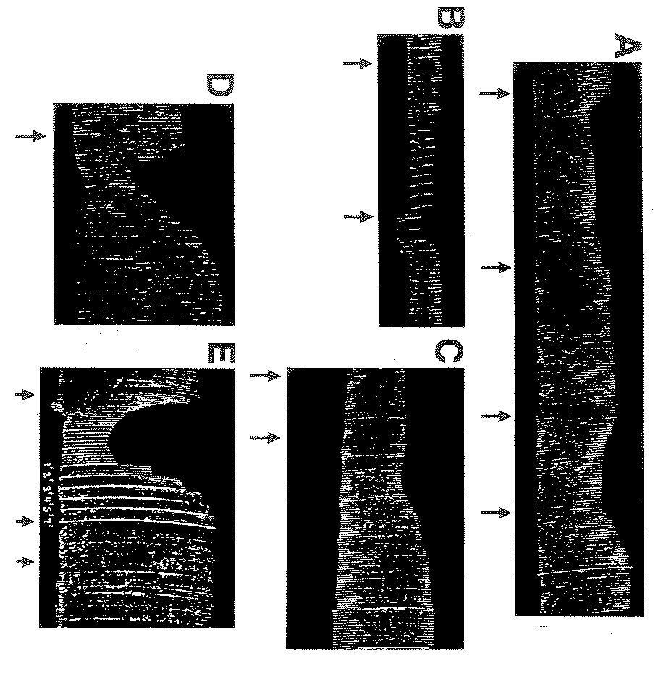
The actual experiments
1
2
3
4
1: Ringer from stimulated donor
2: ringer from un-stimulated donor
3: Ringer from stimulated donor
4: + atropine
1: Ringer from stimulated donor heated to 55C then left for 3 hours before adding to recipient heart
2: ringer from stimulated donor that was left at room temperature for 3 hours
1 2

Slide 6
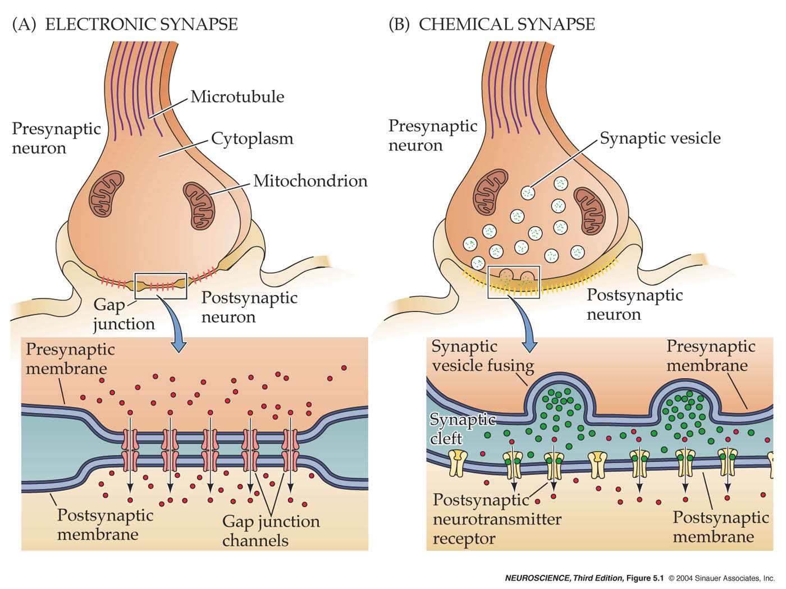
Synapse types

Slide 7
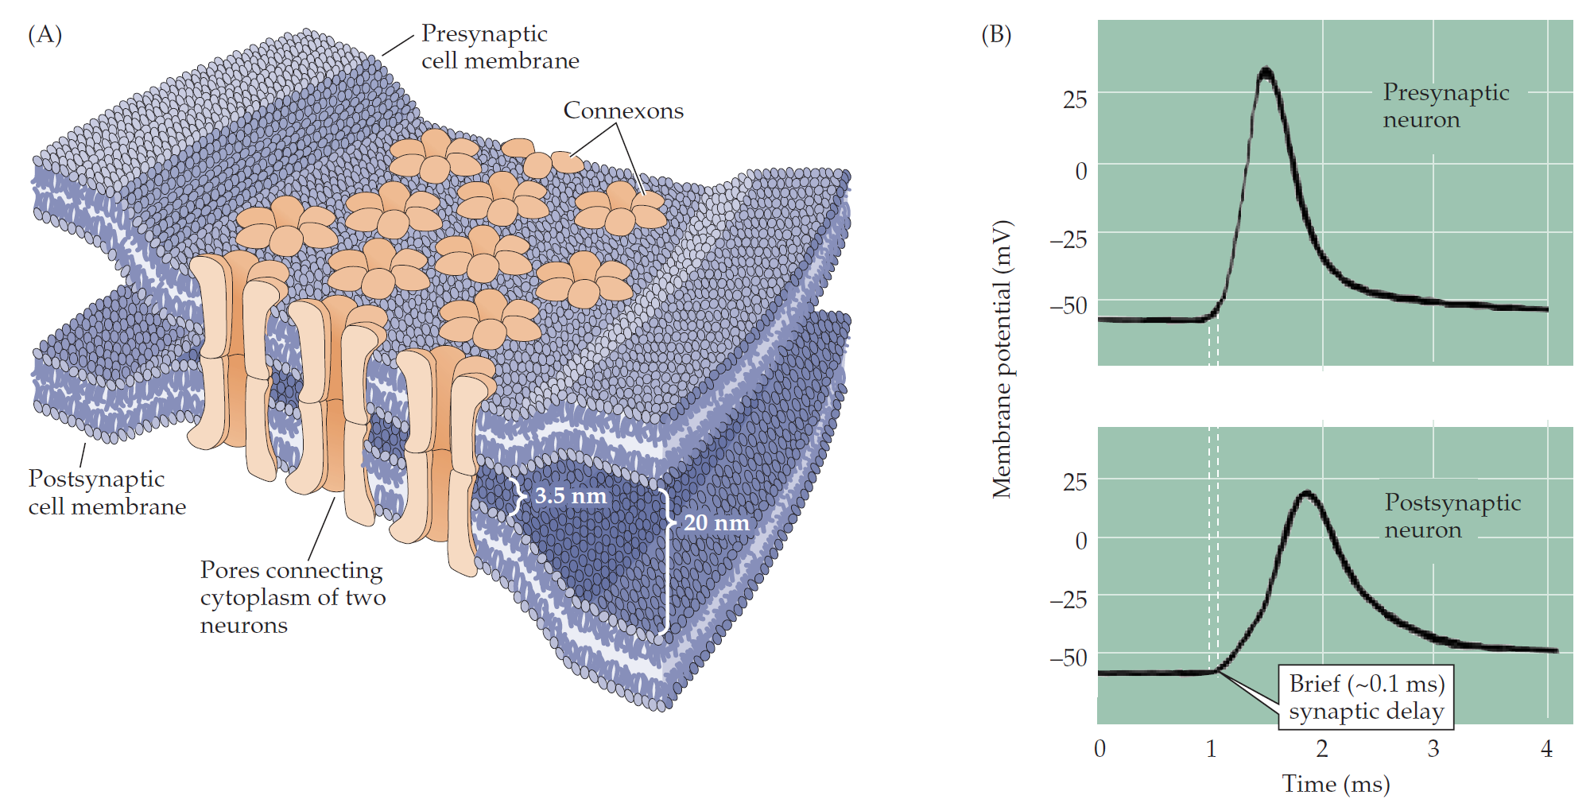
The electrical synapse

Slide 8
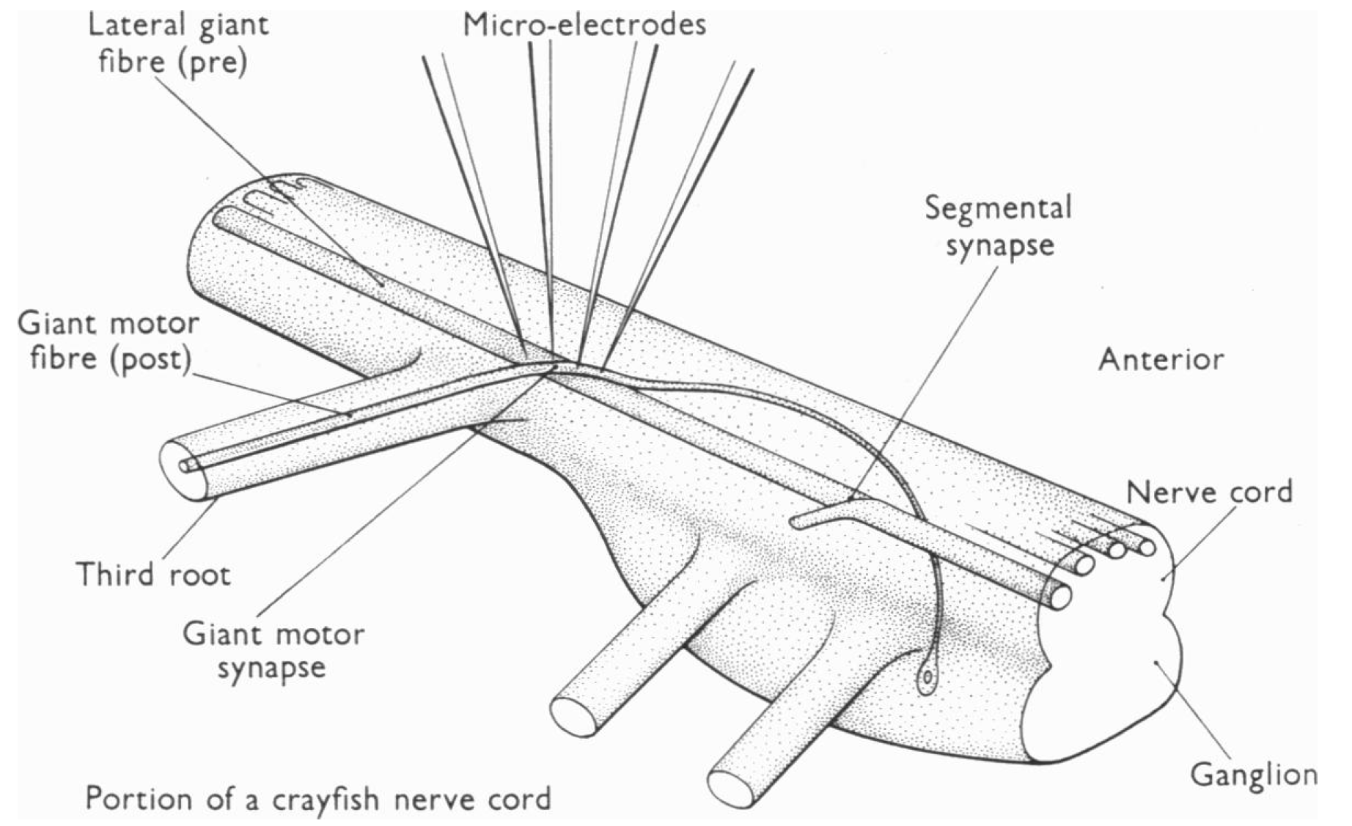
Crayfish giant motor synapse
A
B

Slide 9
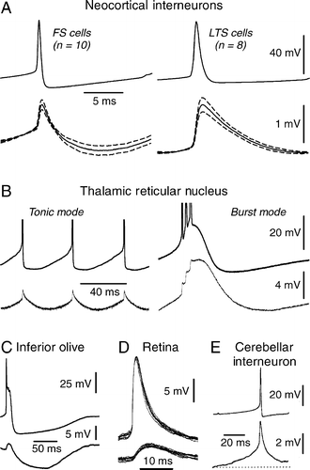
Mammalian examples of electrical synapses

Slide 10
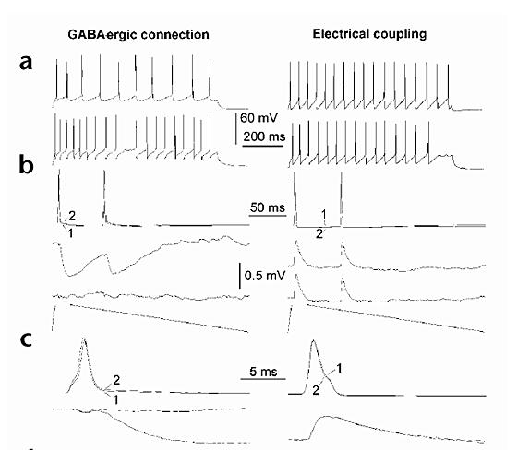
Electrical vs chemical transmission
bicuculline
(20 μM)
Tamas G. et al. Nature Neuroscience 2000

Slide 11
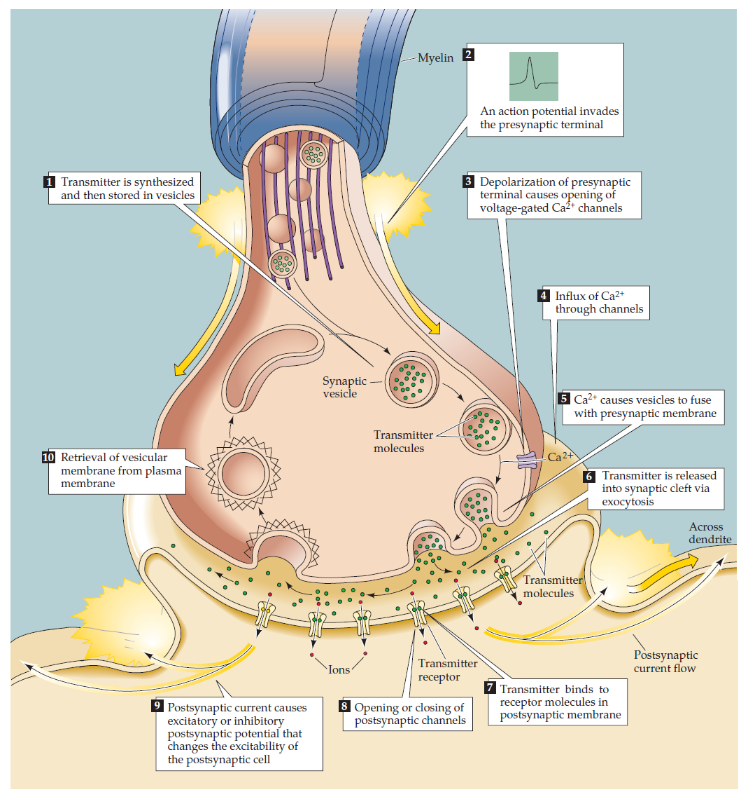
The chemical transmission – anatomy

Slide 12
Electrical vs chemical transmission

Slide 13
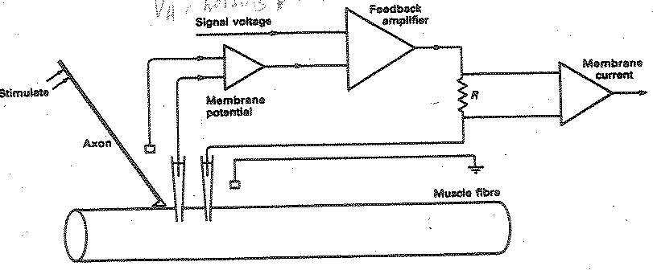
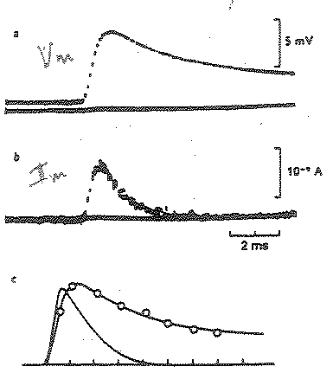
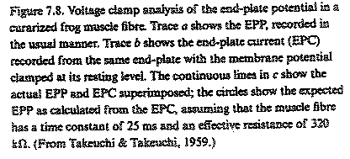
Chemical transmission – voltage clamp in frog muscle

Slide 14
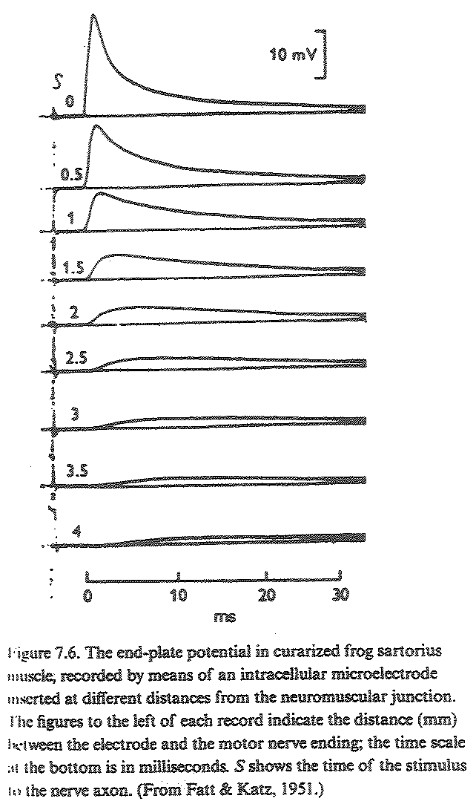
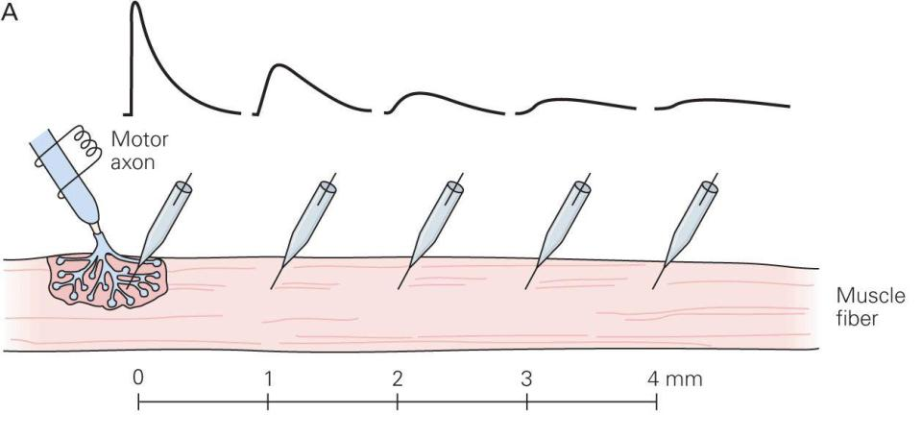
Chemical transmission – local end plate potential (EPP)

Slide 15
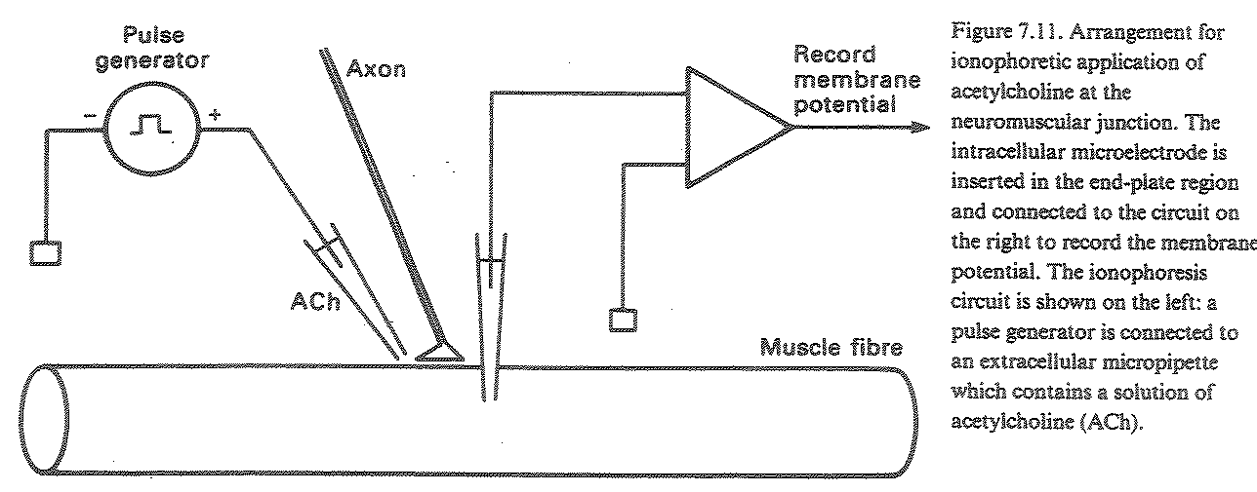
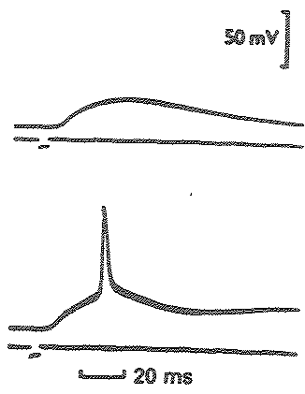
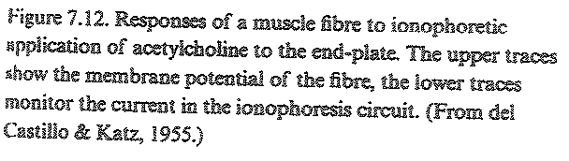
Chemical transmission – ACh application on the frog muscle

Slide 16
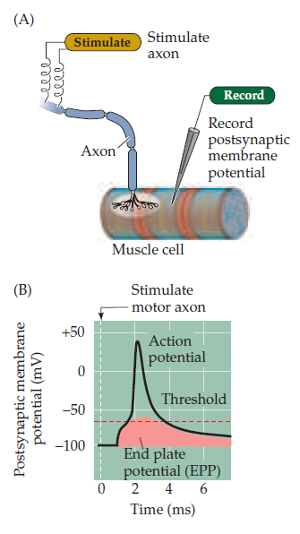
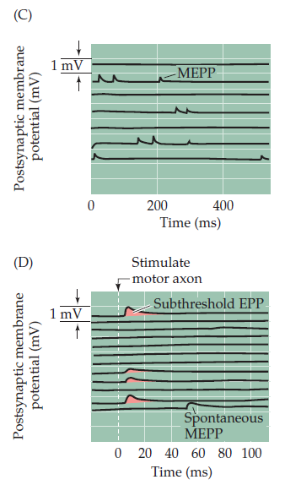
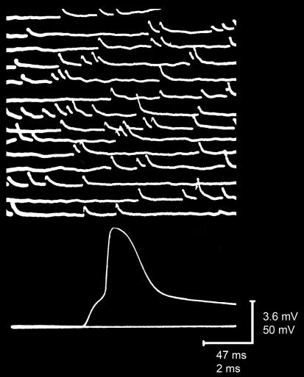
Chemical transmission – EPP recordings
Original recording

Slide 17
Miniature end plate potentials (MEPPs)
Same time course as EPPs
Only detectable at the endplate region
Not in denervated muscle
Blocked by curare (nAChR)
Increased frequency by prostigmine (acetylcholinesterase blocker)
Spontaneous release of a single packet of ACh

