Slide 1
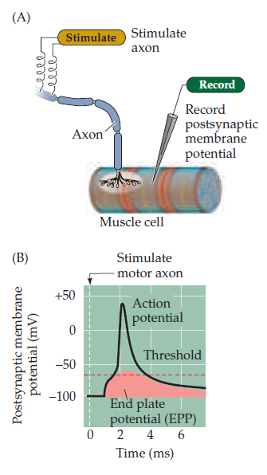
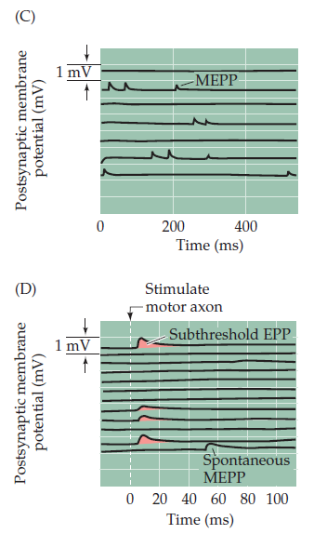
Chemical transmission – EPP recordings

Slide 3
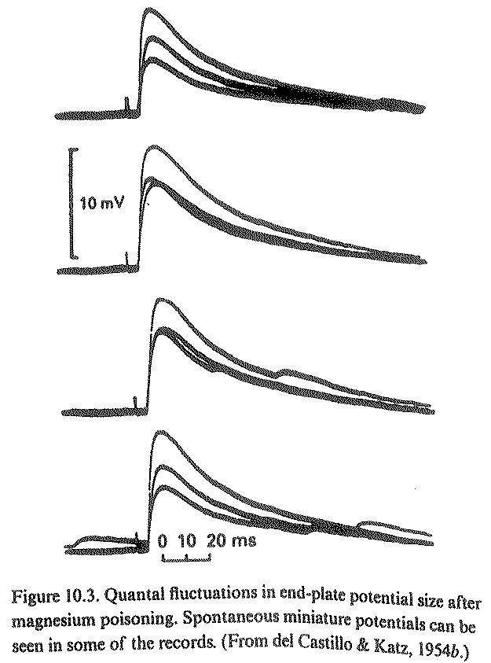
Fluctuation in EPP amplitude

Slide 4
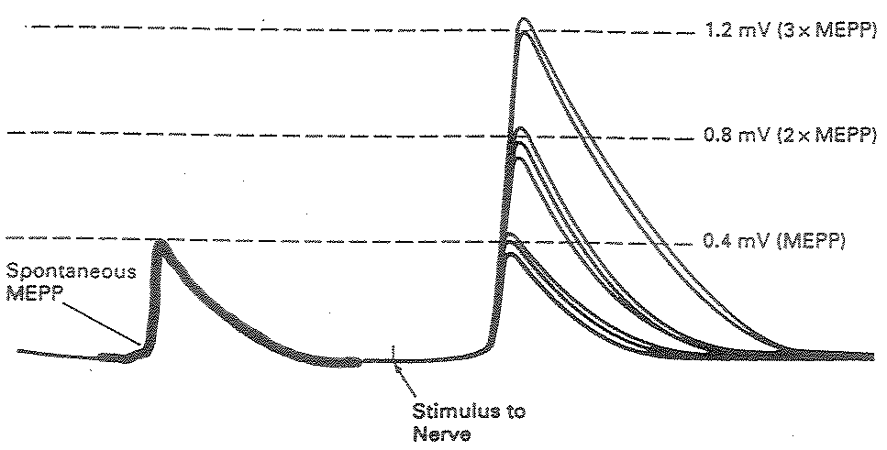
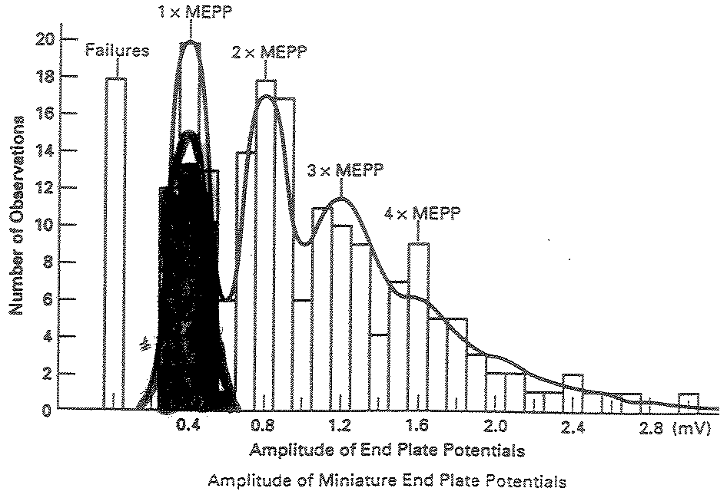
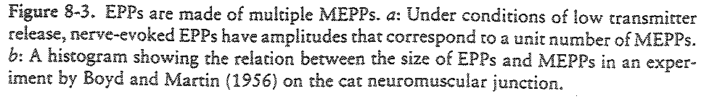
Quantal fluctuations of EPP amplitude

Slide 5
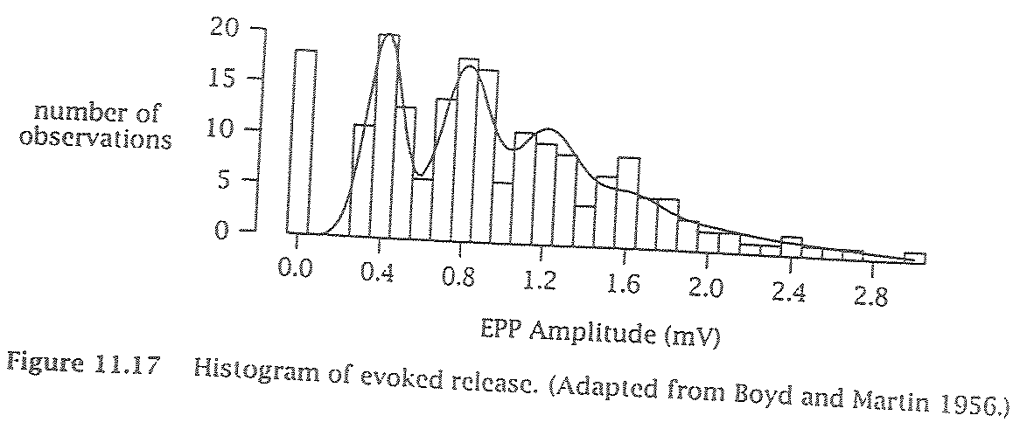
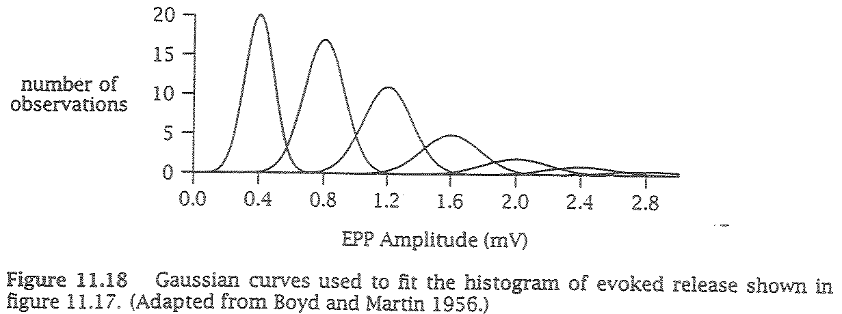
Statistical estimation of EPP amplitude distribution

Slide 6
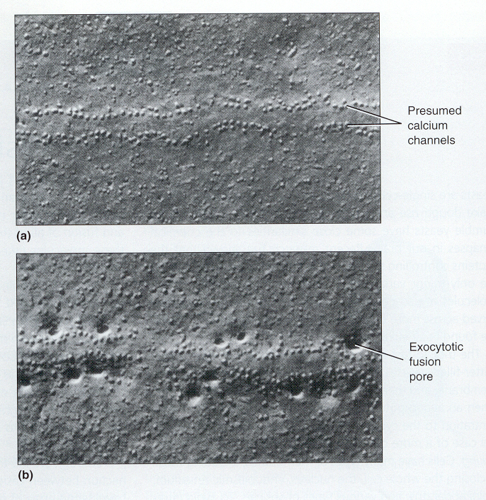
Correlating vesicle fusion with quantal content

Slide 7
Quantum Hypothesis
(del Castillo and Katz, 1954)
units of release are quanta (contents of single vesicle)
evoked response in multiples of quanta
m = np
m, quantal content (# of units released)
n, total # of available units
p, probability of release

Slide 8
Quantal analysis
Characterizing the quantal properties gives insight into the function of a given synapse:
NMJ: m=~200, p=high → stimulus = contraction
CNS: m=1, p=variable → synaptic integration

Slide 9
Ca²⁺ and release
Postsynaptic potentials (PSPs)
Ca²⁺ requirement for synaptic transmission
Short term synaptic dynamics

Slide 10
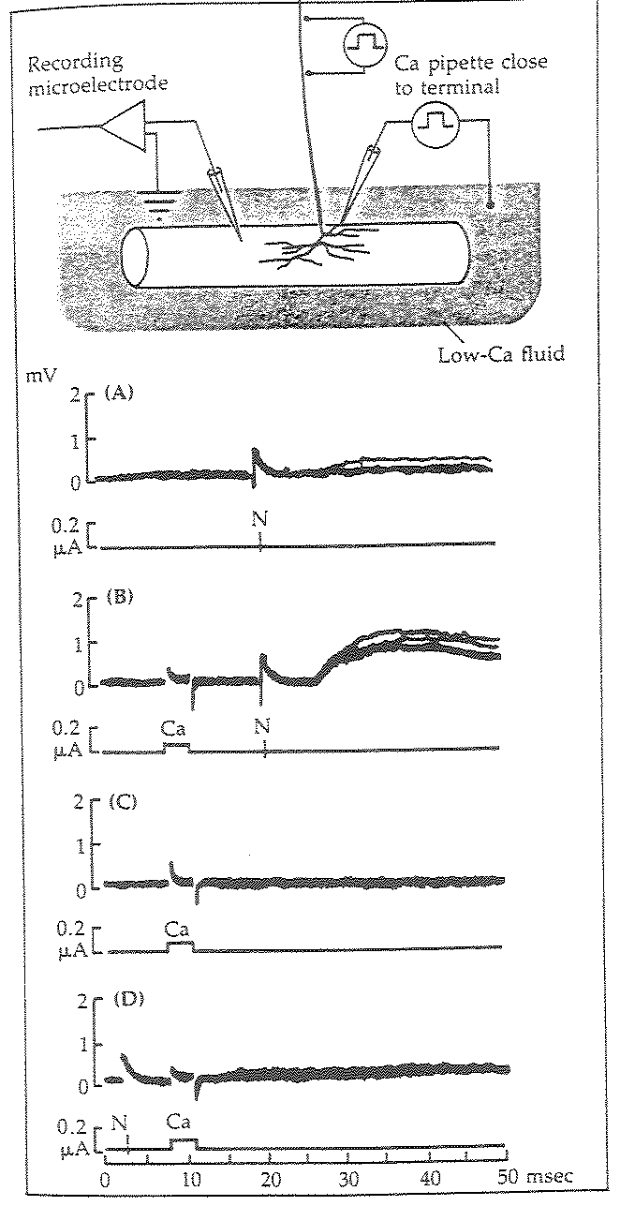
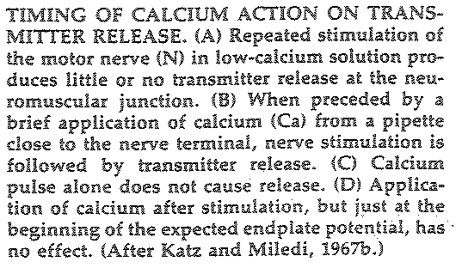
The role of calcium

Slide 11
Evidence for the Ca2+ hypothesis
Ca2+ injection induces release
Ca2+ buffer (BAPTA) injection eliminates release
Ca2+ in the presynaptic terminal

Slide 12
More Ca2+ = more release
Dodge et al. 1967

Slide 13
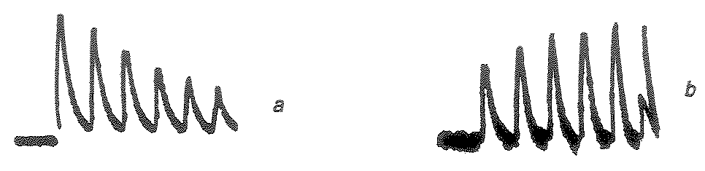
Short-term dynamics of synaptic release
2.5mM Ca2+ outside
0.28mM Ca2+ outside
Short term facilitation: “Residual Calcium Hypothesis” (Katz and Miledi): Increased transmitter release is due to residual Ca2+ within the axon terminal, still bound to the vesicle release mechanisms (helps trigger the next release cycle)
Short term depression: frequent (or strong) stimulation depletes the pool of releasable vesicles (“readily releasable pool”)
Usually: high probability of release leads to depression, low probability of release leads to facilitation

