Slide 1
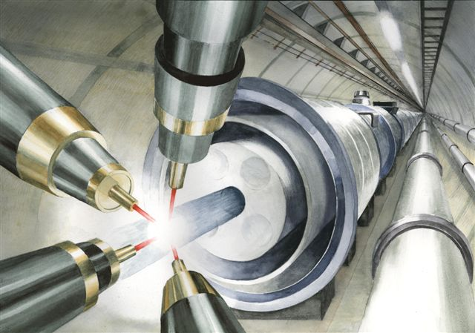
`
Opening:
Miniworkshop on
Plasma Astrophysics and Extreme High Energies
Department of Physics and Astronomy
University of California at Irvine
Feb. 6, 2017
Toshiki Tajima, Organizer
Norman Rostoker Chair Professor, UC Irvine

Slide 2
Mission
Exchange Ideas between plasma physics and science of extreme high energies (s.a. astrophysics, high energy)
Exchange technology between the two communities (s.a. laser)
Any new ideas?

Slide 3
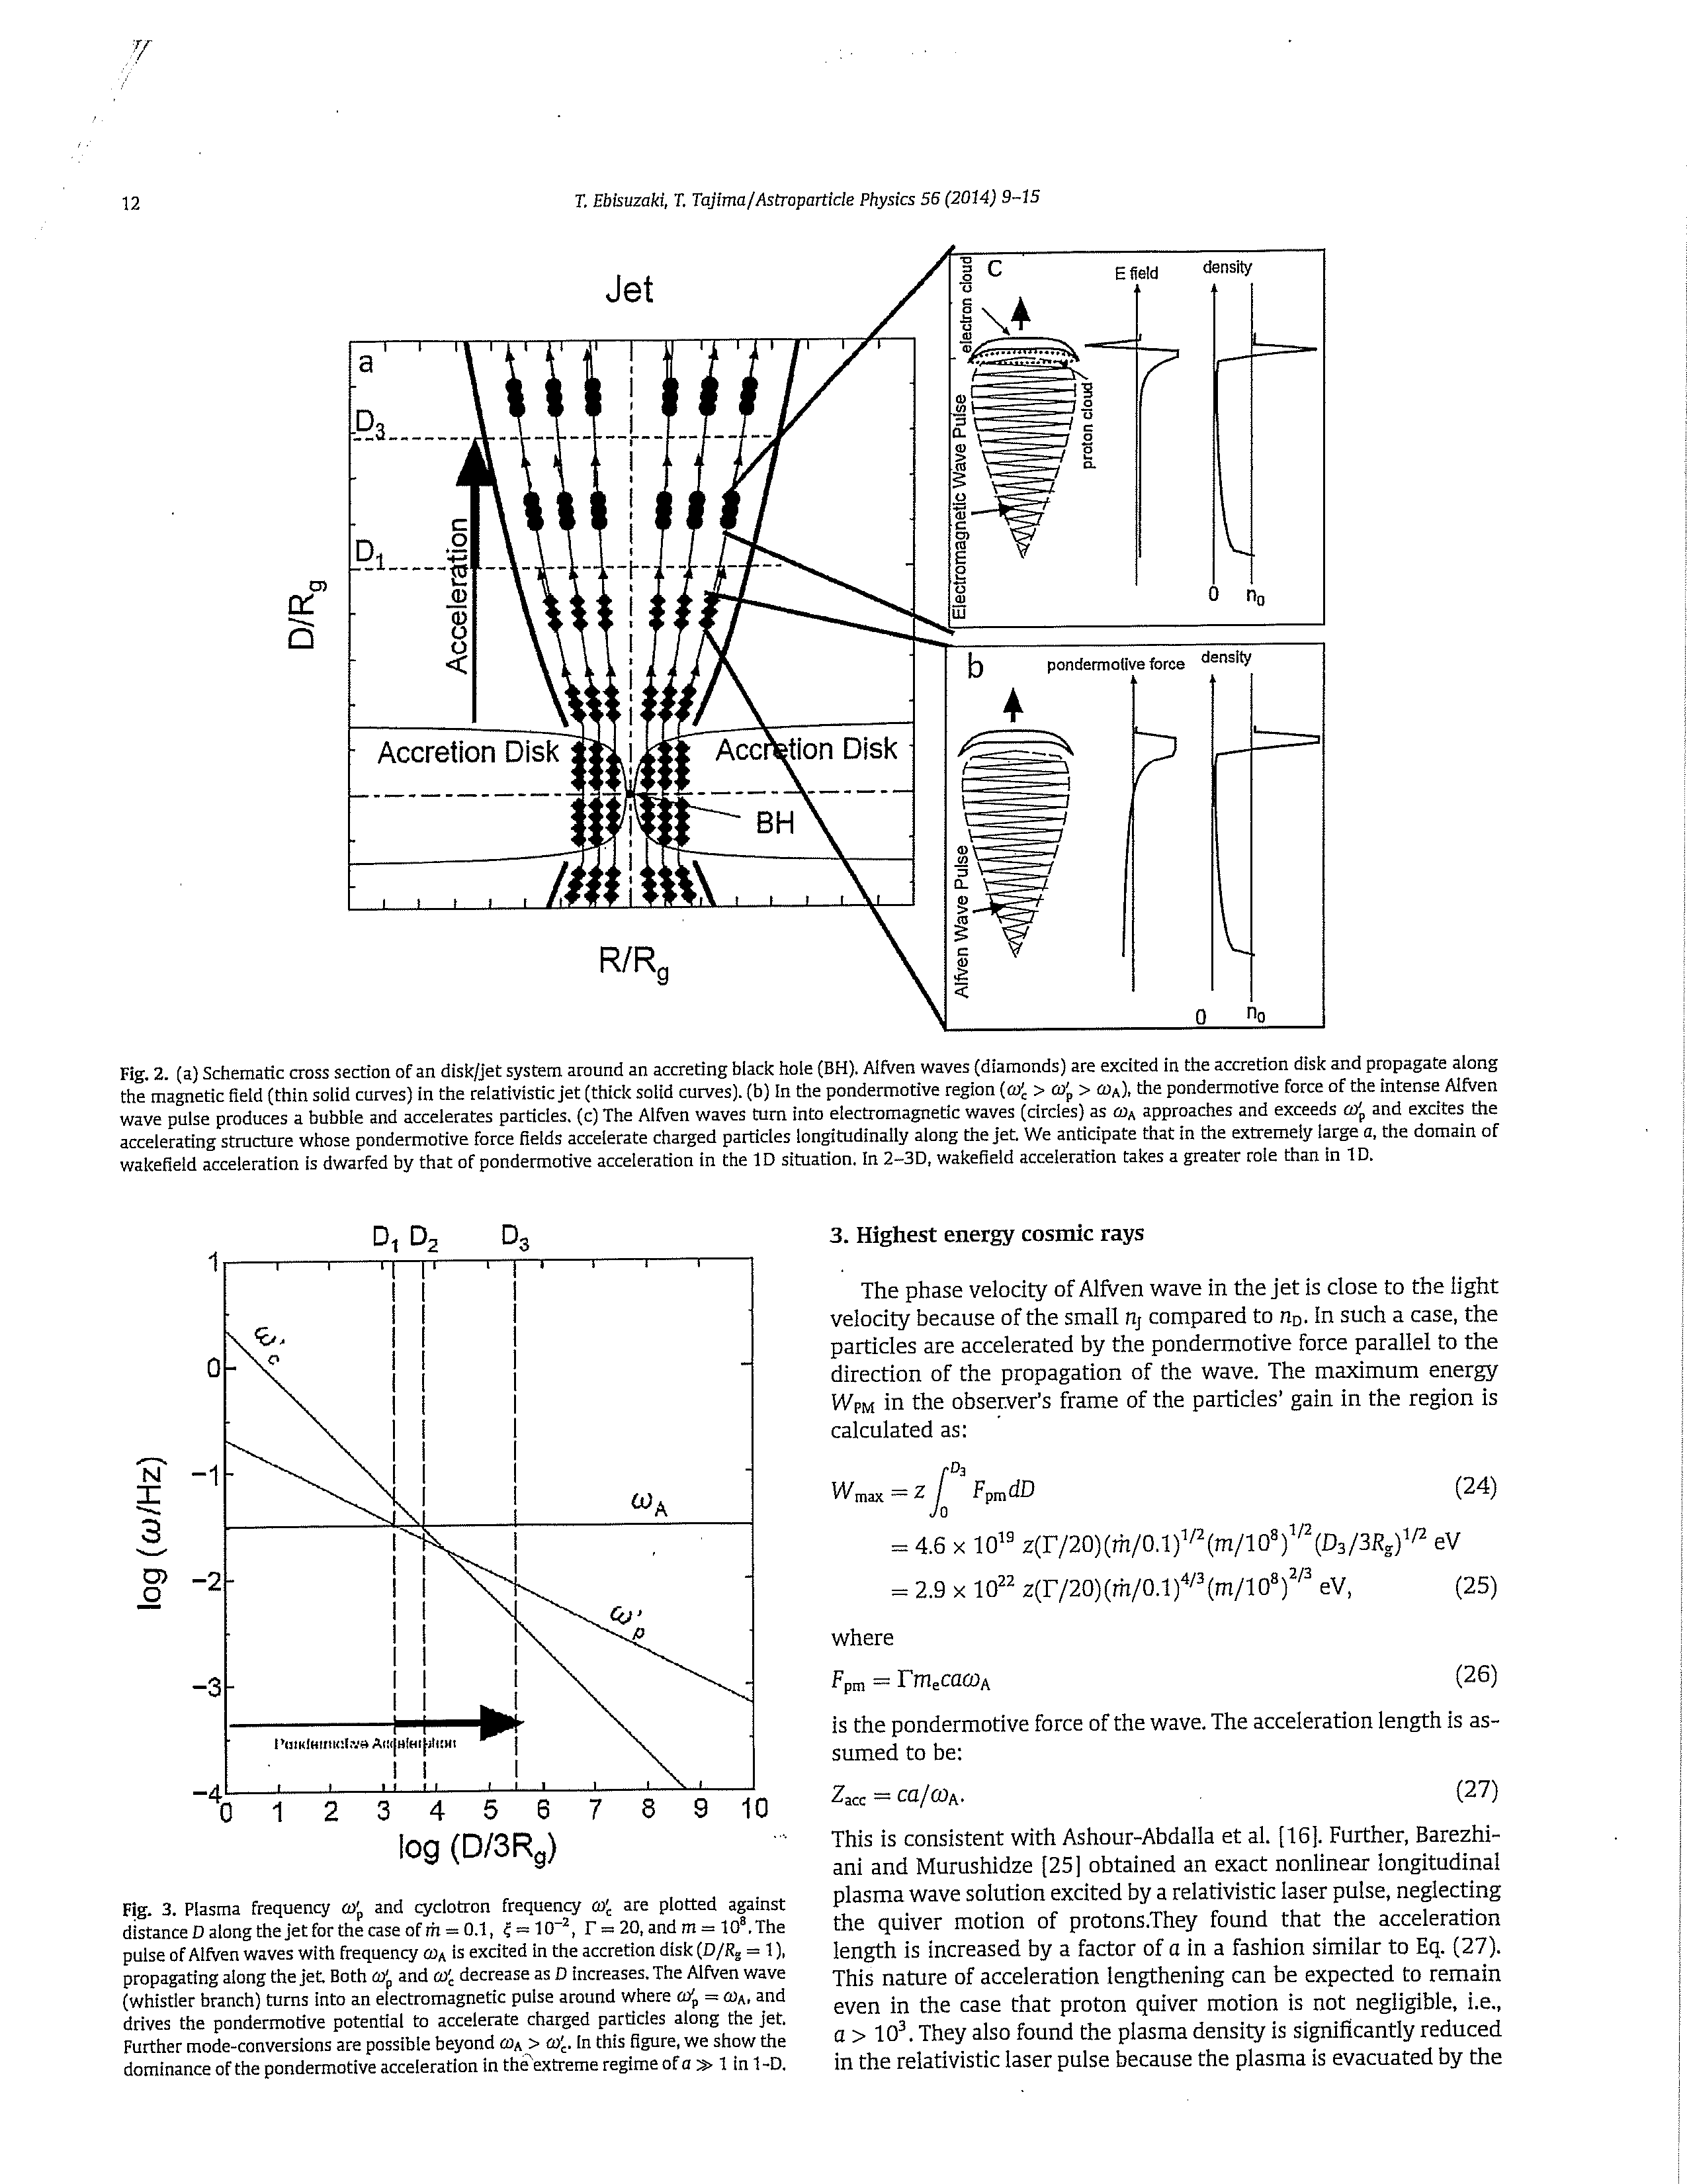
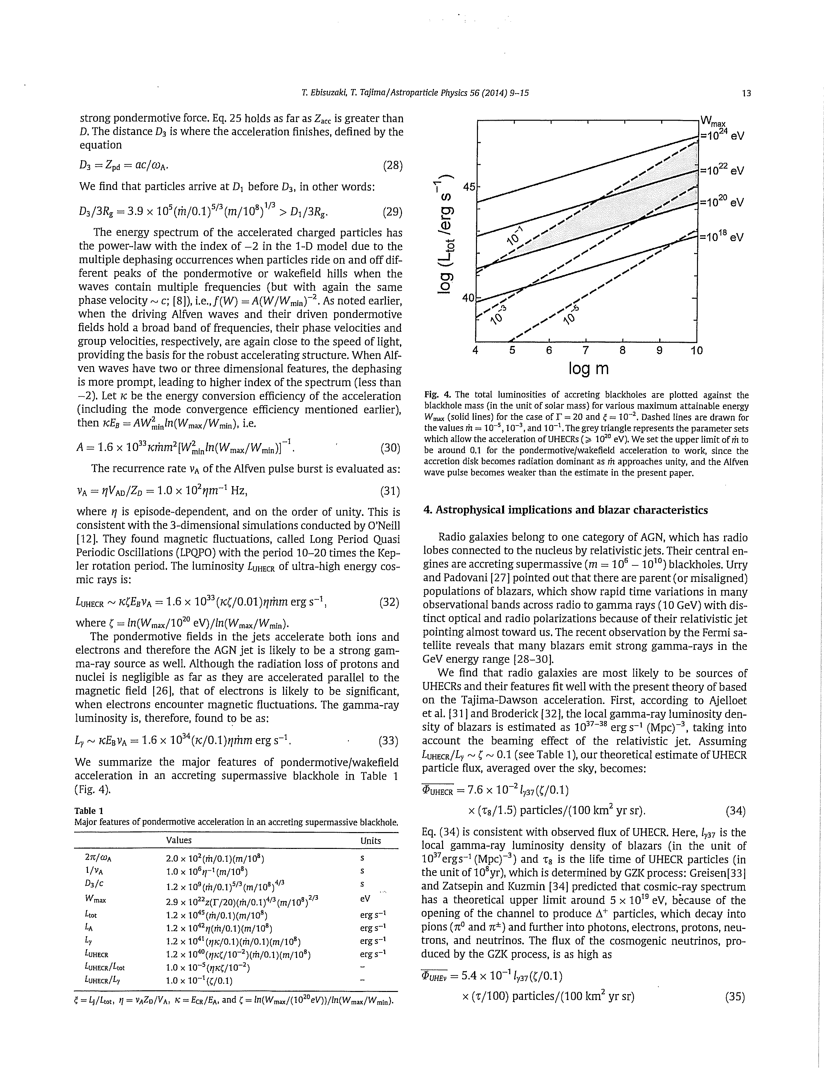
One idea
“Wakefield” applied to BH jets (Ebisuzaki’s talk)

Slide 4
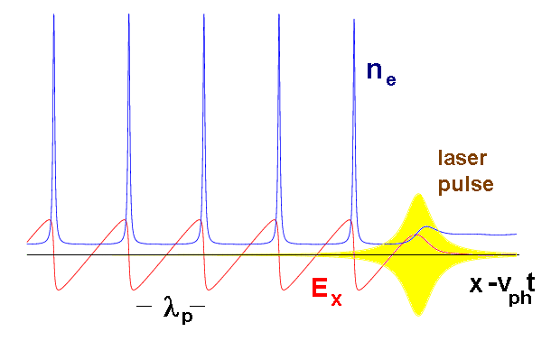
Laser Wakefield (LWFA):
Wake phase velocity >> water movement speed Tsunami phase velocity becomes ~0,
maintains coherent and smooth structure causes wavebreak and turbulence
vs
Strong beam (of laser / particles) drives plasma waves to saturation amplitude: E = mωv_{ph} /e
No wave breaks and wake peaks at v≈c
Wave breaks at v＜c
← relativity
regularizes
(relativistic coherence)
Relativistic coherence enhances beyond the Tajima-Dawson field E = mω_{p}c /e (~ GeV/cm)

Slide 5
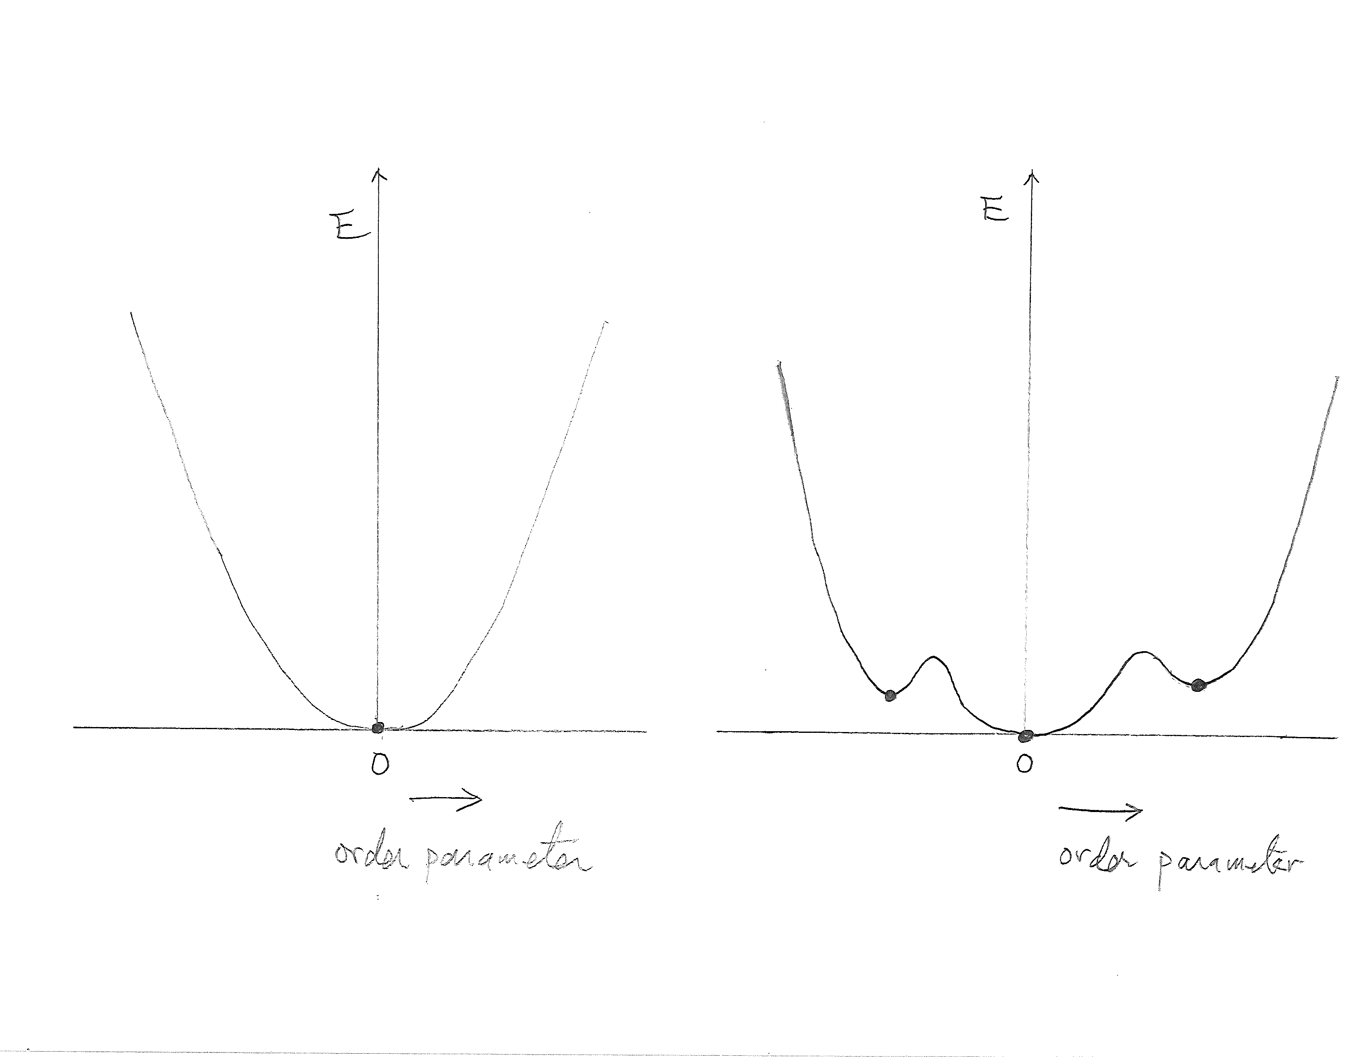
Wakefields and Higgs
Laundau-Ginzburg potential → BCS → Nambu → Higgs particles
Laundau damping: decay of excited waves to equilibrium (left picture)
Wakefield: no damping; distinct excited stable state ←no particles to resonate (@ c)
= plasma’s elevated Higgs state!
| 0 > vs. | H > ( cf . | H > → | 0 > )
thermo-equilibrium wakefield state tsunami onshore

Slide 6
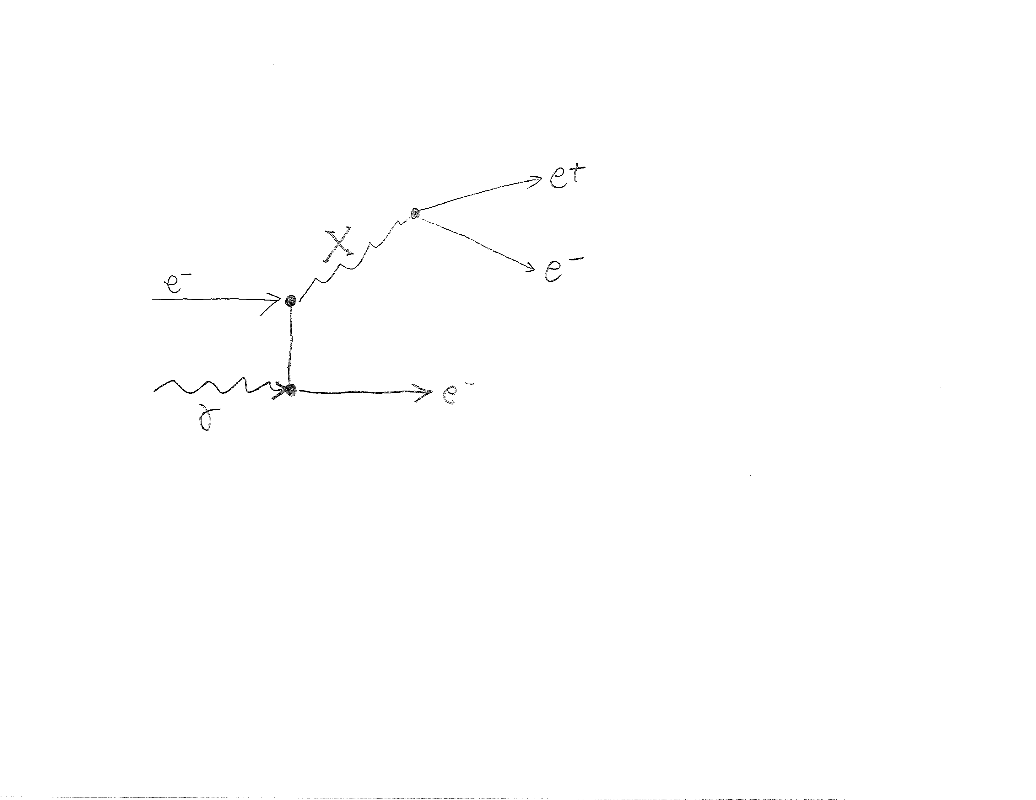
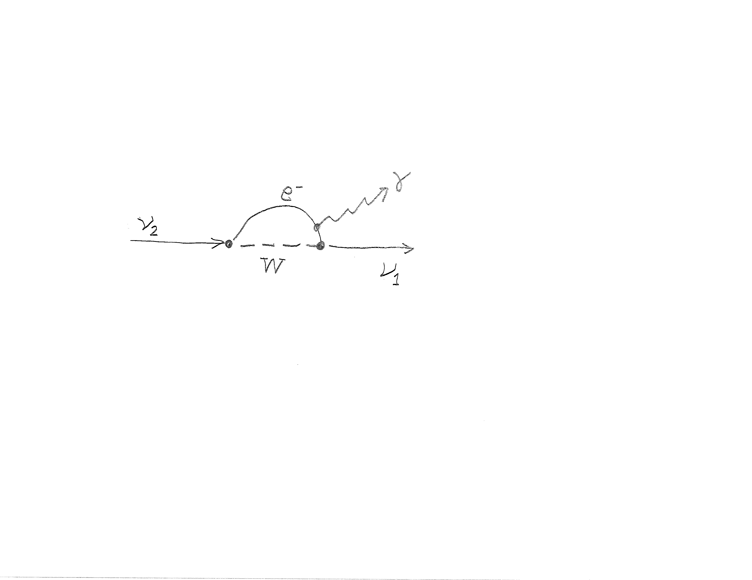
Other (preliminary) ideas?
.......
Can intense coherent (17MeV) γ induce the (possible) 5th force?
- Can dark matter (sterile neutrino) be γ-
induced (at 3.5keV)?
- ……

Slide 7
Welcome!
Let the party begin

