Slide 1
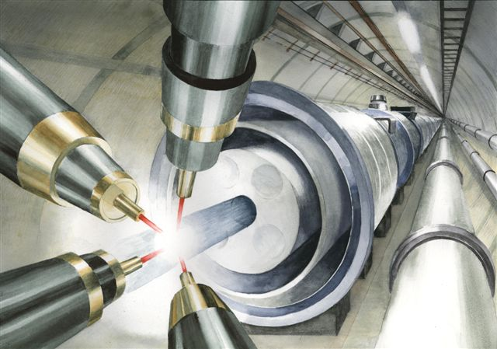
`
Possibility to Simultaneously Observe Gamma Bursts and Gravitational Wave Emission from Blazars
(preliminary idea)
Department of Physics and Astronomy
University of California at Irvine
Feb. 6, 2017
Toshiki Tajima and Toshikazu Ebisuzaki

Slide 2
abstract
wakefield driven by large clump accreting from the disk toward BH / jets --→ gamma emissions that reflect the accretion episode (Ebisuzaki; Mizuta; Abazajian)
accreting clump to induce gradvitational wave emission (GWE)
More intense case: jet formation by the collising two NS’s (Takahashi-Tajima, 2000) or BH’s → jet formation
4. Estimated GWE luminosity (Ebisuzaki)イク

Slide 3
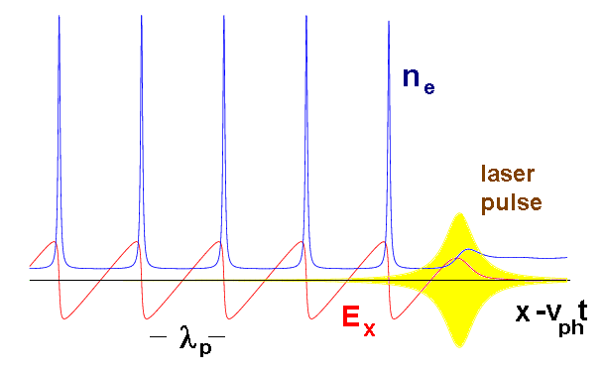
Laser Wakefield (LWFA):
Wake phase velocity >> water movement speed Tsunami phase velocity becomes ~0,
maintains coherent and smooth structure causes wavebreak and turbulence
vs
Strong beam (of laser / particles) drives plasma waves to saturation amplitude: E = mωv_{ph} /e
No wave breaks and wake peaks at v≈c
Wave breaks at v＜c
← relativity
regularizes
(relativistic coherence)
Relativistic coherence enhances beyond the Tajima-Dawson field E = mω_{p}c /e (~ GeV/cm)

Slide 4
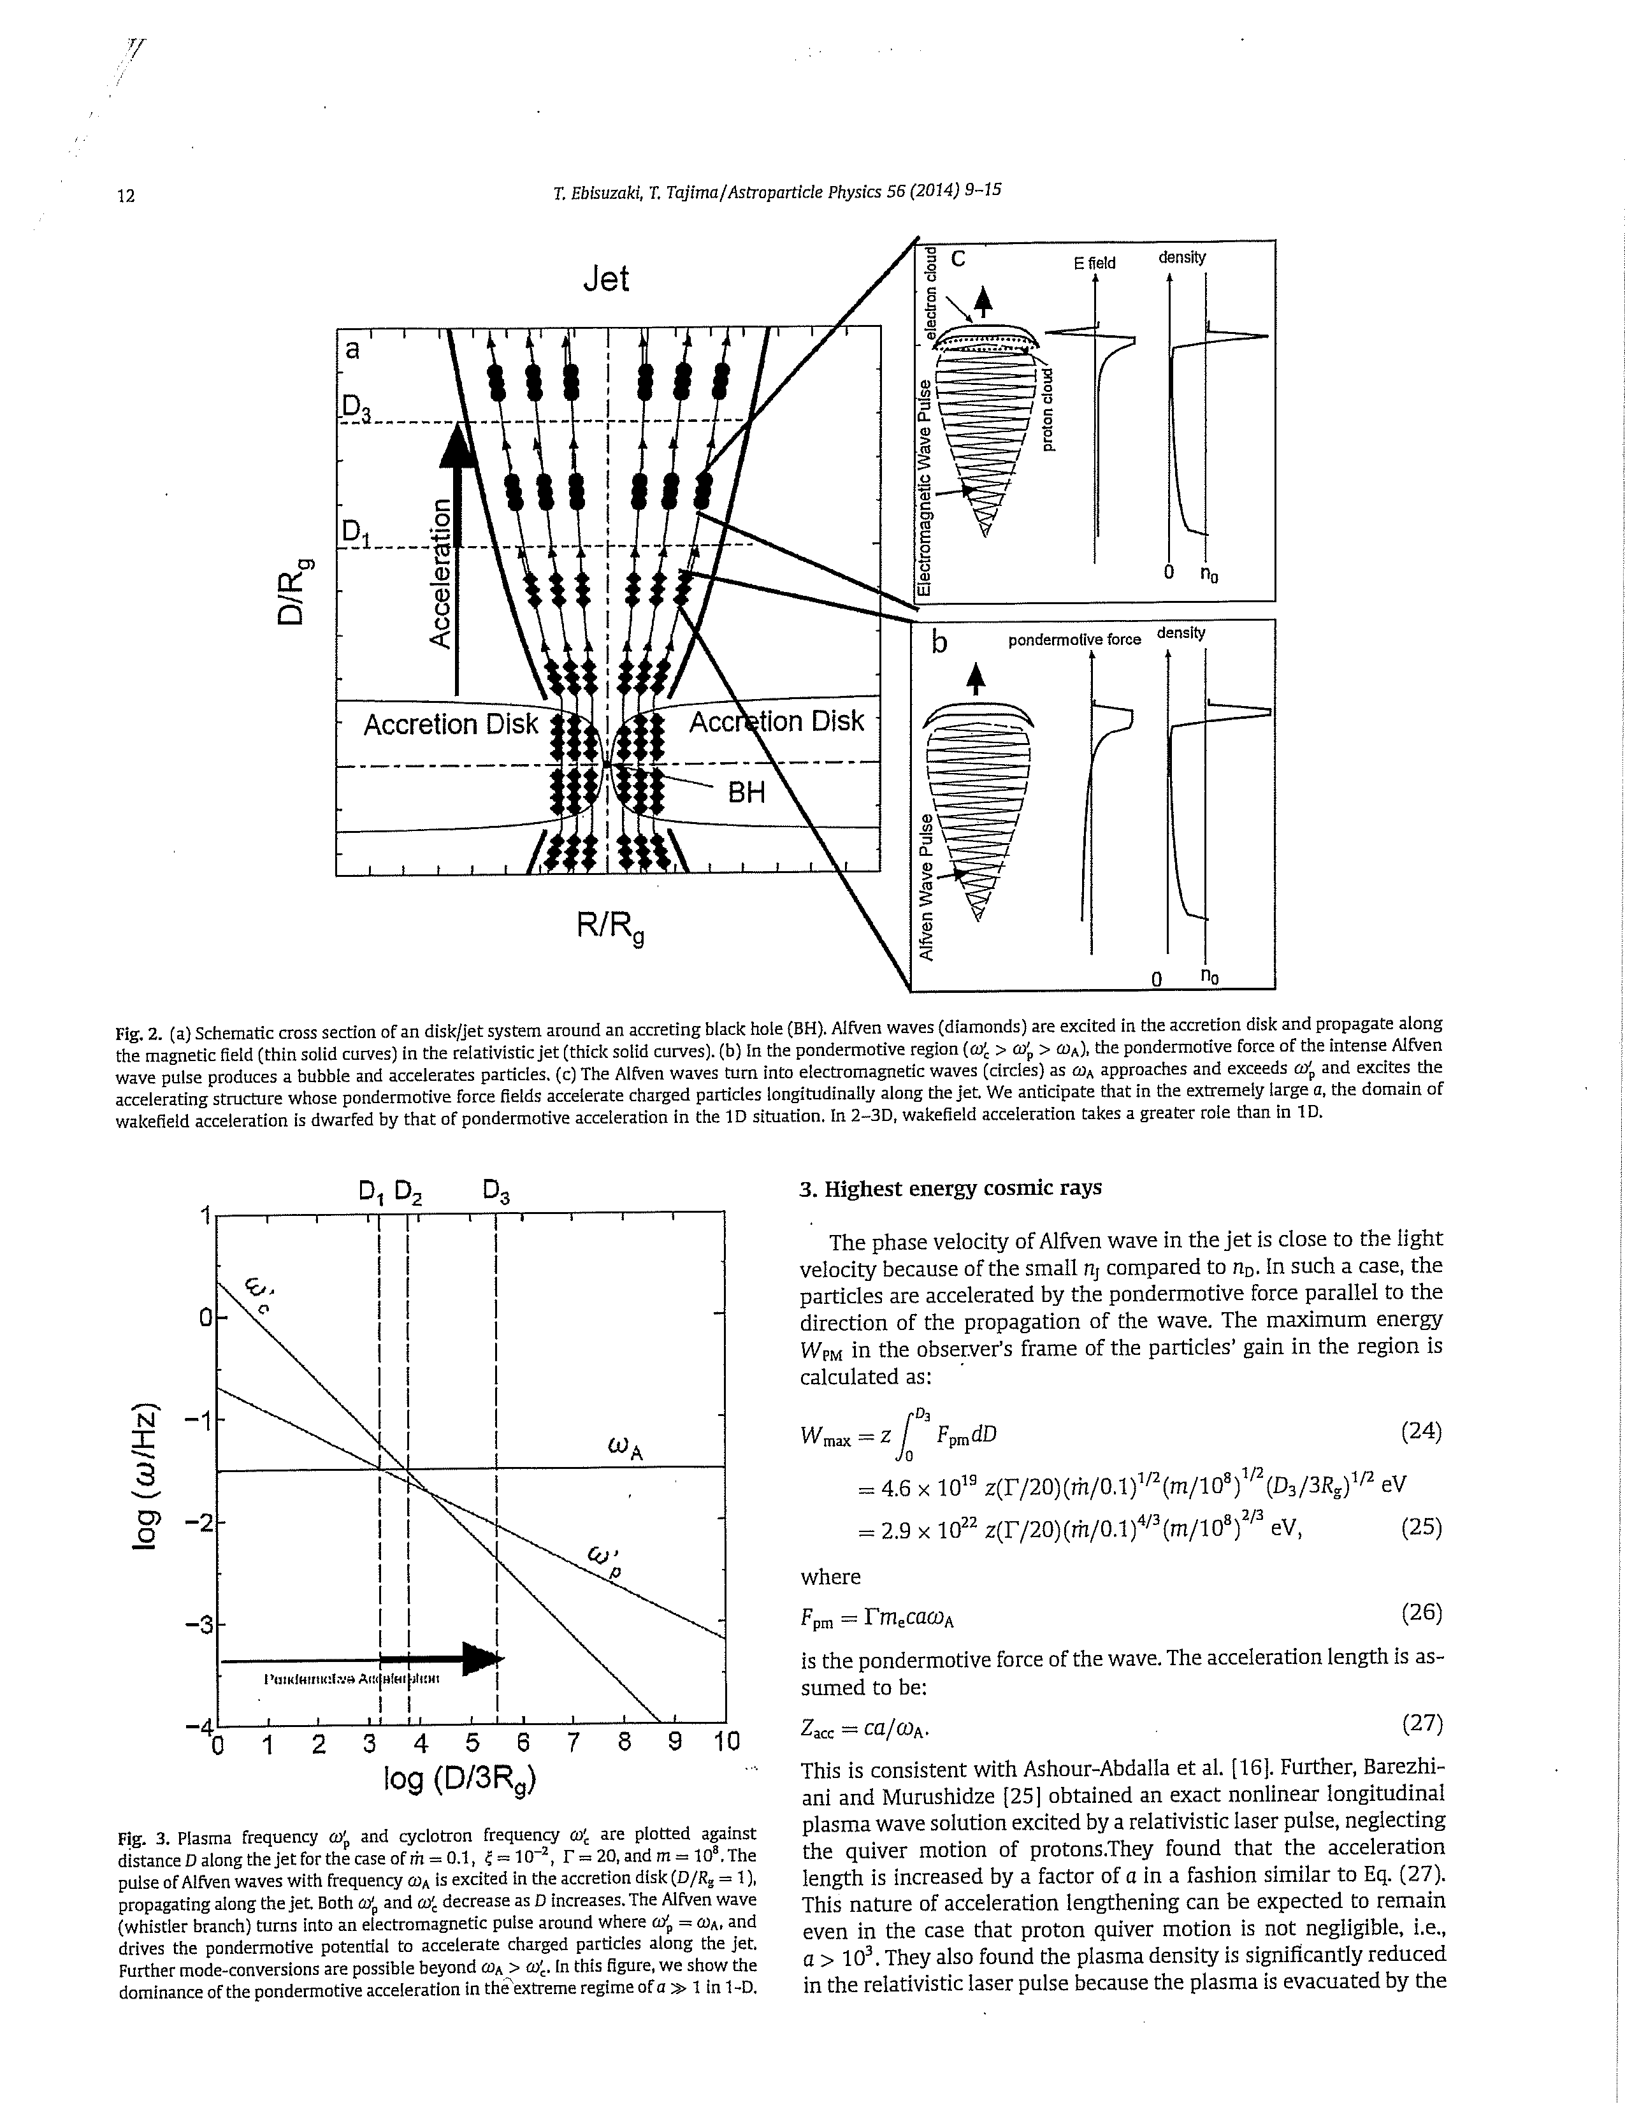
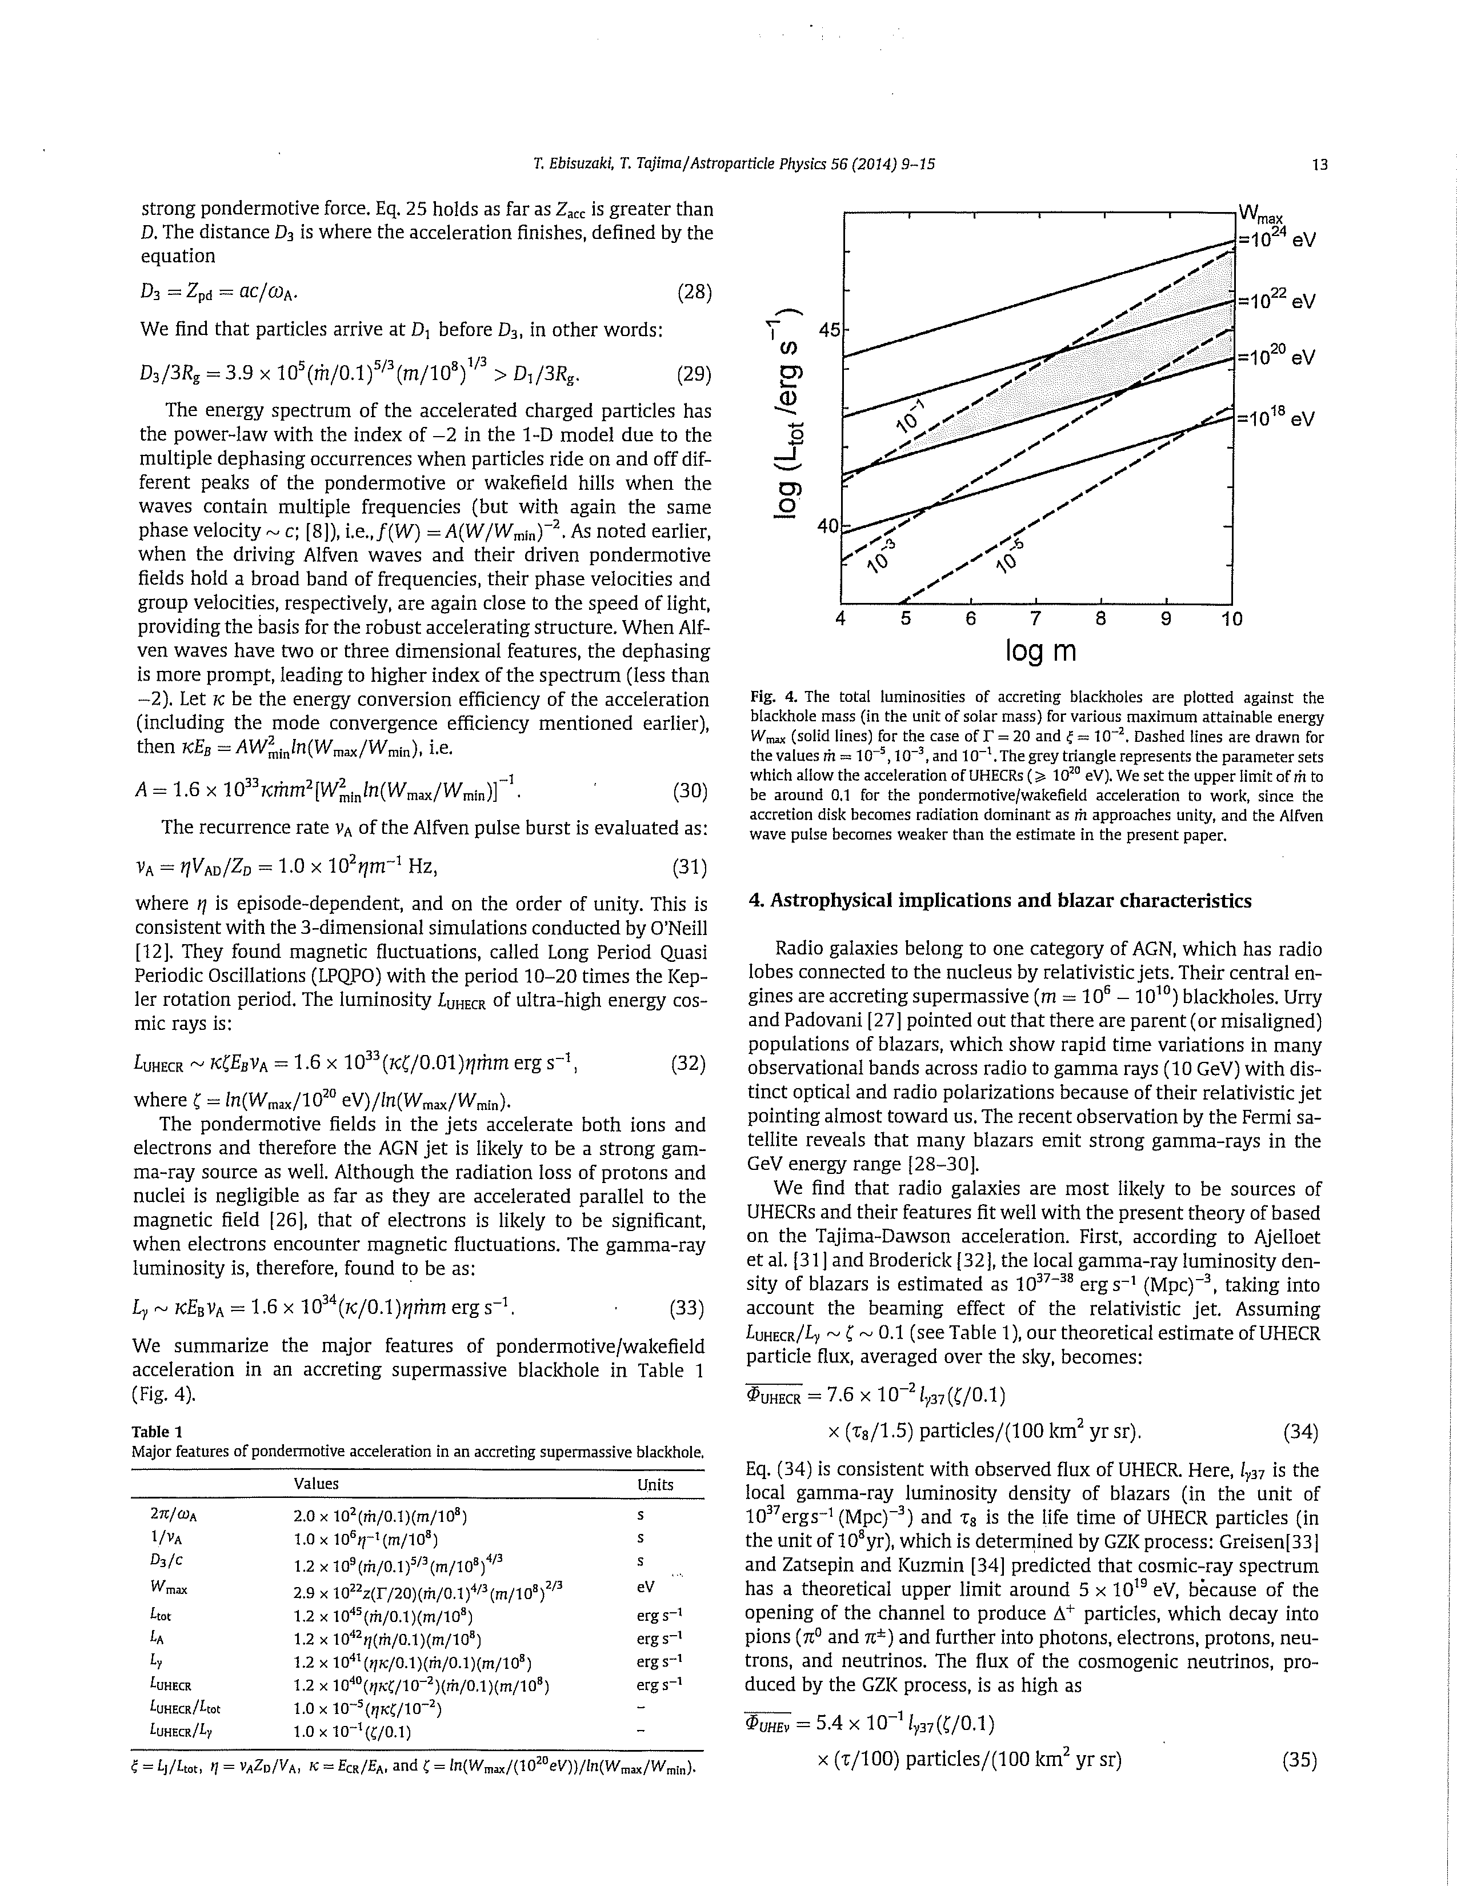
Wakefield excited on the jets from BH: genesis of EHECR
and gamma bursts
Gamma emission luminosity by wakefield
Lγ ~ 10³³ (κ / 0.1) η m’ m (erg /s)
κ (efficiency), η (episode dependent ~1)
(Ebisuzaki, Tajima, Astropart. Phy., 2014)

Slide 5
Enhanced energy emission of jets and shocks
by merging two NS’s (or BH’s)
(Takahashi, Hillman, Tajima, 2000)
in High Field Science, Eds., T. Tajima, K., Mima, and H. Baldis (Kluwer, NY, 2000).p177.
Also, Chen, Tajima, and Takahashi, PRL (2002).

Slide 6
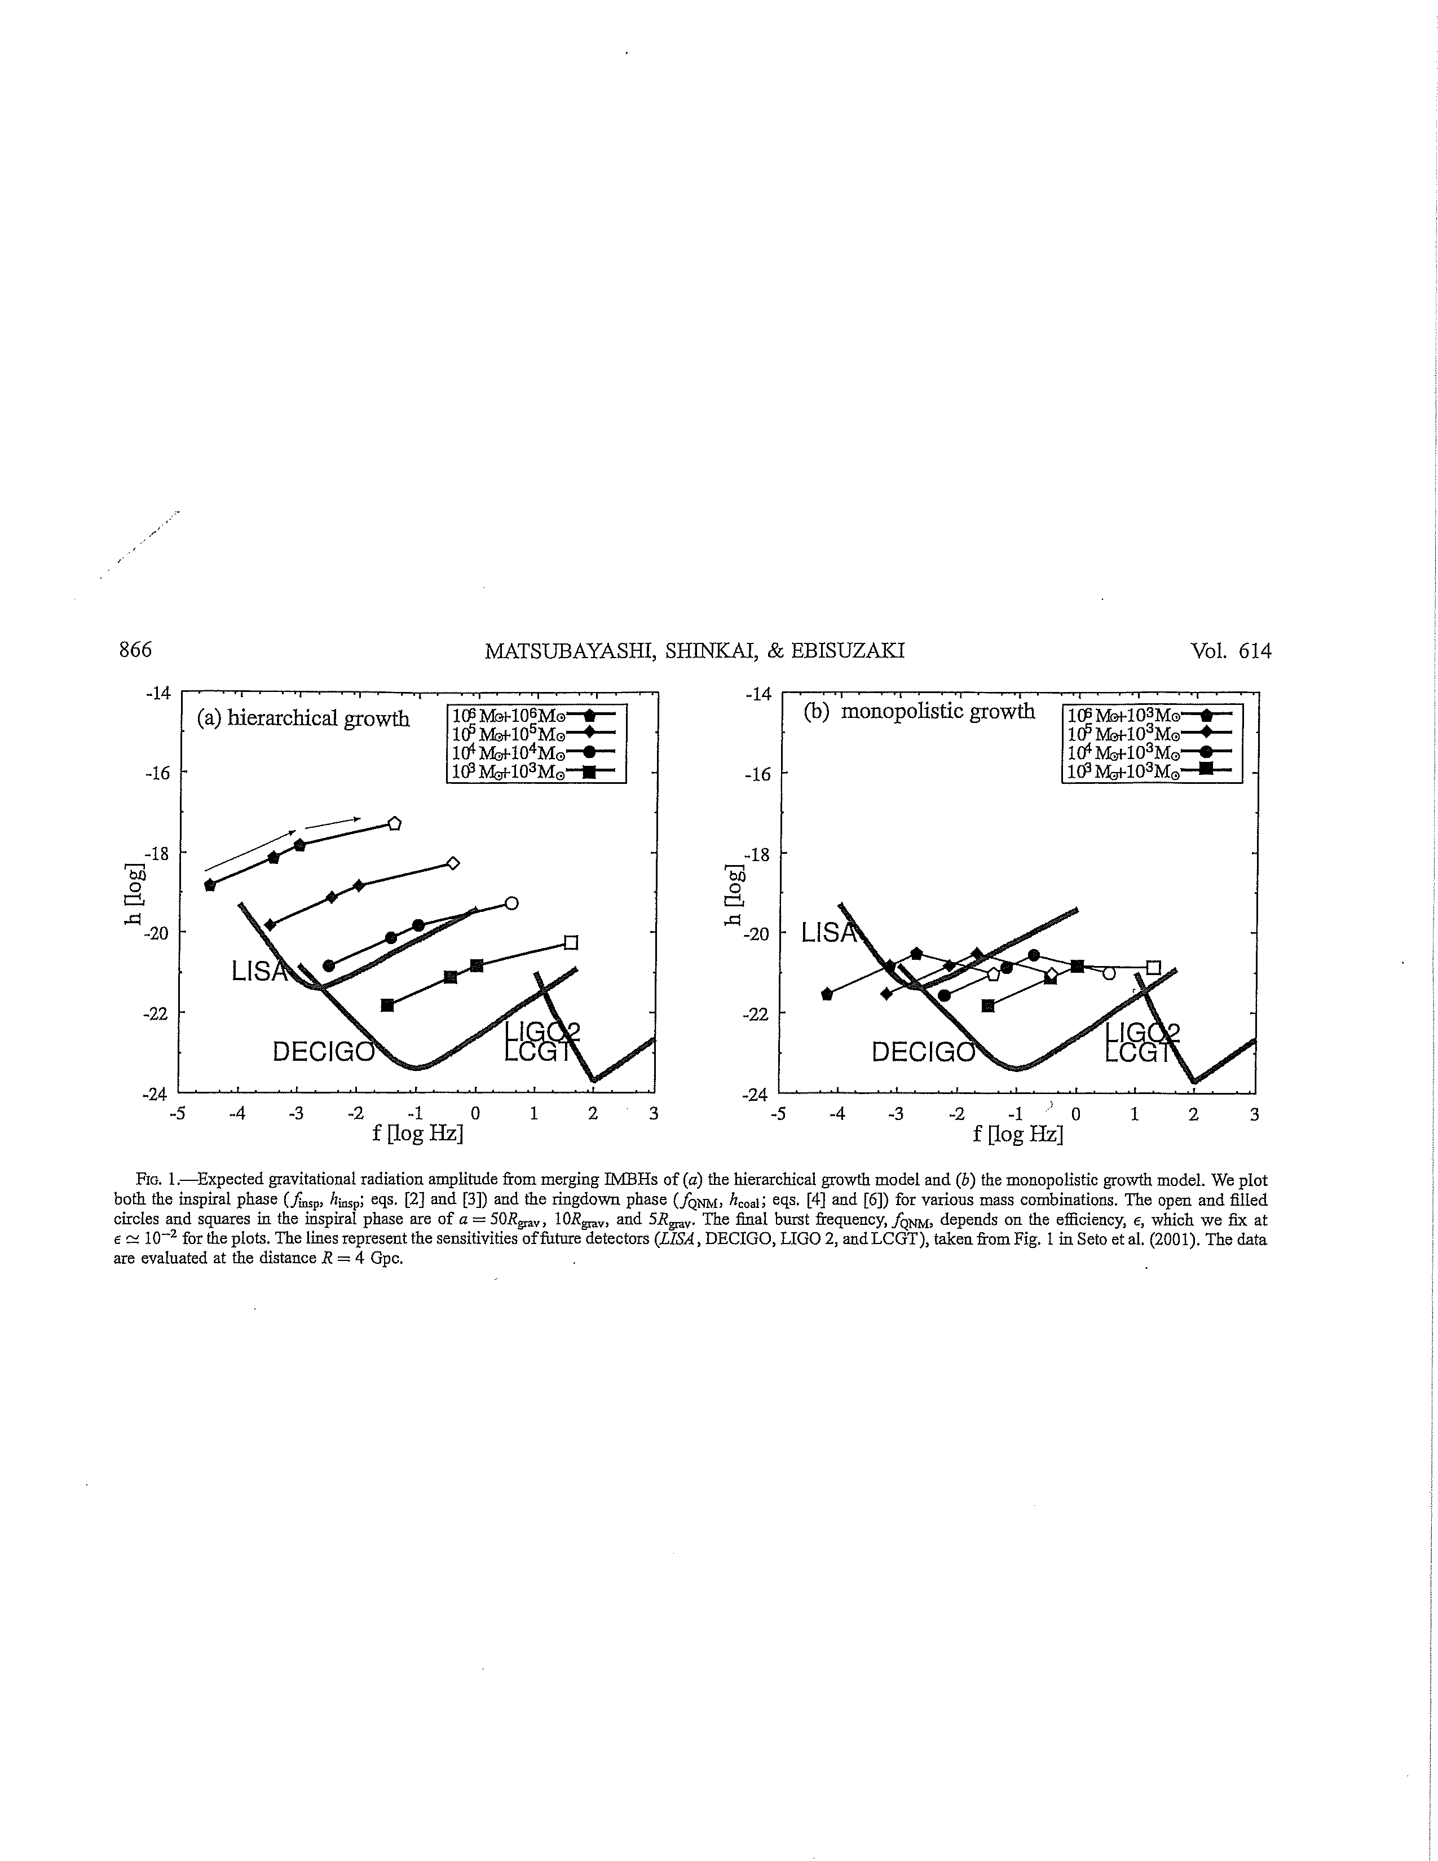
Merging BHs and their emission of
gravitational waves
Matsubayashi, Shinkai, Ebisuzaki (ApJ,2004)
Dimensionless amplitude of the
gravitational wave
h ~ 5 x 10⁻²¹ ε^{1/2} R ⁻¹ μ
ε (efficiency normalized to 0.01),
R (distance in 4 Gpc))
μ (reduced mass of two stars
in 10³ solar mass)

Slide 7
Thank you!

